Slide 1
I’m glad that’s settled
Conflict and Resolution

Slide 2
Dealing with conflicts
What sort of conflicts have you had in your life?
How have you dealt with those conflicts?
What’s your conflict resolution style?
Owl
Turtle
Shark
Teddy Bear
Fox

Slide 3
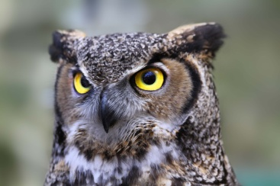
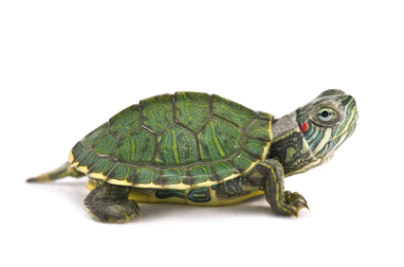
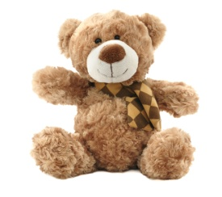
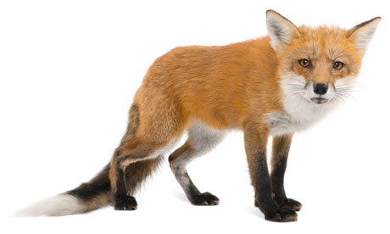
OWL – The Collaborator
Turtle – The Avoider
Shark – The Competitor
Teddy Bear – The Accommodator
Teddy Fox – The Compromiser

Slide 4
Conflict Type Quiz

Slide 5
Conflict Scenarios

Slide 6
Teamwork Challenge
Paper clip tower
Egg drop

Slide 7
The Situation could get dicey
Conflict and Resolution

Slide 8
World Conflict

Slide 9
How do you feel?
What are your thoughts on the conflict with North Korea?
Are you scared of a future war?
Do you think that North and South Korea with reunite? Why or why not?

Slide 10
Other Conflicts
What other conflicts does South Korea face?
What world conflicts do you know of that are going on right now?

Slide 11
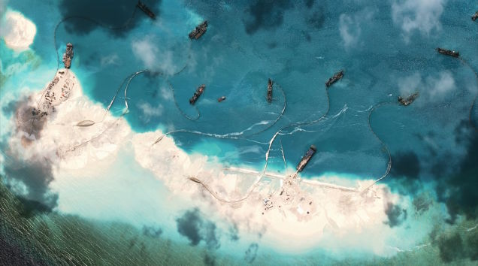
Land Disputes?
Dokdo
Mischief Reef China

Slide 12
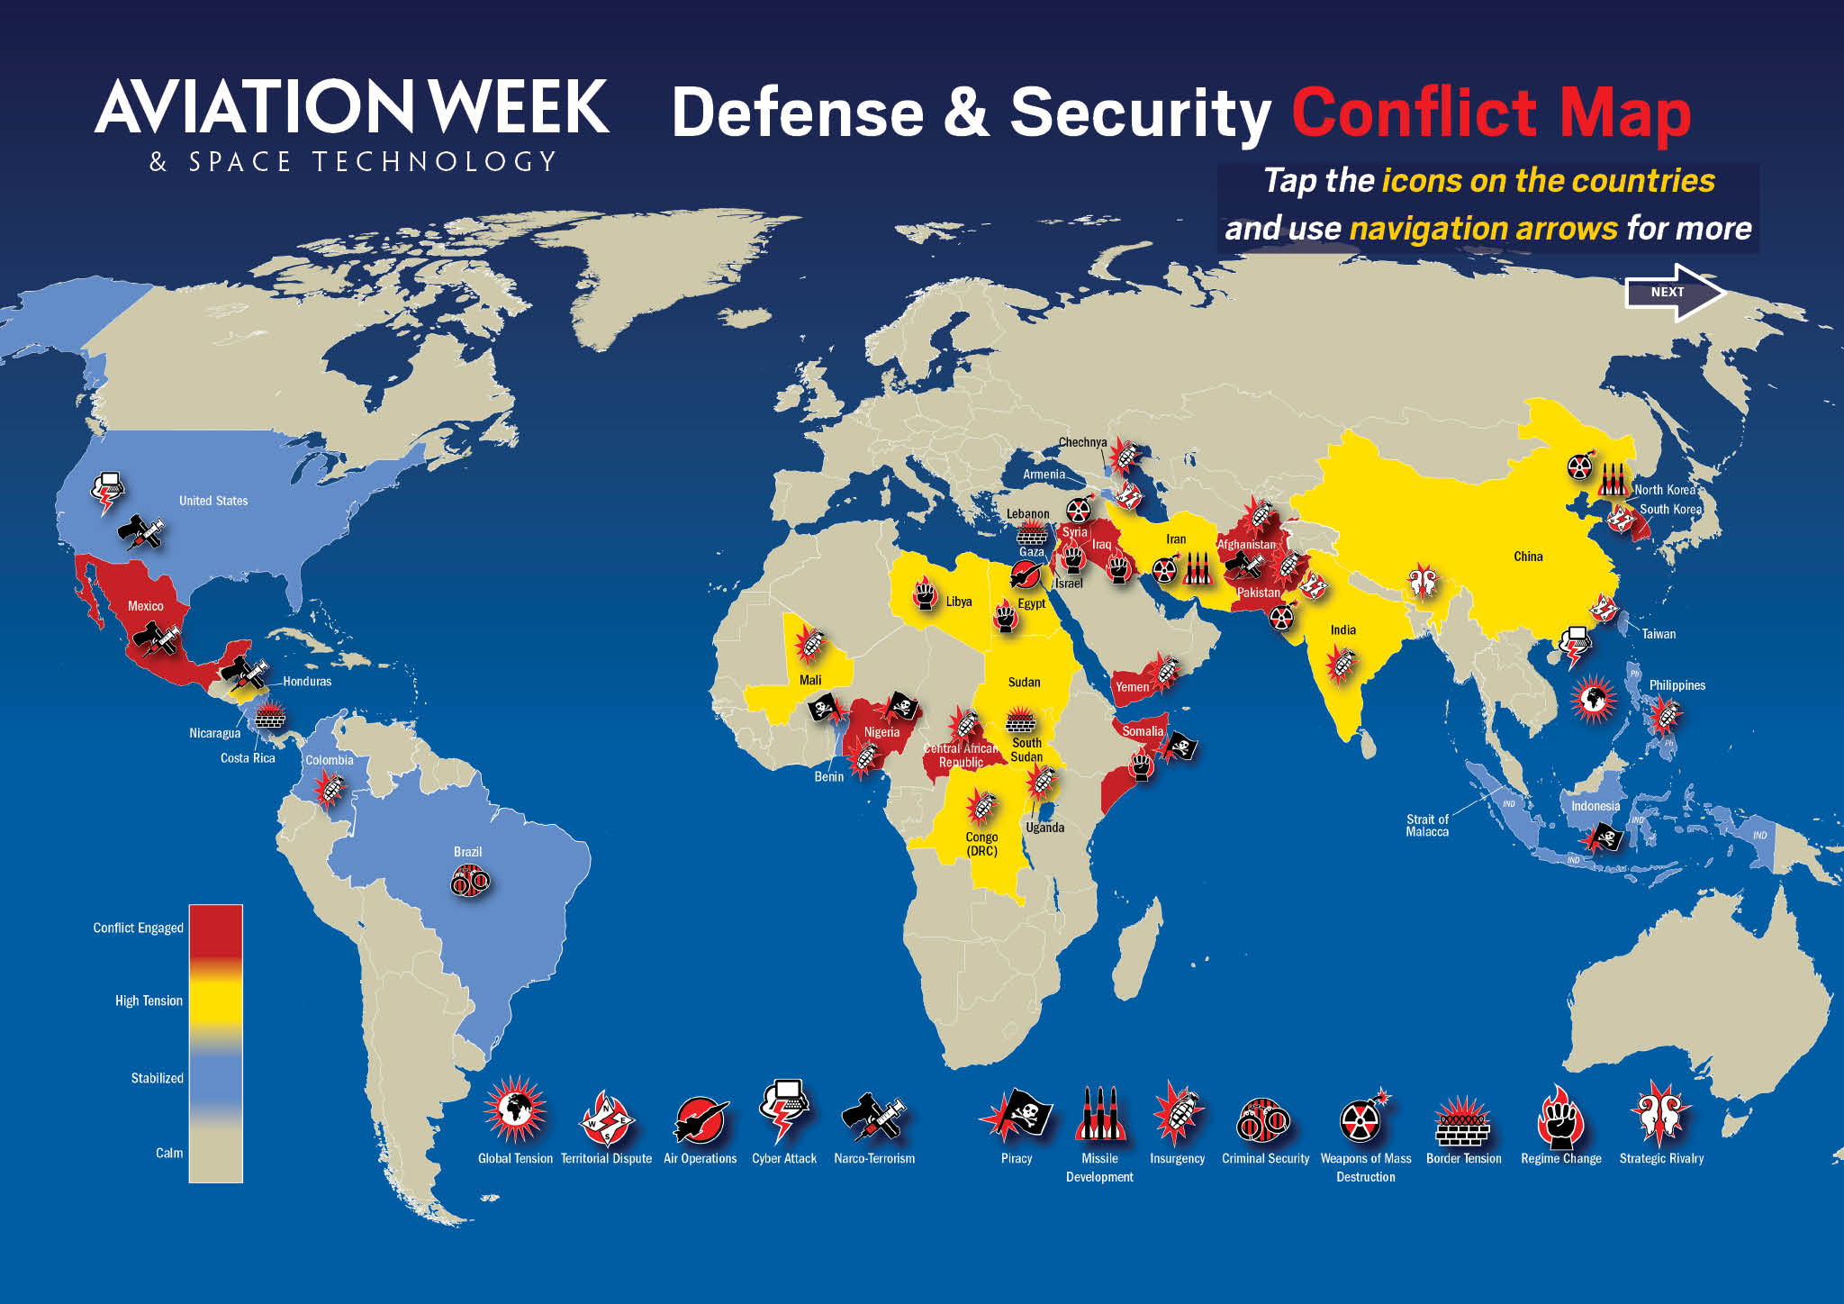
Conflict Map 2015

Slide 16
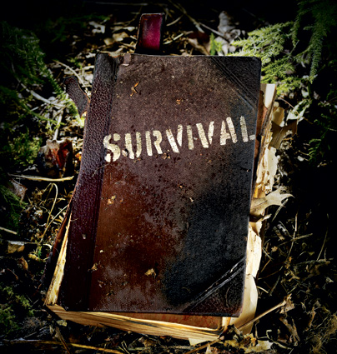
Survival Activity

Slide 17
Dealing with Conflict
What causes war?
Do you believe that war is a good way to deal with things?
How else can conflicts be resolved?
Do you think that we can end war on earth? Why or why not?
What would it take to end wars on earth?

