Slide 1
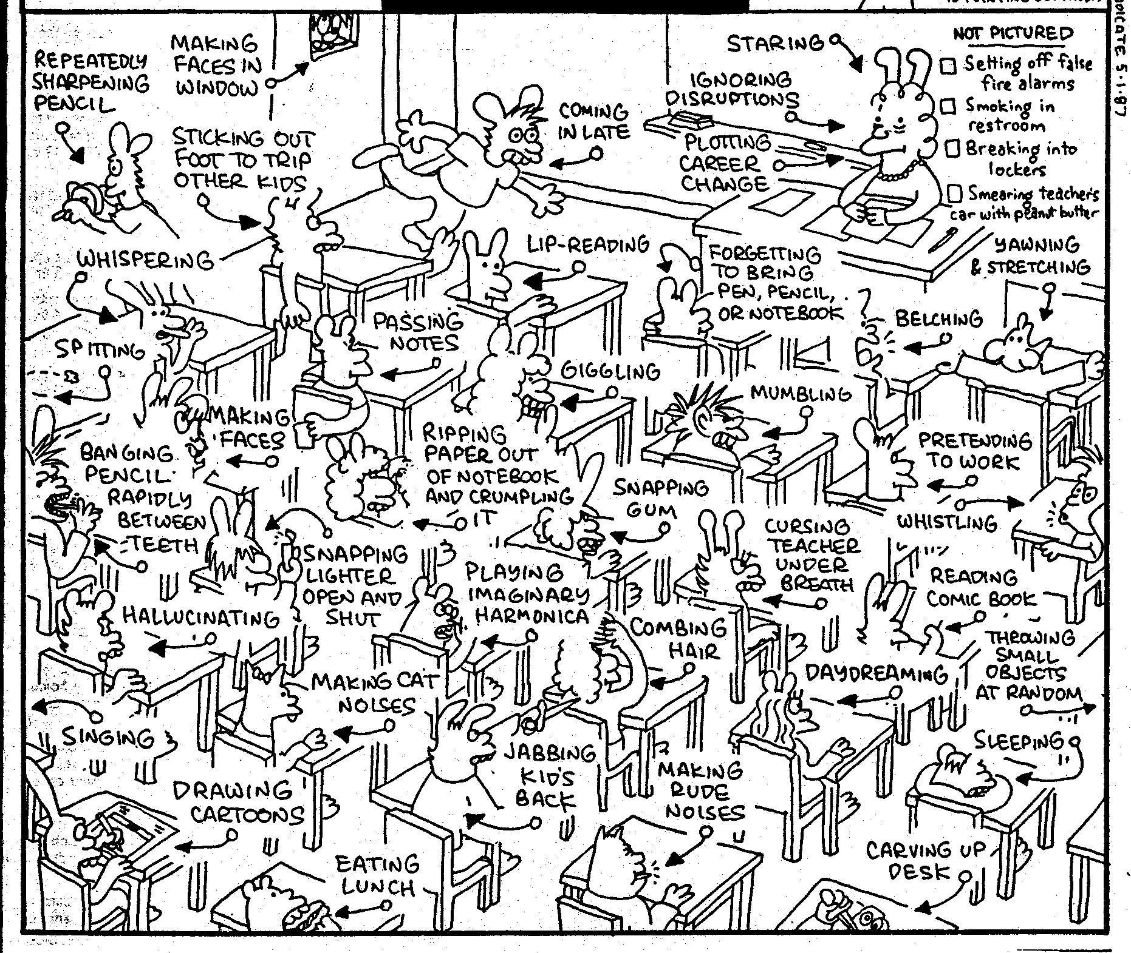
Positive Classroom Management Techniques

Slide 2
What would you do in the following situations?
Students are very noisy while doing an activity and you need to get their attention quickly.
A student is disrupting the class by ripping their textbook and throwing the pieces at their friend.
3 students are refusing to do their worksheet and continue talking with one another.

Slide 3
Techniques to Avoid
Yelling at students
Humiliating students
Corporal punishment
Losing your temper
Threatening
Scaring students

Slide 4
Helpful tools to utilize
Reward systems
Attention grabber routine
Making promises/deals
Mutual respect approach
Limited choice
Natural consequence

Slide 5
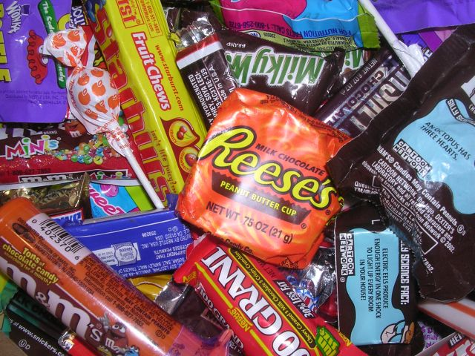
Reward Systems

Slide 6
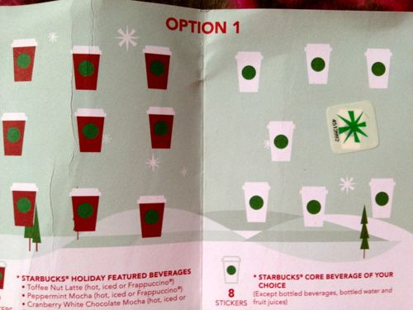
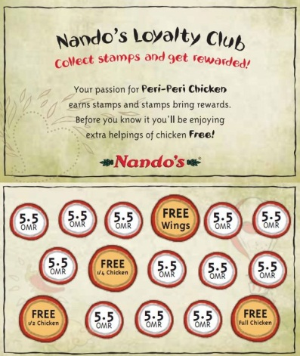
Reward Systems
The more often the reward, the worse.
Rewards support mechanical tasks, they are harmful to creative tasks.
Rewards can also damage tasks for enjoyment.
It is important to create a long term goal system.

Slide 7
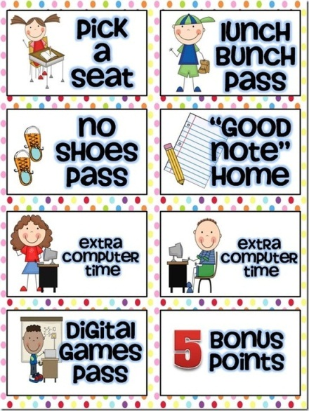
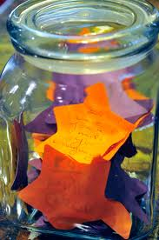
Types of Rewards
Candy
Extra points
Time
Coupons
Bomb Jar

Slide 8
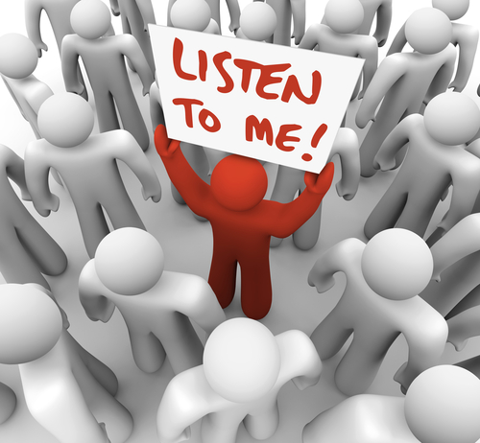
Attention Grabbing

Slide 9
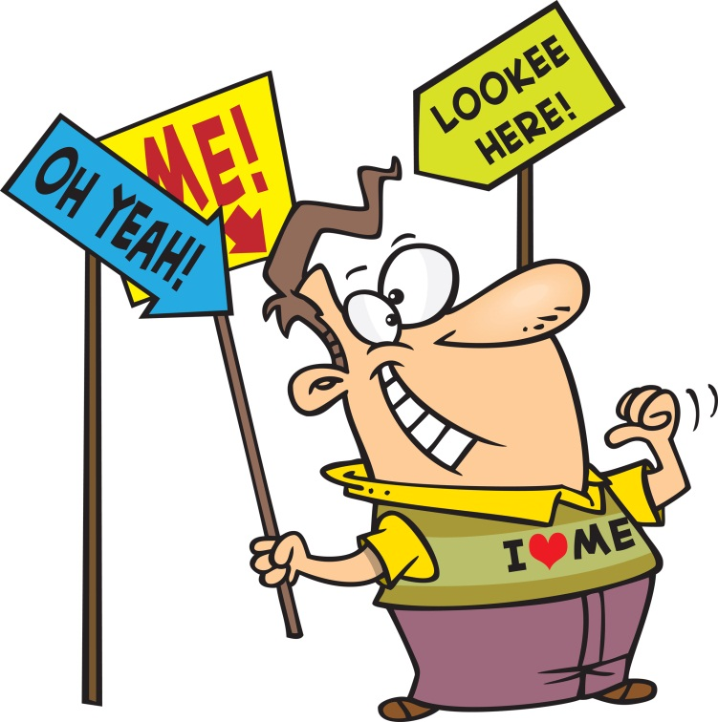
Attention Grabbing Routine
Technique tips:
Repetition is necessary
Continue and increase until all students are paying attention
No thinking should be required

Slide 10
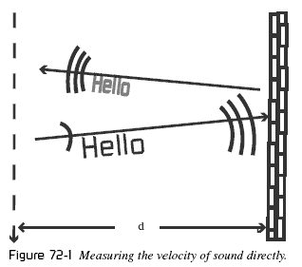
Attention Grabbing
Action
Type 1: I SAY - YOU DO!
Type 2: I DO - YOU SAY!
Type 3: I DO - YOU DO
Verbal
I SAY - YOU SAY, I SAY SAY - YOU SAY SAY
>>repetition and intonation important<<

Slide 11
Attention Grabbing
Signal (gesture, lights, silence, sound)
I DO A SIGN - YOU DO THE SIGN
I DO A SIGN - YOU BE QUIET
Teacher puts hand in air→ Students see and also put their hands up → teachers waits until all students have their hands up
Teacher turns the lights off and waits for silence
Teacher is silent signaling for the students to be silent
Sound to signal for attention

Slide 12
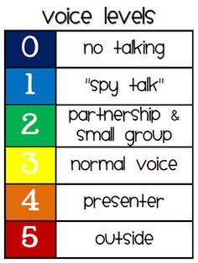
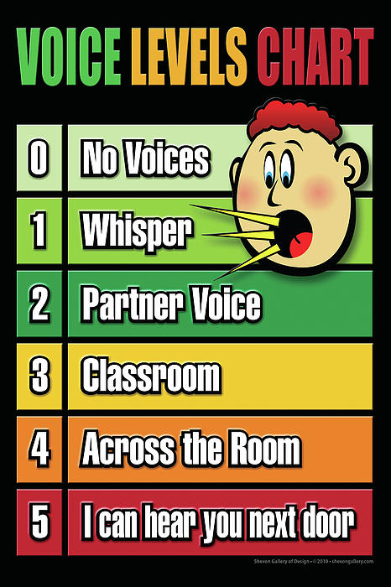
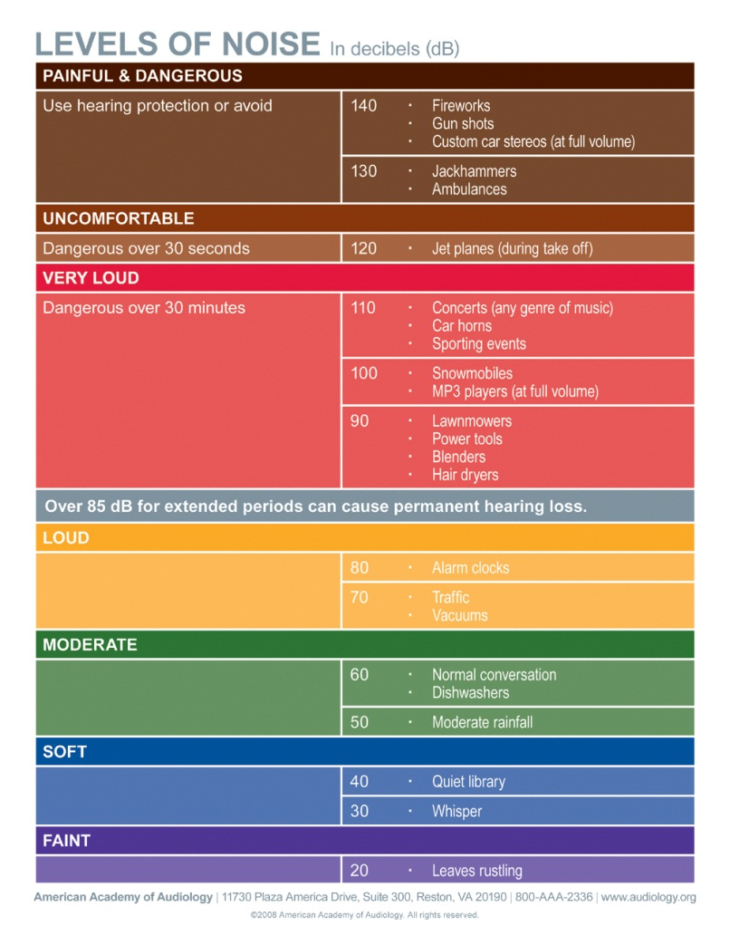
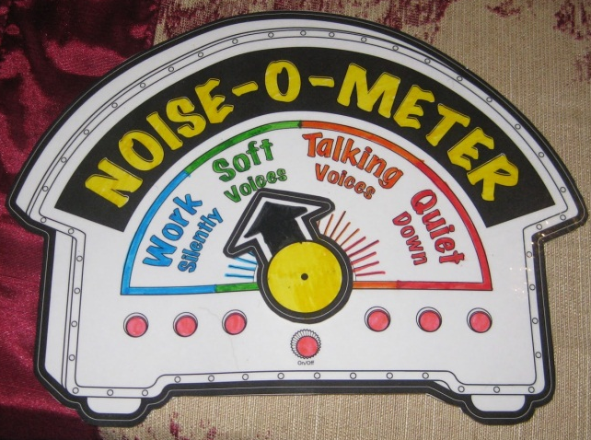
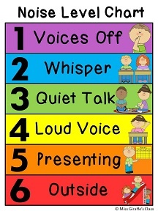

Slide 13
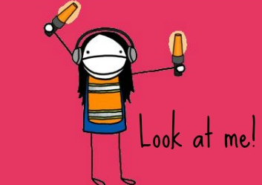
Make your own attention grabber!

Slide 14
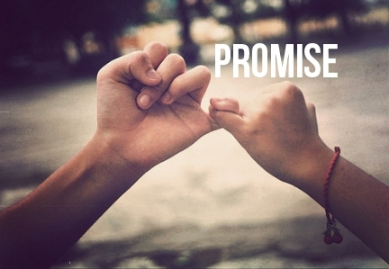
Making Promises/ Deals

Slide 15
Making Promises/ Deals
If you do A I’ll do B.. Deal or no deal?
If you work hard for another 5 minutes we can take a break.. Deal or no deal?
If you finish the worksheet, we can play a game… Deal?
If you work well with your group I will give you an extra sticker today… deal?
If I do A, do you promise to do B?
If we play a game now, do you promise to work hard for the rest of class?
If I let you work together, do you promise to work quietly?
If I let you take a break now, do you promise to work hard for the rest of class?

Slide 16
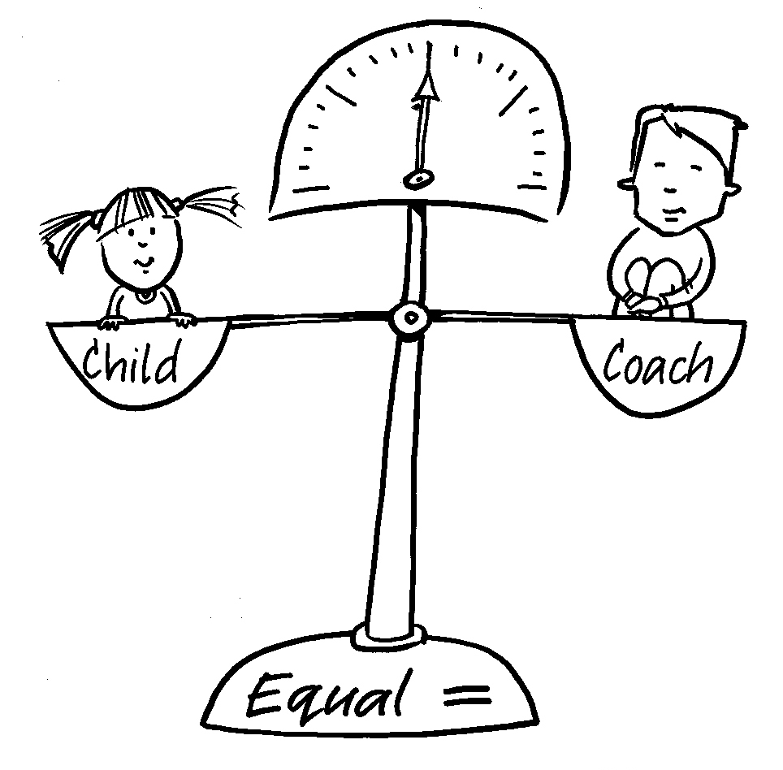
Mutual Respect
Student
Teacher

Slide 17
Mutual Respect
Making students feel responsible for how their actions affect the teacher and/or other people.
Ex. When you talk while I’m talking, it makes me feel sad…
When you don’t try your best, it make me feel disappointed… I know you are better than that…
Ex. When you do that it makes the other students feel upset…
Ex. If you don’t come, it’s ok, but I will be a little disappointed…

Slide 18
Limited Choice

Slide 19
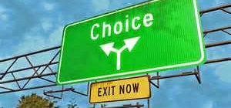
Limited Choices
You can do A or B… Which one do you want to do?
Both choices solve the issue at hand without threatening.
SITUATION: A student is playing with their phone during class.
Good Example: You can stop playing with your phone or you can give it to me… which one do you want to do?
Bad Example: You can stop playing with your phone or I will call your parents… which one do you want?

Slide 20
Examples of Limited Choice
민아, you can work quietly with your group or you can work alone next to me.. Which one do you want?
수현, you can stop yelling out the answers, or I will never ask you another question… which one do you want?
You can do your work quietly or get out.
You can work together quietly or you will have to sit separately today… which one do you want
You can finish the work now or you do it as homework… which one do you want?
You can do worksheet A or worksheet B… which one do you want?

Slide 21
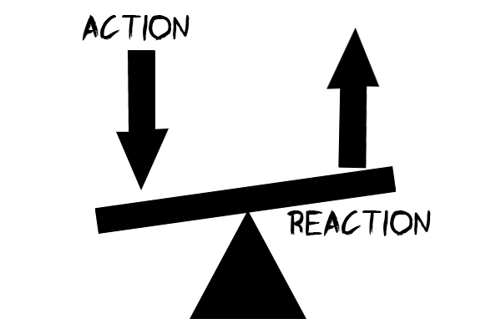
Logical Consequence

Slide 22
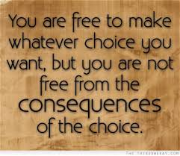
Logical Consequence: nicely threatening ^^
If you do A…. I’m sorry but I have to do B… I don’t want to do that but I have to.
KEY POINT: the consequence must relate to the problem and solve it!
If we don’t finish this in class, I’m sorry but you will have to do it as homework.. I don’t want to give you homework but I’ll have to if you don’t finish…

Slide 23
Try it out!
A student continues to use Kakao talk even after you warned them once.
A student continues to talk to his friend rather than pay attention to your lesson.

Slide 24
Useful Phrases
If you do A I’ll do B.. Deal or no deal?
If I do A, do you promise to do B?
When you do that it makes me (other students) feel upset…
You can do A or B… Which one do you want to do?
If you do A…. I’m sorry but I have to do B… I don’t want to do that but I have to.
Make a Deal
Respect
Limited Choice
Logical Consequence

Slide 25
What management technique would you use in the following situations?
A student often does not bring in homework on time.
A student is constantly disrupting the class by asking the teacher personal questions.
A student is sleeping in class.
A student is refusing to work with another student.
Students are very tired and really want to take a break. They can not concentrate on your teaching because they are so tired.

