Slide 1
Examining Teacher Talk in Korean English Classrooms: Advocating the Judicious use of L1

Slide 2
Key Points when using L1
If used judiciously, it can aid language acquisition.
If used haphazardly, it can inhibit language acquisition.

Slide 3
When Using Korean…
Use Korean as a tool not as a habit.
Literal translation can be dangerous!

Slide 4
Some Rationale for Using L1
Korean English teachers are obligated to teach lesson content that is far above the students’ level of English comprehension.
Teachers have difficulty managing classes in English only.
Teachers are under time constraints to cover test content material.

Slide 5
Examining Common Classroom L1 Use
How do you use L1 in your classroom?

Slide 6
Common Ways Korean is Currently Used
Following English immediately with Korean translation. (reading sentence by sentence)
Directly translating after instructions and/or explanations. (co-teaching, self)
Habitually explaining in Korean when the content can be simplified to students’ level of comprehension in English. (English teacher talk)

Slide 7
Using L1 Effectively
Student Centered Rationale
Teacher Centered Rationale

Slide 8
Student Centered Rationale
Facilitating and aiding the comprehension of L2 that is extremely difficult or abstract (Cook, 2001)
Increasing deeper understanding through L1 explanation (Harbord, 1992).
Giving feedback (explanation of errors) (Piasecka, 1988)
Aiding vocabulary acquisition (Atkinson, 1987)
*BUT BE CAREFUL OF LITERAL TRANSLATION!!*

Slide 9
Teacher Centered Rationale
Class control and discipline (Cook, 2001)
Time efficiency (Harbord, 1992)
Checking students understanding of difficult or abstract concepts (Atkinson, 1987)
Reduce students’ affective filter (Auerbach, 1993)
Drawing attention to/emphasizing key points
Addressing issues unrelated to language learning

Slide 10
The Dangers of Translation

Slide 11
The Double Iceberg Model (Whitehead & Hwang, 2012)
English
Korean
Language
Meaning
Meaning in context

Slide 12
Steps to Effective L1
DO NOT translate word to word simply from memory or from an English to Korean dictionary! (GTM style) This can lead to inaccurate translation!
Find the English meaning of the word or phrase in the context you are teaching. (English to English dictionary)
www.dictionary.com
DO NOT teach multiple definitions. The context will give you the correct meaning to teach.
This is your starting point to effective translation.

Slide 13
Common Translation Process…
English
Korean
[1]
Language
Meaning
Meaning in context

Slide 14
Thinking Process for Translation
English
Korean
Language
[2]
[3]
[3a]
Meaning in context
[1]
[2a]
[4. Same or Different?]

Slide 15
Word Meaning Relationships
Relationship | Definition
1:1 | The word or phrase meaning being translated from English has a perfect word or phrase match in Korean. English word + Meaning = Korean word + Meaning
Fake 1:1 | Type A Words appear to have 1:1 relationship; however, in context the meaning of the English word is not what it first appears. Therefore, the Korean translation/explanation must also reflect the meaning in context.
 | Type B On the surface, the words appear to have a perfect 1:1 relationship; however, slight differences exist in meaning. (Word meaning differs in different language and cultures.)
1:0 | English word and meaning has no direct match in Korean, and therefore, requires an explanation of meaning.

Slide 16
Let’s Try
I ate a big apple.

Slide 17
1:1 Translation
English
Korean
big apple
큰사과
Language
Meaning

Slide 18
Let’s Try
I want to go to the Big Apple.

Slide 19
Fake 1:1 Translation
English
Korean
Fake 1:1 (Type A) Translation
There is a representative in the Korean language, but meaning is different. The translation/explanation must reflect the meaning in the context.
Big Apple
큰사과
Language
Meaning

Slide 20
Let’s Try
I want shepherd’s pie for dinner.

Slide 21
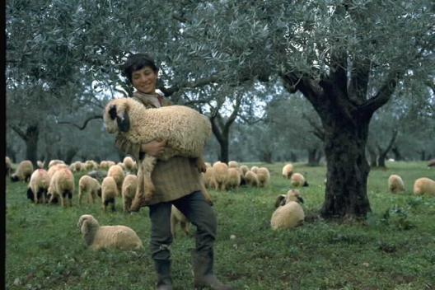
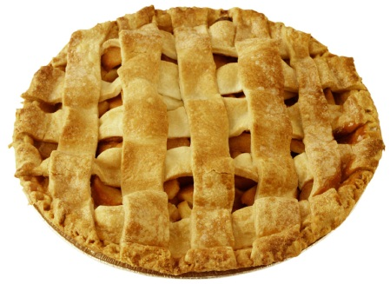
Fake 1:1 Translation
English
Korean
Fake 1:1 (Type A) Translation
There is a representative in the Korean language, but meaning is different. The translation/explanation must reflect the meaning in the context.
shepherd’s pie
양치기의 파이
Language
Meaning

Slide 22
Let’s Try
I love you.

Slide 23
Fake 1:1 Translation
English
Korean
Fake 1:1 (Type B) Translation
On a language level, it seems to be a perfect match, however, languages hold different usage and meaning. In such cases, you have to give explanation to provide a full picture of the word/expression used.
I love you
난 너를 사랑해
Language
Meaning

Slide 24
Let’s Try
Xiaoming ate a poutine for lunch.

Slide 25
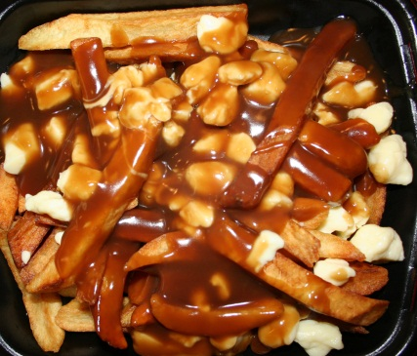
Fake 1:1 Translation
English
Korean
Fake 1:0 Translation
There is no direct match in Korean for the English word/phrase. In such case, you have to provide explanation to understand what it means and how it is used.
poutine
Language
Meaning

Slide 26
Thinking Time
The test was a piece of cake!
Shut Up! I can’t believe you won!!
The bag is heavy.
I saw a snail on the road. The car was driving so slow!
An old man sees a young boy (they have never met).. He says, “Come here son!”.
Hi pumpkin! How was your day?
I bought a kilt when I went to Scotland

Slide 27
Extra Practice
The coffee shop was crowded.
My friend launched his new clothing line last week.
She was paranoid about her parents finding out.
He injured his leg in the game.
She got cold feet before the wedding.
He was very masculine.

Slide 28
Steps to Effective L1
DO NOT translate word to word simply from memory or from an English to Korean dictionary! This can lead to inaccurate translation!
Find the English meaning of the word or phrase in the context you are teaching it.
DO NOT teach multiple definitions. The context will give you the correct meaning to teach.
Decide on what method would be the clearest and fastest to teach the contextual meaning to your learners.
If the teacher decides to teach the meaning using L1, analyze what type of word meaning relationship exists between the target language and learners L1.
1:1 = word to word translation
Fake 1:1 = target language meaning to L1 match and/or explanation of word meaning
1:0 = explanation

Slide 29
Implications of the Model

Slide 30
It is essential that students are provided with as much comprehensible L2 input as possible.
If the use of L1 is taking away from possible comprehensible input, then it can hinder language acquisition.
English should be the default classroom language and Korean, the support tool.

Slide 31
With translation, you want to eliminate or minimize loss of meaning between two languages.
Preservation of meaning is essential, not so much the language itself.
If word-to-word translation does not suffice, it will need further explanation/examples to support meaning.

Slide 32
http://www.koreaherald.com/view.php?ud=20140624001277
Summary
Therefore, we no longer call translators “traitors” in the literal sense of the word these days. Instead, we call them “cultural mediators” because they bridge two worlds, two cultures and two languages.
We need competent translators because languages are different and they render the world differently. As Anthony Burgess said, “Translation is not a matter of words only: it is a matter of making intelligible a whole culture.”

