Slide 1

Teacher Talk

Slide 2

The Facts
The revised 7th National Curriculum (2008) emphasizes TEE
“Korean teachers will be required to teach English by using only the foreign language by 2012.”
~Lee Myung Bak Administration, 2009

Slide 3

Discuss
English teachers should have…?
  Their proficiency level
  Their pronounciation
  Their experience abroad
  Amount of English usage in class

Slide 4


Common Misconceptions
You have to be a native-like
You have to create/provide an ‘immersion’ environment
              By talking a lot
              By having perfect pronounciation
ENGLISH

Slide 5
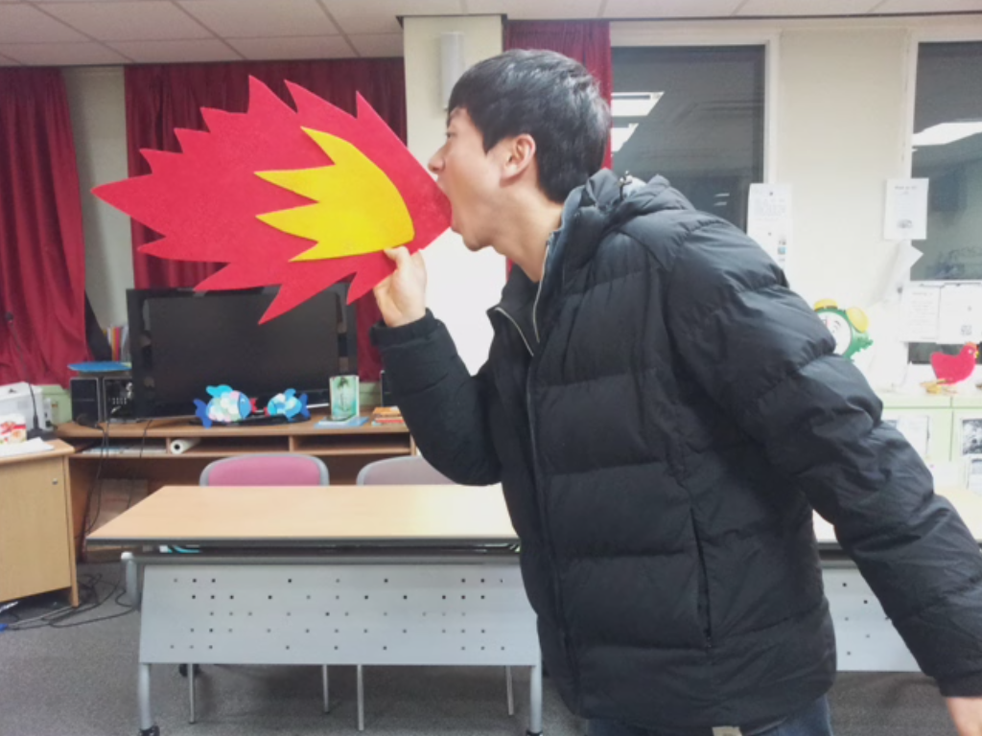



Slide 6




Slide 7
It’s not about your English abilities,
It‘s about how you use it!
ENGLISH
굿티처

Slide 8


5 Don’ts of Teacher Talk
Talk TOO much
Use difficult language
Chunk
Explain
Ask ‘Do you understand?’

Slide 9
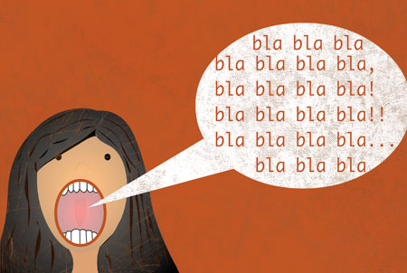

Slide 10

Students

Slide 11
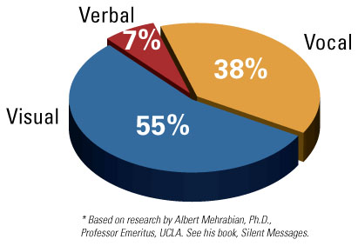
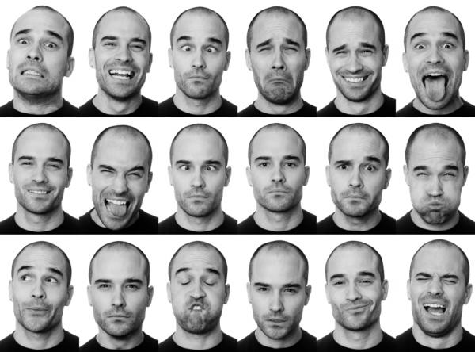



Non-Verbal Tools

Slide 12
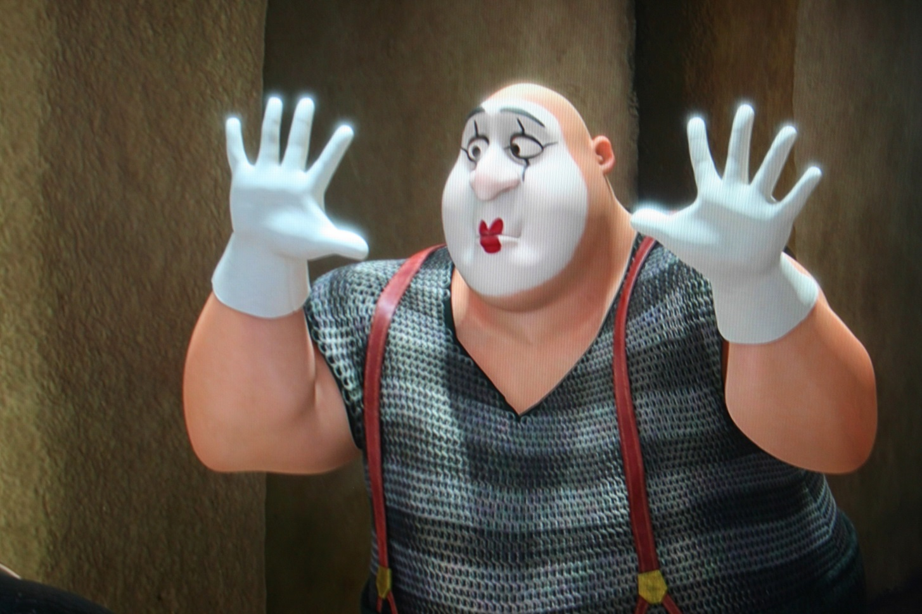
Non-Verbal Practice

Slide 13
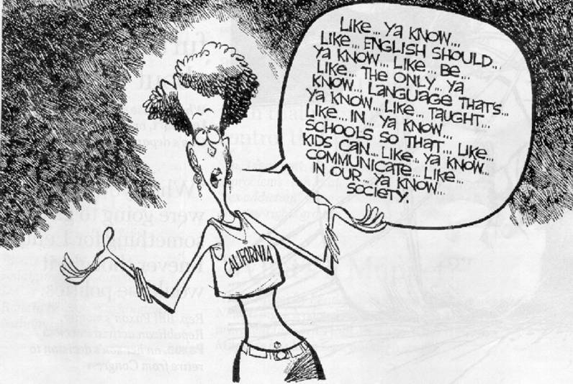
Verbal Tools
Keep your words
easy and simple!

Slide 14
Verbal Tools
Keep It Simple and Short
  How to: What is the key point?
  Is it simple?
  Short?
  How can you simplify further?
Good morning everybody. Please sit down (Ss are chatting with each other). Now this morning we’re going to look at examples like…let me write that on the board…Oh no, the board needs to be cleaned (Ss are still chatting not paying attention to the teacher) .Where is the eraser? Ah, there it is... great, just a moment now and I’ll clean the board. Then I’ll put the example on the board for you (cleans the board)….Now, what were we doing? Ah, right, I’ll put the example on the board for you.

Slide 15

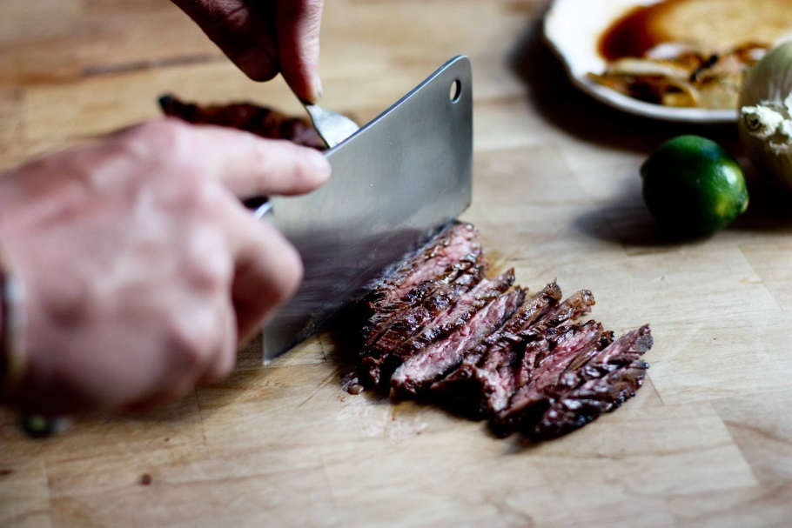
Verbal Tools
Clarity
  Volume/ Intonation
  Pronounciation
Manner of Delivery
  Rate
  Pausing and Chunking

Slide 16

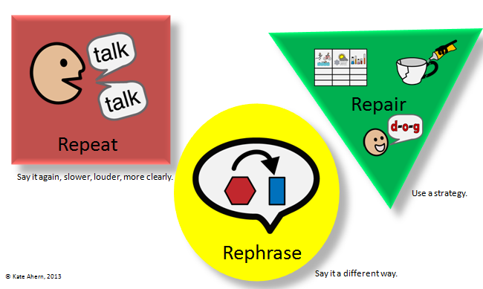
Verbal Tools
Repeat
Recycle
Rephrase

Slide 17
Discourse Analysis
Well, now we’re going to read the story. I’ll read it first and you listen, and after that I want you to read it again and there are some questions after the story, so after we have read the story I’m going to ask you some questions and you are going to answer them. Understand? (Some students look confused)…Good!

Slide 18
Discourse Analysis
Today, we will review what we learnt last lesson. Do you remember what we did? (T continues to talk with no wait time) I have 3 pictures I’m going to show you. Please look at the screen. Can you see this okay? I know it’s small and dark, but I don’t know how I can fix it. Just stand up or come closer if you can’t see. So here is picture one. What do you see? Right. There is a girl crying on the platform. Second one. Here is a boy, do you think younger or older than the girl? The two pictures are connected. The boy here is wearing a new pair of shoes, can you see where he got it from? New Balance.. ooohhh.. so expensive brand. I like New Balance too. I have a winter coat I bought last year, but I would like a new one. Who else likes New Balance? Yes. Now, before I show you the third picture, can you guess the relationship between the girl and the boy? In today’s class we are going to learn about ‘communication’.

Slide 19
Discourse Analysis
Let me tell you what to do. I am not going to put you into 2 groups. You 3 are group 1 and you 3 are group 2. So, first of all you must talk with your group about common benefits of the following activities. Learning a language, reading extensively and drinking black coffee. Then after you talk about it, write down your thoughts on the piece of paper that I am going to give you in a minute. Once you have finished please raise your hand so that I can come and check over what you have done.

Slide 20
Teacher Talk Recipe
Don’t talk…. SHOW.. DEMO DEMO DEMO!
Keep your teacher talk: i
Be clear and concise by chunking your talk
K.I.S.S.
Have students’ attention

Slide 21

4 Steps for Teacher’s Input
English
Korean (Ss)
Korean (T)
Visual Aids
Demo
Body language

