Slide 1
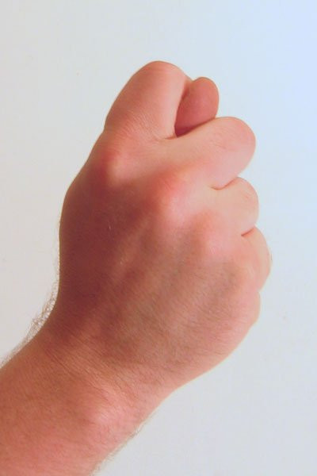
What do you mean?
Body language

Slide 2
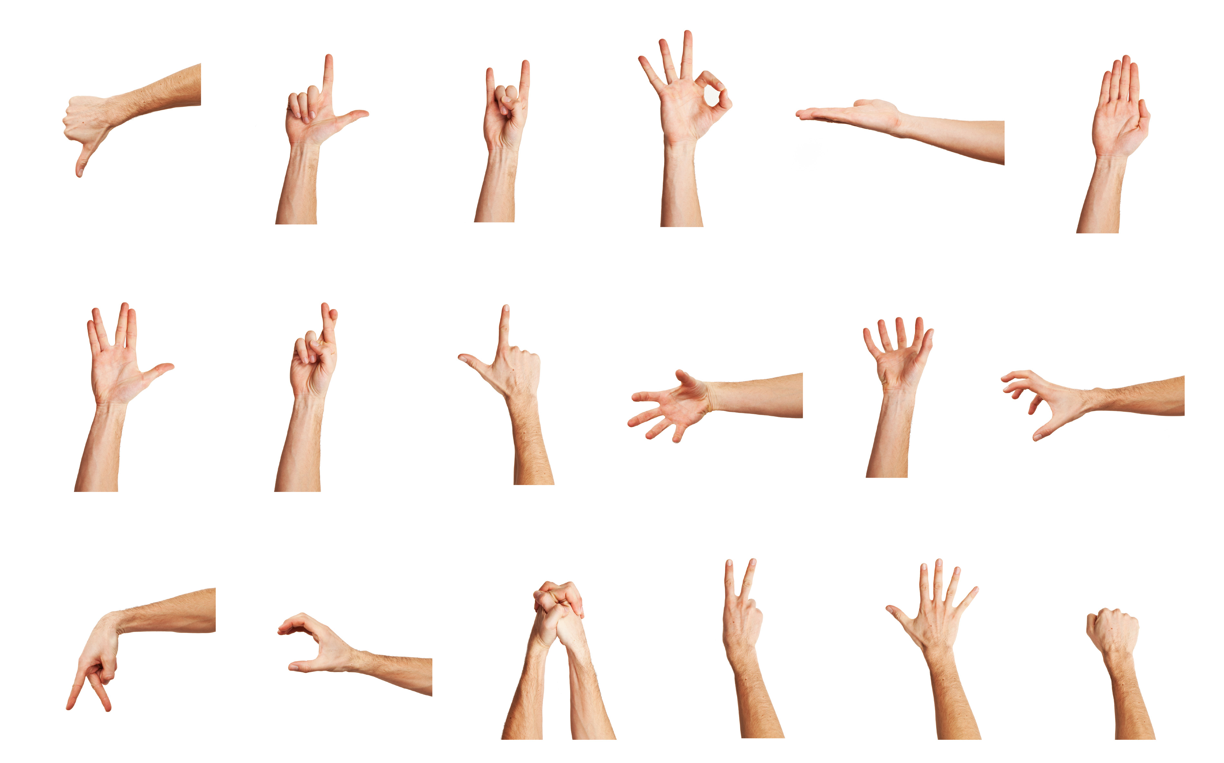
Gestures
What are some common gestures in your culture?

Slide 3
International Gestures Quiz

Slide 5
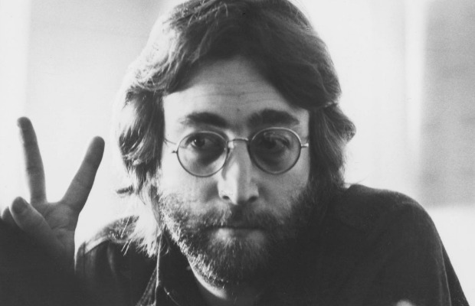
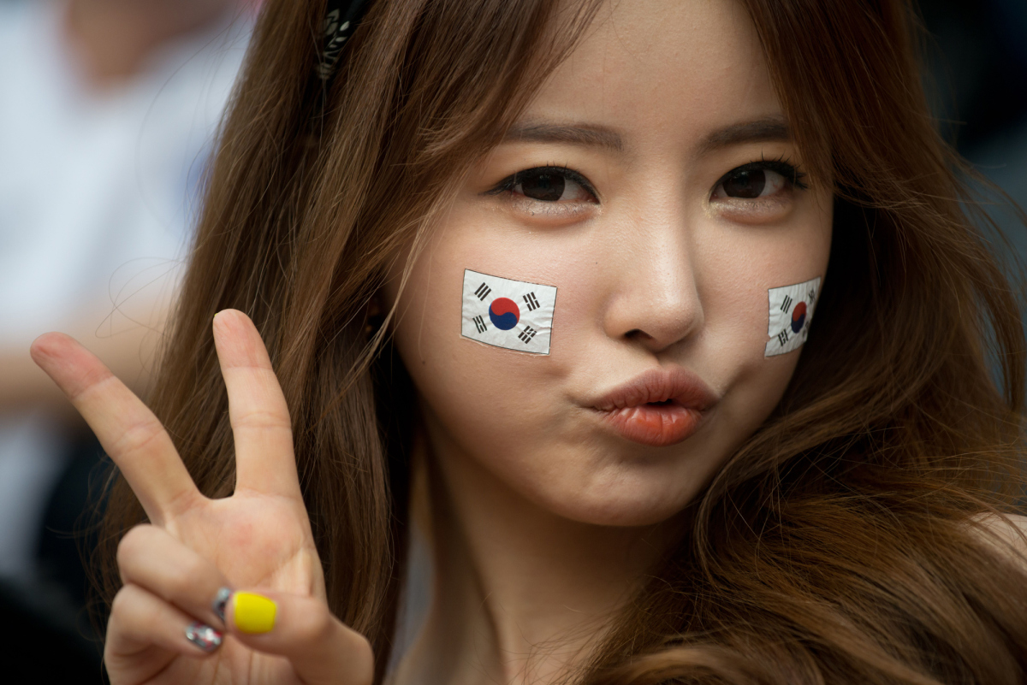
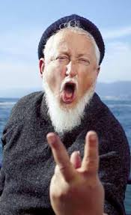
Some cultures this mean ‘peace’ (Canada, USA, )
Some cultures this means ‘victory’
If you turn this around it is very offensive in Canada, US, South Africa, UK.

Slide 7
Thumbs-Up
Germany – “Number one”
China – Excellent
Japan – Boss or husband
Canada, USA – Sign of approval
Greece – “Up yours”
Middle East – F*** YOU!

Slide 8
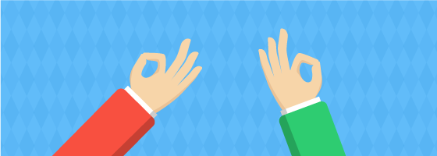

Slide 9
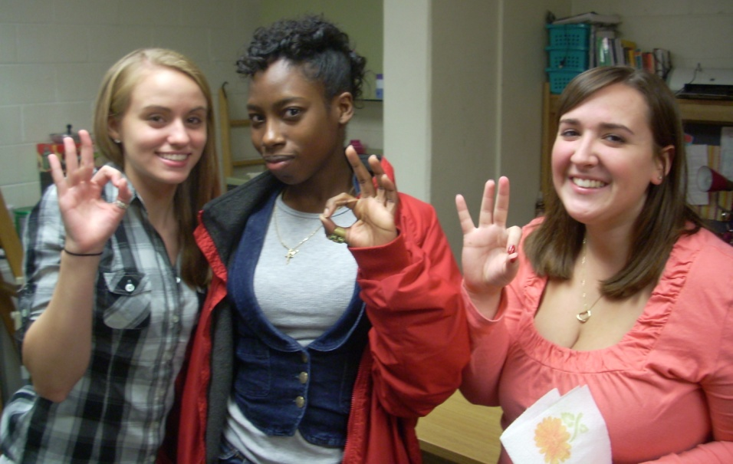
A-OK Sign
America, England – “A-OK”
Japan, China – Money
France – “You’re a zero”
Germany – “A**hole” or “Homosexual

Slide 10
Asking for Clarification
I’m sorry, I don’t quite understand?
I’m sorry, can you say explain what ____ means?
I’m not sure I understand.
What does X mean?

Slide 11
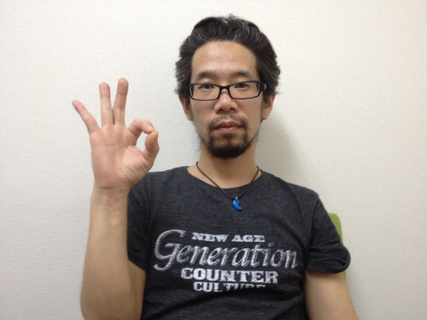
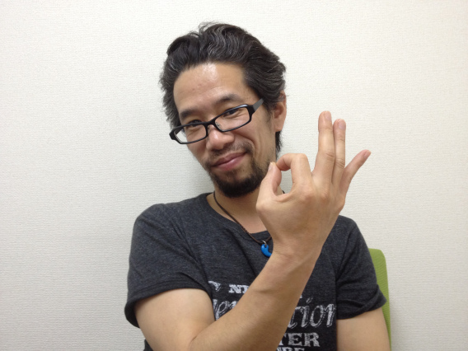
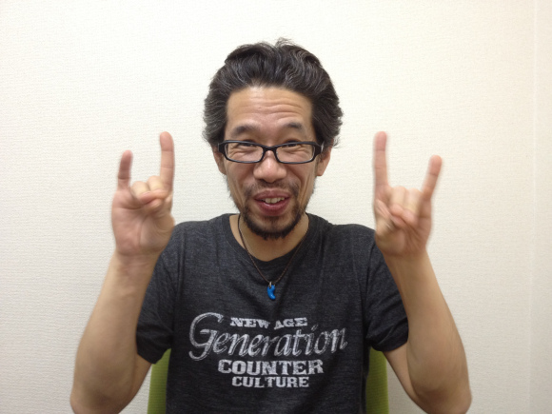
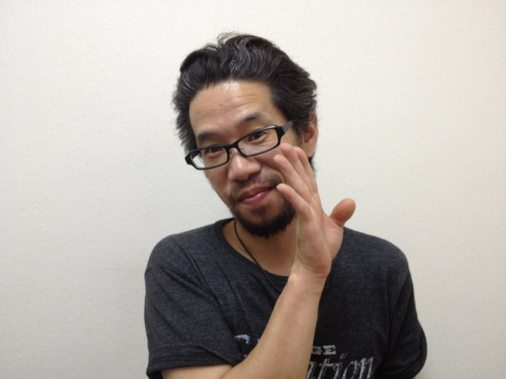
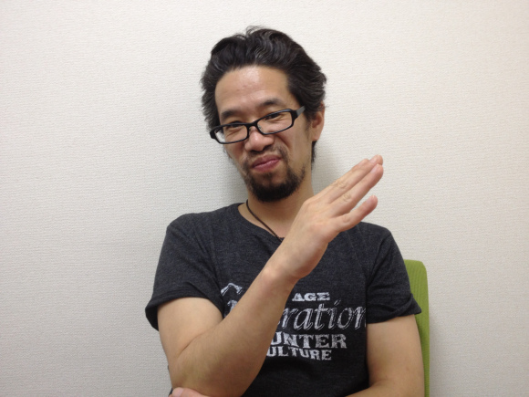
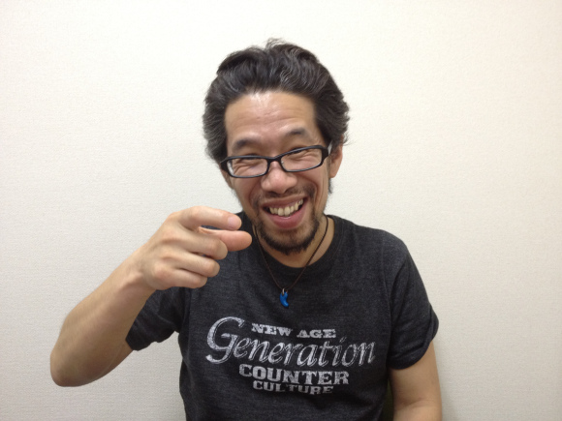
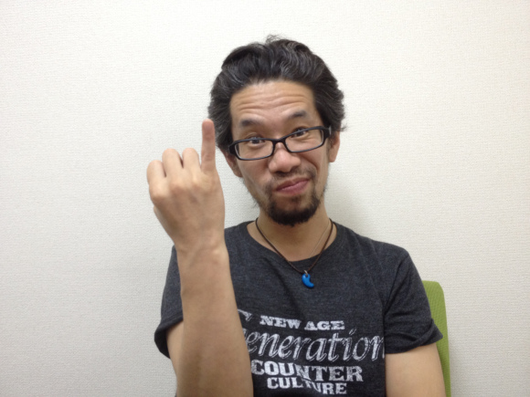
http://en.rocketnews24.com/2012/06/10/quiz-how-well-do-you-know-your-japanese-hand-gestures/

Slide 12
Guessing Game

Slide 13
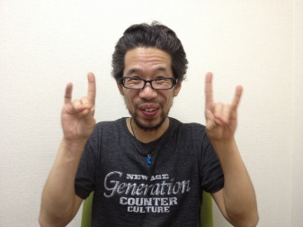
In Japan
Do you have money?
The gentleman is gay
Let’s drink some alcohol together
2 foxes

Slide 14
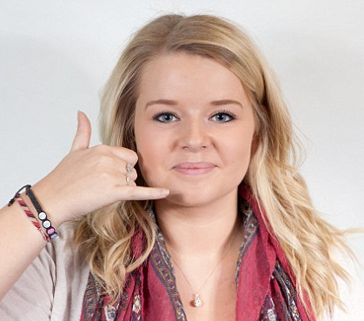
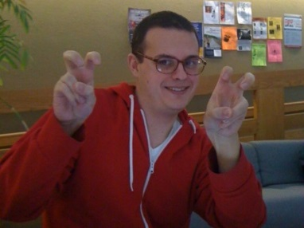
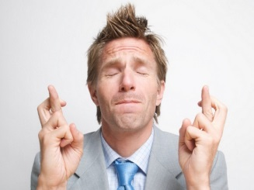
Western Gestures
Call me
Sarcasm
Wishing for good luck
Loser!

