Slide 1
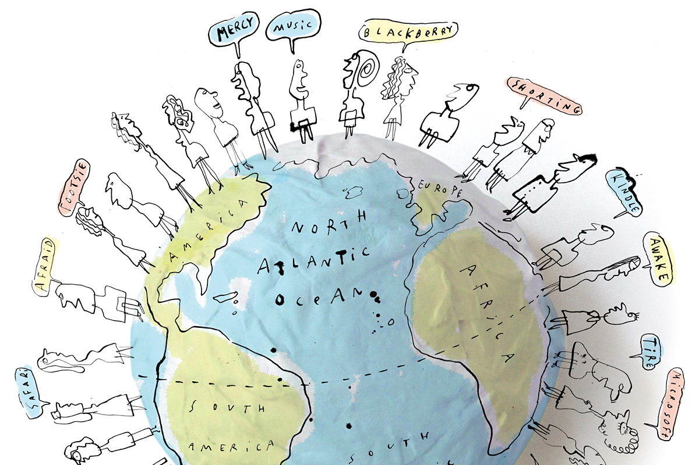
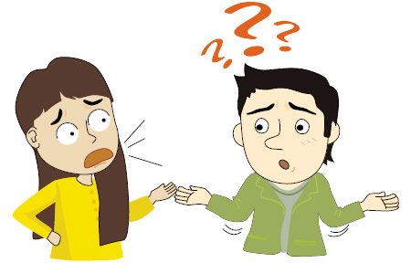
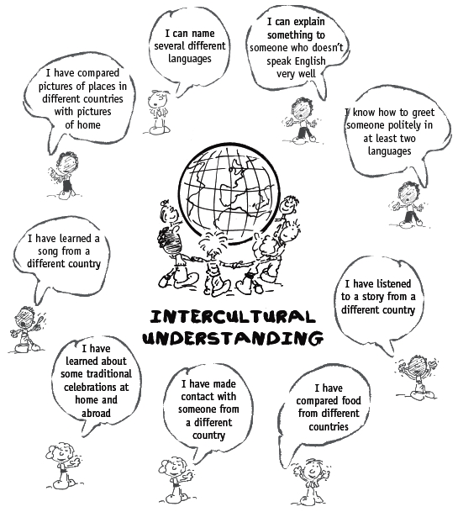
Global Communications

Slide 2
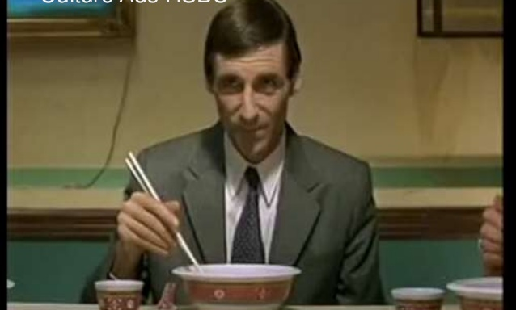
Global Communications

Slide 3
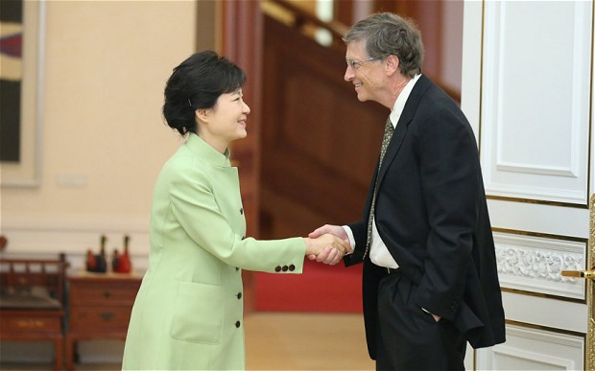
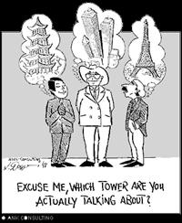
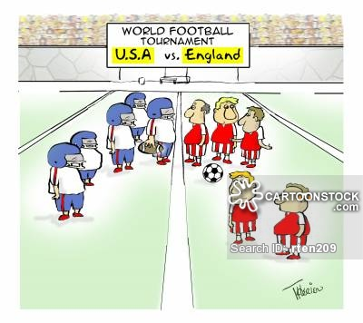
What is happening in these pictures?
Shut up!
I’m going to the EXO concert tomorrow!

Slide 4
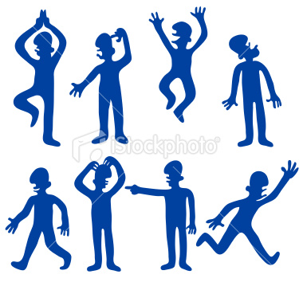
Misunderstandings
Actions and Words

Slide 5
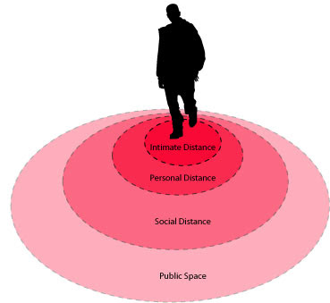
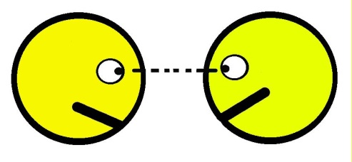
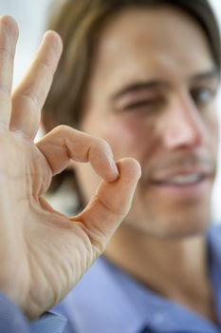
Actions
Eye Contact
Personal Space
Gestures
Physical contact

Slide 6
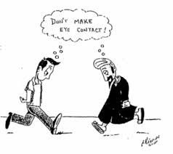
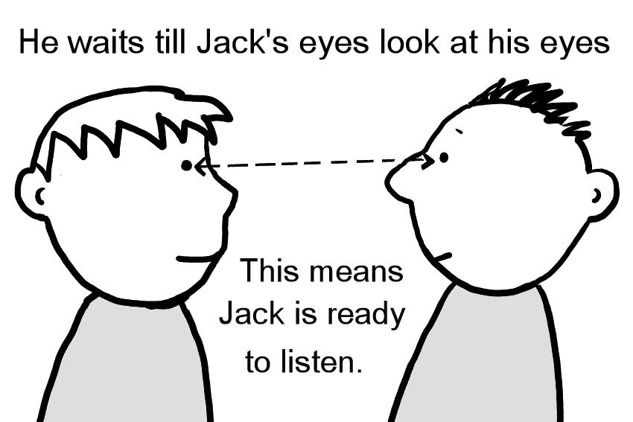
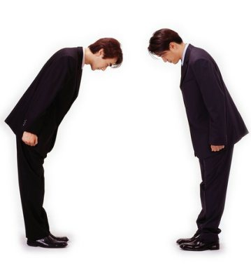
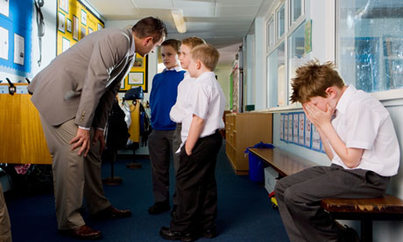
Eye Contact

Slide 7
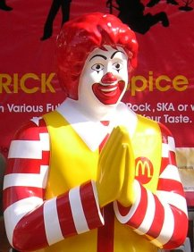
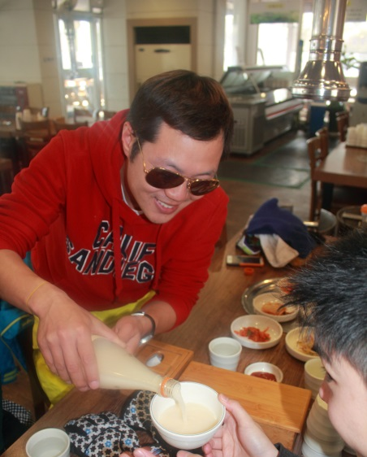
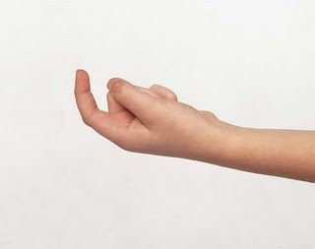
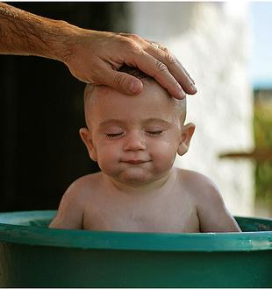
Actions/ Gestures

Slide 8
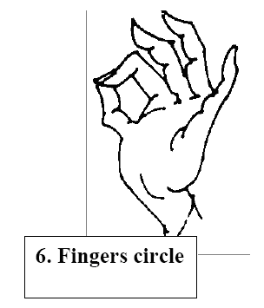

Slide 9
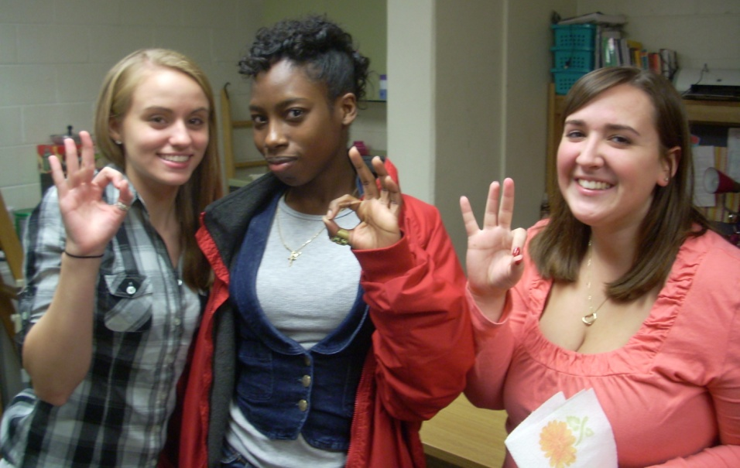
A-OK Sign
America, England – “Ok, Sure”
Korea, Japan, China – Money
France – “You’re a zero, You’re a loser”
Germany – “A**hole” or “Homosexual

Slide 10
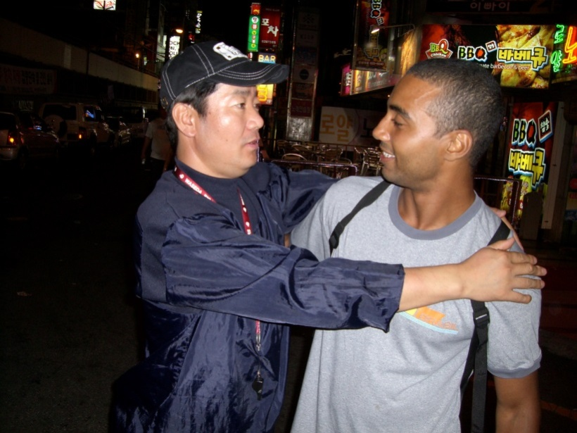
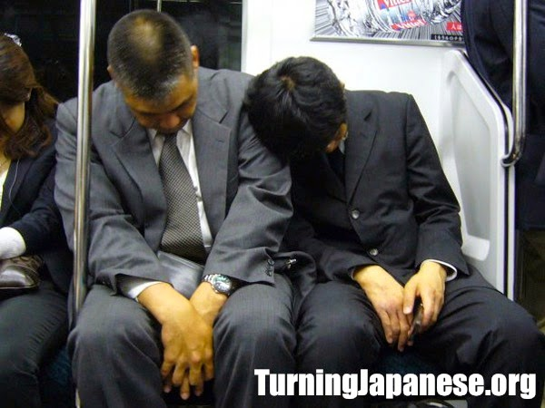
Personal Space

Slide 11
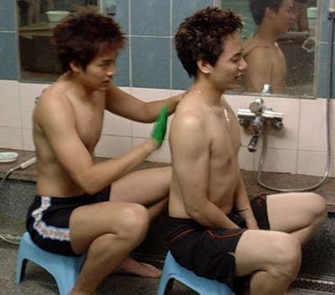
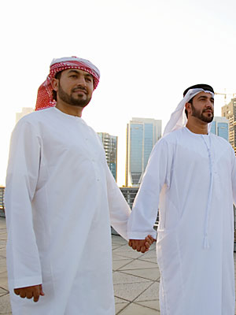
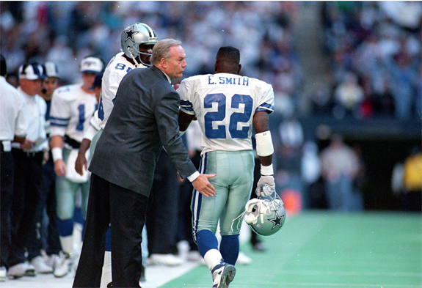
Physical Contact

Slide 12
Cultural Taboos
Can you think of any other types of cultural taboos? Or important cultural points that a visitor should know about?
With your groups make a list of important cultural points.
Think about things like eating, greeting, dating.

Slide 13
Words

Slide 14
What people say and what they mean may differ depending on who you are talking to.

Slide 15
Wow!
Be quiet!
Your kidding
Shut your mouth!
닥쳐
Shut up!
Shut up!

Slide 16
What people understand may differ depending on who you are talking to.

Slide 17
Wow!
닥쳐?
I am getting married!
Shut up!

Slide 18
Cultures and languages that are more similar will tend to have similar meanings.

Slide 19
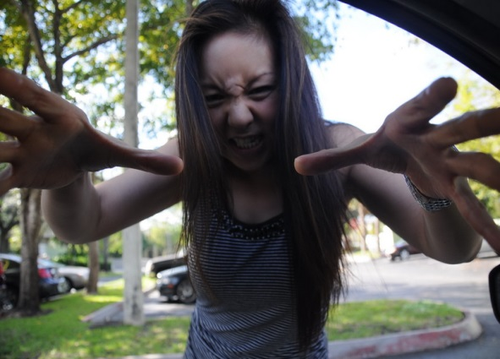
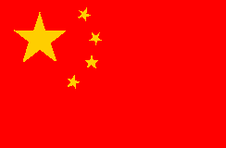
Wow!
닥쳐
How was your date?
Crazy!

Slide 20
Many things happened…
닥쳐
How was your date?
Crazy!

Slide 21
Individual Differences
Speed
Grammar
Pronunciation
Meaning
Directness
Intonation
Word choice

Slide 22
How to avoid misunderstandings
SPEAKING | LISTENING
Keep it short and simple | Ask for clarity (Don’t jump to your own conclusions)
Be as direct in your words as possible | Ask people to repeat
Don’t use idioms, slang or abstract language | Ask “ What do you mean?”
Show and demonstrate by using examples ,illustrations, gestures etc. | Ask them to slow down
Watch their face and body language | Don’t pretend you understand if you don’t.
Pause a lot and check if they understand
Repeat and rephrase when necessary
Notes:
M. Kovyazina Comparative Culturology Lectures, Tyumen State University, 2004-2009

Slide 23
Quiz Time

Slide 24
International Gestures Quiz
Look at the pictures showing gestures and guess their meaning

Slide 25
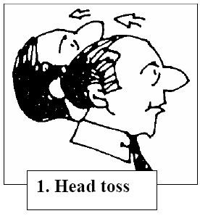

Slide 26
Some cultures this mean ‘YES’ (Canada, USA, )
Some cultures this means ‘NO’ (Greece, Bulgaria)

Slide 28
Thumbs-Up
Germany – “Number one”
China – Excellent
Japan – Boss or husband
America – Sign of approval
Australia- Sign of approval
Greece – “Up yours”
Middle East – Obscene gesture

Slide 29
Quiz Part 2

Slide 30
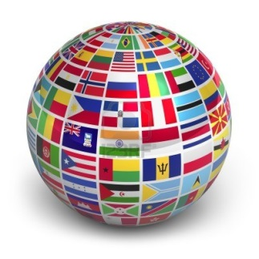
What 3 countries have the most people who use English as a primary language?
USA, UK, Canada
b. USA, India, UK
c. USA, India, Pakistan
d. USA, Australia, Canada
1. USA 291,524,091 | 6.Phillippines 43,994,000
2.India 125,344,736 | 7.Canada 25,246,220
3.Pakistan 88,690,000 | 8.Australia 18,172,989
4.Nigeria 79,000,000 | 9.South Africa 19,424,417
5.UK 59,600,000 | 10.Ireland 4,450,252

Slide 31
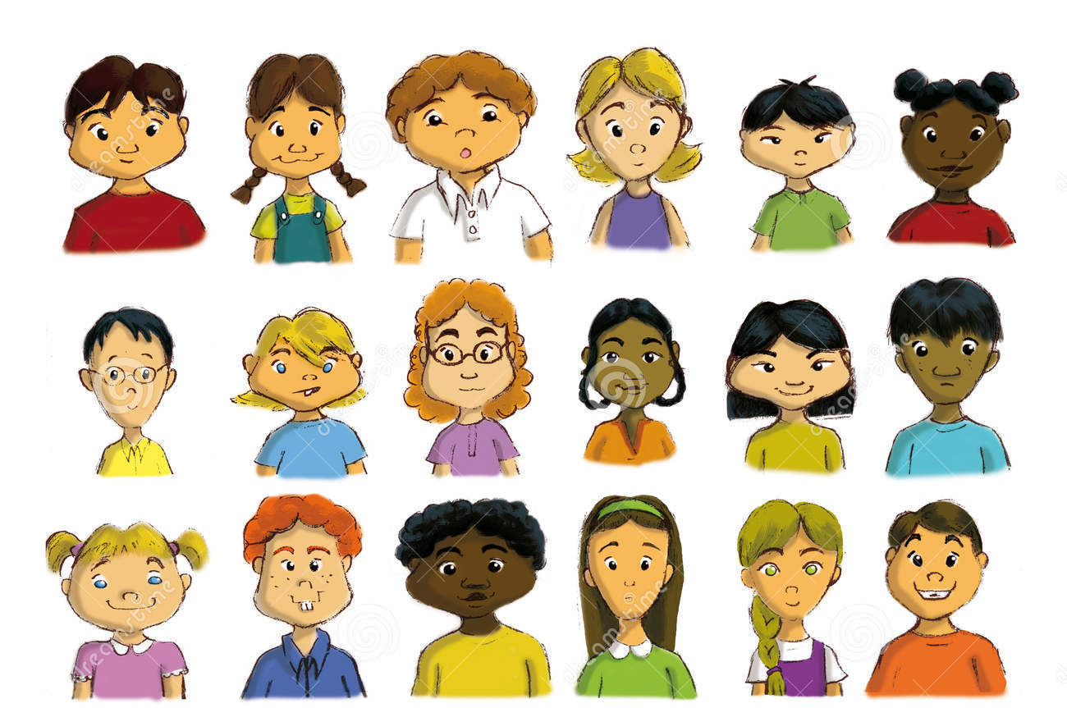
Which of these people are native speakers of English?

Slide 32
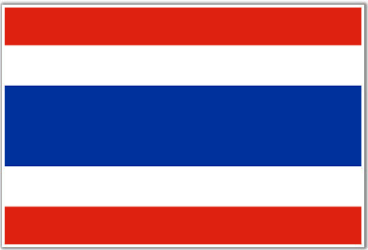
In Thailand…
a. Men holding hands is considered a sign of friendship.
a. it is common to see men walking along holding
hands.
b. it is common to see a man and a woman holding
hands in public.
c. it is rude for men and women to walk together.
d. men and women traditionally kiss each other on meeting in the street.
Public displays of affection between men and women, however, are unacceptable.

Slide 33
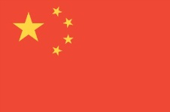
What does the color yellow mean in China? Ex. yellow book
a. Good luck
b. Bad Luck
c. Adult Content (18+)
d. Happiness
C. The word yellow often refers to adult content in China .

Slide 34
When a taxi driver shakes his head from side to side, it probably means..
c. This is the Indian way of saying “yes.”
a. he thinks your price is too high.
b. he isn’t going in your direction.
c. he will take you where you want to go.
d. he doesn’t understand what you’re asking.
It can also express general agreement with what you’re saying or suggest that an individual is interested in what you have to say.

Slide 35
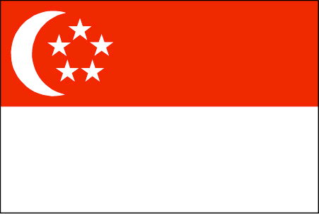
Which is NOT banned in Singapore?
a. Spitting
b. Littering
c. Gum
d. Lighters
D. Lighters are not banned in Singapore unless they look like a weapon.

Slide 36
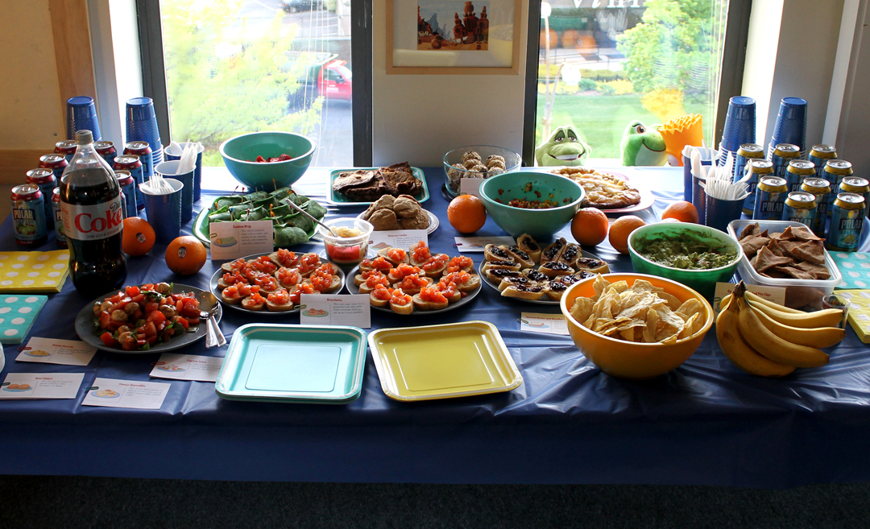
In Canada, a potluck party is..
C.
a . a party where everyone sings.
b. a party where everyone bangs on pots.
c. a party where everyone brings some food to share.

Slide 37
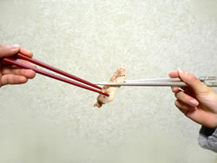
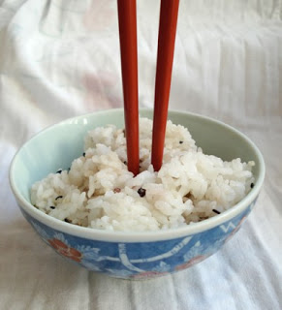
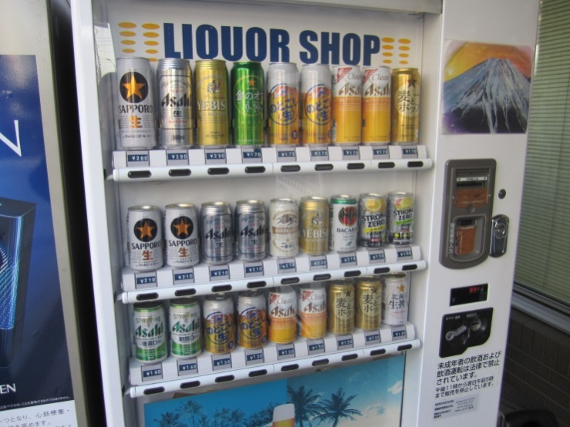
Which is OK in Japan?

Slide 38
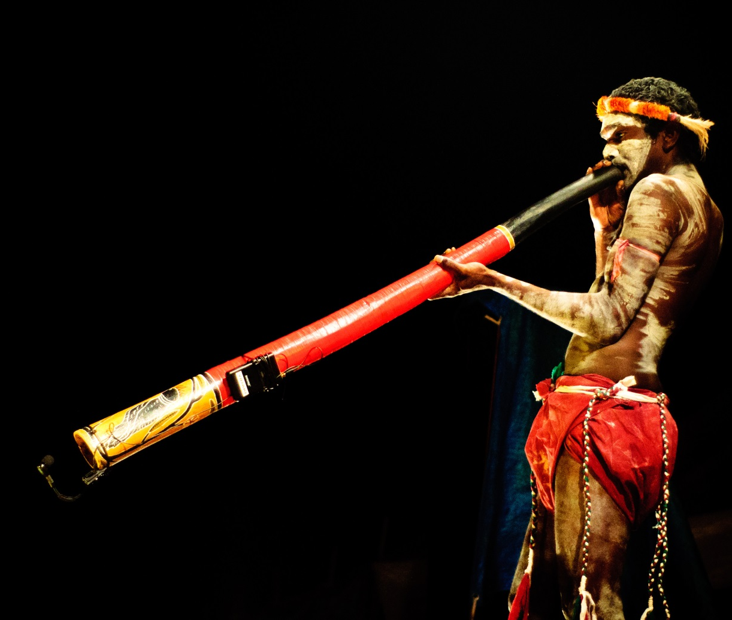
What country does this instrument come from?
a. Kenya
b. New Zealand
c. Nigeria
d. Australia
C. The didgeridoo was developed over 1500 years ago in Australia!

Slide 39
Which country has the most lakes in the world?
a. USA
b. Russia
c. Canada
d. China
C. With over 3 million lakes,60% of all the lakes in the world are found in Canada.

Slide 40
Keep in Mind
Native English varieties represent a minority amongst the many ‘Englishes’ that are spoken around the world.
The more you know about the world, the better you will be able to use English.

Slide 41
Culture Project
Each group will be assigned a country.
Designate roles for each person in your group
Facts and statistics (language, population etc.)
Food
Culture
Interesting places, people
Research and present the information

Slide 42
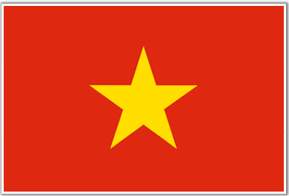
Countries of Choice

