Slide 1
The World of English
by Prof. George Whitehead

Slide 2
What do you think?
English teachers and learners should know a lot about western culture.
The more native like a person’s pronunciation is, the better their English is.
Konglish (Korean English) is not real English and should be avoided.
A trained native English speaking instructor is better than a trained non-native instructor.
Language teachers should only expose students to only native English models.
Knowing a lot of idioms and slang is important in becoming fluent in English.
It difficult to communicate if your grammar not good.
English learners should have an English name.
Being like a native speaker should be the primary goal of English learners.

Slide 3
With your group come up with 6 English speaking Countries?

Slide 4
Which one has the best Engilsh?

Slide 5
What does a native speaker look like?
OLD STEREOTYPE

Slide 6
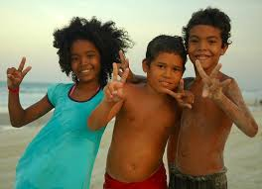
The Faces of English Today

Slide 7
English Today

Slide 8
How did this video make you feel?

Slide 10
English as a Native Language
Primary/ Secondary Language
Foreign
Language

Slide 12
The Interests of the West

Slide 13
Scholastic Dimension
The West has furthered its own best interests by promoting western knowledge and by belittling local knowledge about language learning, teaching, and teacher education.
i.e. CLT, TEE, Learner-centered

Slide 14
Linguistic Dimension
Knowledge and use of local language(s) were made irrelevant for purposes of learning and teaching English worldwide.
i.e. TEE, English only zones, English names, Native speaking teachers

Slide 15
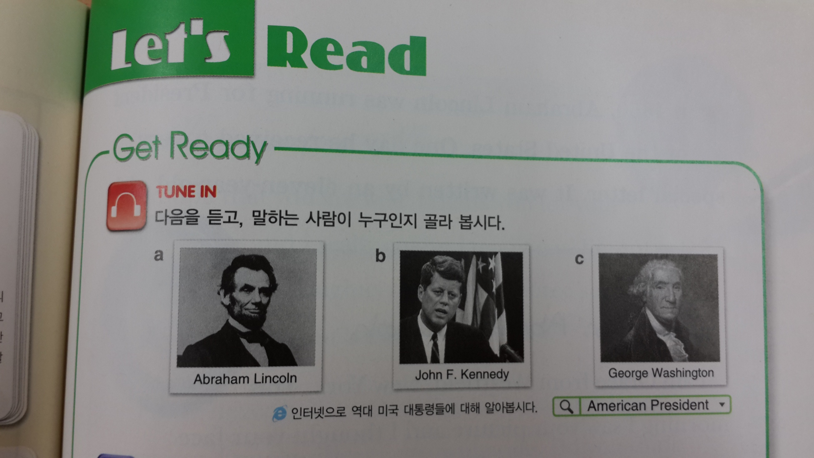
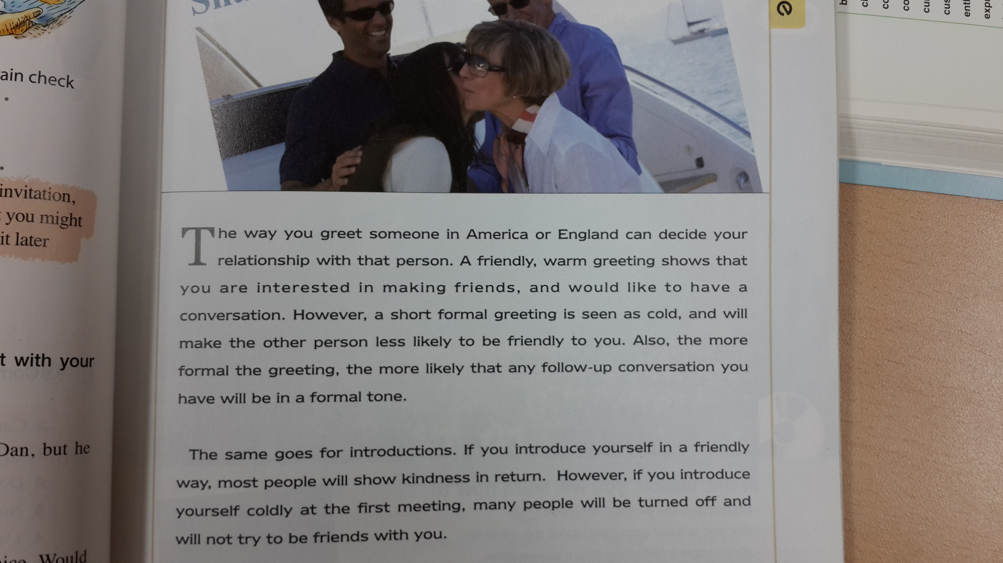
Cultural Dimension
The teaching of English language has been associated with the teaching of western culture in order to develop cultural assimilative tendencies among L2 learners.
Westernization of learners
i.e. major focus on western culture, little focus on world cultures, little focus on being able to promote your own culture in English

Slide 16
Overall Benefits
All of this is linked to an economic dimension aimed at job and wealth creation benefitting the economy of English speaking countries through a worldwide ELT industry.
i.e. Just because you can speak it, you can teach it!

Slide 17
The New Paradigm

Slide 18
What now?
The linguistic and cultural sensitivities triggered by cultural globalization have prompted the English language teaching community to try to make a meaningful shift in policies and programs, and methods and materials governing English language teaching and teacher education.

Slide 19
English as a Native Language
Second Language
Foreign
Language

Slide 20
Regional Varieties
Konglish
Chinglish
Turklish
Finglish
Poglish
Norweglish
Dunglish
Czenglish
Porglish
Hinglish
Spanglish
Greeklish
Tinglish

Slide 21
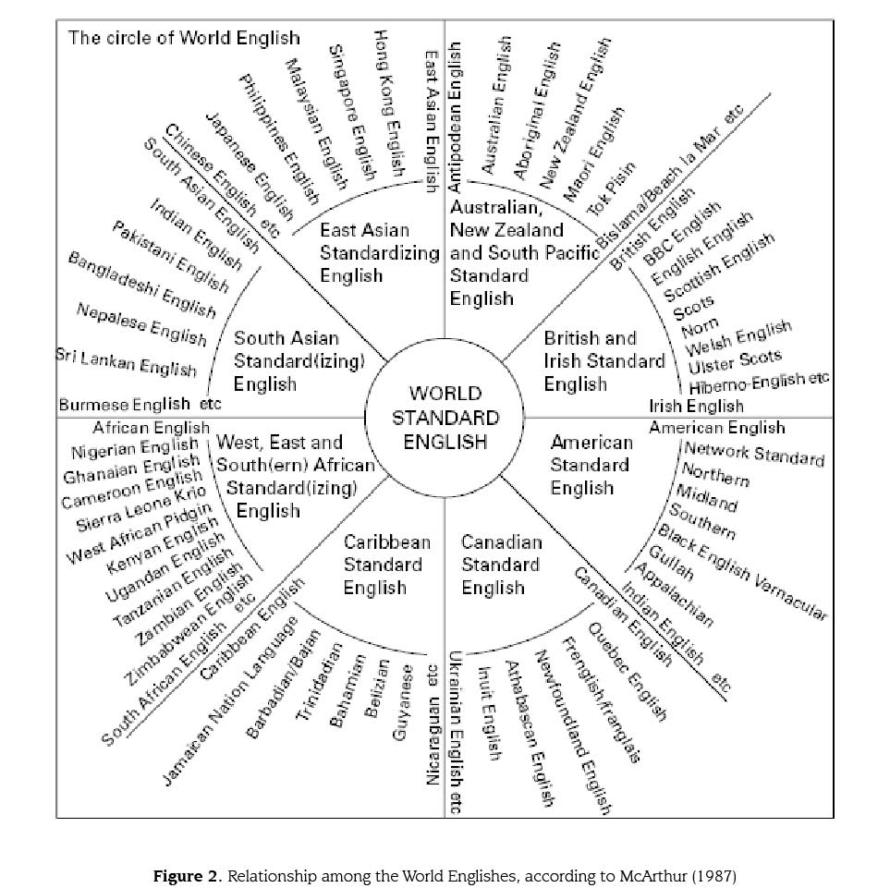

Slide 22
English is now an international language

Slide 23
Current Facts
Currently, non-native speakers outnumber native speakers
5 to 1
Who are you and your students most likely to interact in English with?

Slide 24
English Speakers Today

Slide 25
Current Facts
There are now speakers of English all around the world.
There are many fluent non-native speakers.
EFL learners use the English language mostly for purposes of communication.
English should not necessarily affect ones national identity.

Slide 26
What does English sound like?

Slide 27
Activity
Write down the score you would give these speakers of English from 1-10.
1 = very very bad
10 = perfect!

Slide 31
Cultural Dimension
The teaching of English language has been associated with the teaching of western culture in order to develop cultural assimilative tendencies among L2 learners.
Westernization of learners
i.e. major focus on western culture, little focus on world cultures, little focus on being able to promote your own culture in English

Slide 32
Overall Benefits
All of this is linked to an economic dimension aimed at job and wealth creation benefitting the economy of English speaking countries through a worldwide ELT industry.
i.e. Just because you can speak it, you can teach it!

Slide 33
The New Paradigm

Slide 34
What now?
The linguistic and cultural sensitivities triggered by cultural globalization have prompted the English language teaching community to try to make a meaningful shift in policies and programs, and methods and materials governing English language teaching and teacher education.

Slide 35
What’s really important?
With your group discuss your opinions about the order of importance of the skills below for English today.
Pronunciation
Grammar
Confidence
A large vocabulary
Comprehensible output
Being familiar with different dialects
Understanding western culture
Idioms and slang

Slide 36
Prof. G’s List
Comprehensible output
Confidence
Being familiar with different dialects
Pronunciation
A large vocabulary
Grammar
Understanding western culture
Idioms and slang

Slide 37
Jack. C. Richards

Slide 38
Key Points
In countries like Korea, Korean language and culture needs to come first. (한국에서는 한글과 한국문화가 우선이다)
English should not take over Korean culture and identity. (영어가 한국문화와 자기 정체성을 차지하지 않아야 한다)
You can be brilliant in your own language. English does not = intelligence! (자기의 언어 가지고도 훌륭할 수 있다)
English is an additional skill.

Slide 39
Key Points
There are many fluent English speakers, not all are native…
The most important thing is to be comprehensible
Be proud to be a Korean English speaker
Native speakers can have troubles in international settings.
Native speakers should try to understand your English just as much as you try to understand theirs.

Slide 40
In the classroom
It is important to maintain cultural values and identity when learning English.
Foster the acceptance of different varieties of English.
Expose learners to varieties of English that they will likely encounter.
Introduce learners to the cultures they will be most likely to interact with.
Non-native speakers can be great role models for English learners.

Slide 41
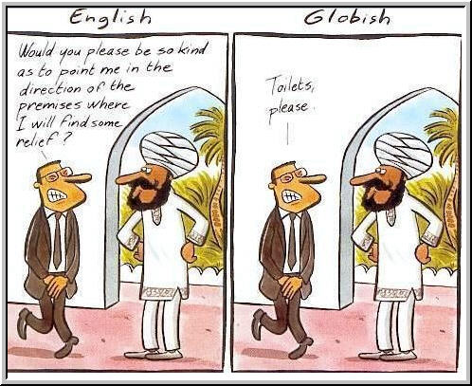
Fluency can be dangerous in International settings

Slide 42
Mind Your Language

Slide 43
Discussion
With your group discuss the answers and reasons to the questions from the beginning of class.

Slide 44
What do you think?
English teachers and learners should know a lot about western culture.
The more native like a person’s pronunciation is, the better their English is.
Konglish (Korean English) is not real English and should be avoided.
A trained native English speaking instructor is better than a trained non-native instructor.
Language teachers should only expose students to only native English models.
Knowing a lot of idioms and slang is important in becoming fluent in English.
It difficult to communicate if your grammar not good.
English learners should have an English name.
Being like a native speaker should be the primary goal of English learners.
It is good for Korean learners to have an English name.

Slide 45
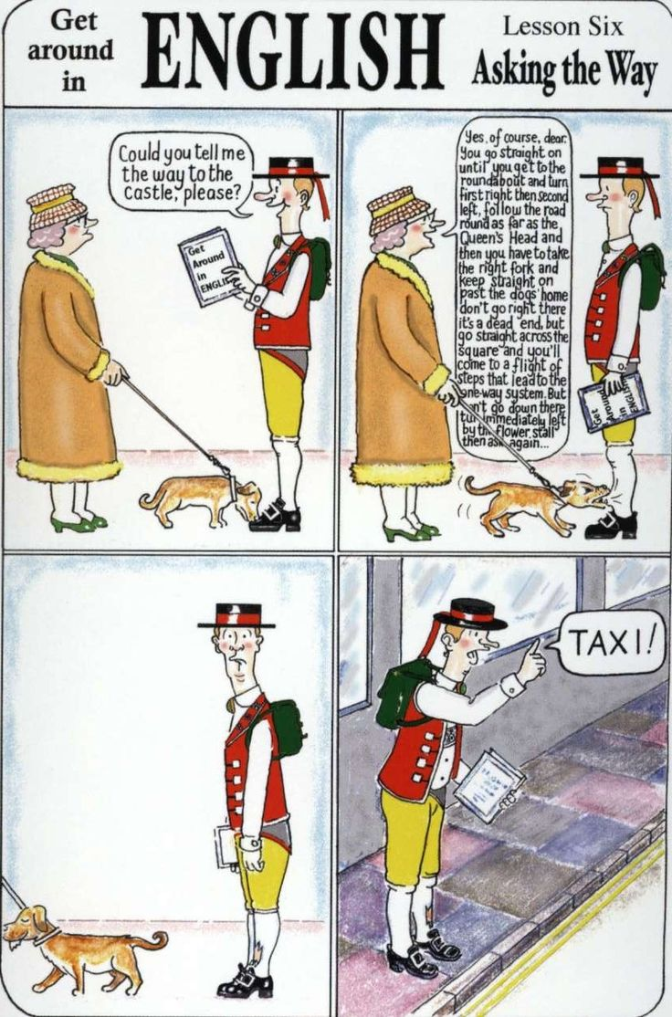

Slide 47
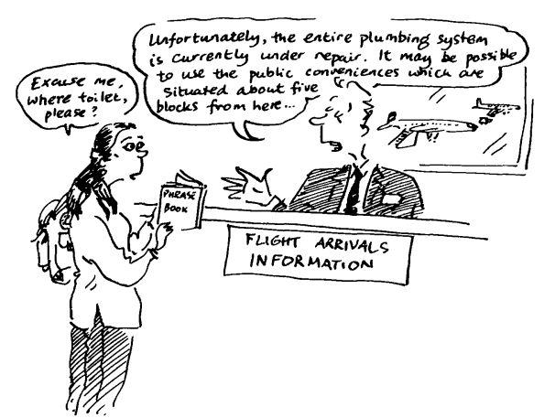

Slide 48
Goals of English
English is more than just a test score, It is a life skill.
The primary goal of learning English should be to understand others and be understood (native and non-native).
Accuracy in grammar, pronunciation are not as important if they do not affect comprehensibility.

Slide 49
Your English Goals
What are your future goals as an English teacher?
Write down at least 3
Try to be as specific as possible
What are your goals as an English learner?

Slide 50
Wrap-up
In this lesson was there any information that shocked you? If so, why?
After learning about English today has your thinking changed about English? How so?
Was there anything you disagreed with? If so, explain.
What can you do to be a more successful user of English in today’s world?

