Slide 1
The World of English
by Prof. George Whitehead

Slide 2
What do you think?
English teachers and learners should know a lot about western culture and manners.
The more nativelike a person’s pronunciation is, the better their English is.
Being like a native speaker should be the primary goal of English learners in South Korea.
The use of Konglish by Korean English speakers should be avoided in South Korea.
Generally speaking, an English teacher with English as their L1 is better than an English teacher with English as their L2.
Language teachers in South Korea should focus on helping their learners communicate with native English speakers.
Knowing a lot of idioms and slang is important in becoming fluent in English.
Grammar is an important element of being a good English speaker.
It is recommended for English learners in South Korea to use an English name.

Slide 3
With your group come up with 6 English speaking Countries?

Slide 4
Which one has the best Engilsh?

Slide 5
What does a native speaker look like?
OLD STEREOTYPE

Slide 6
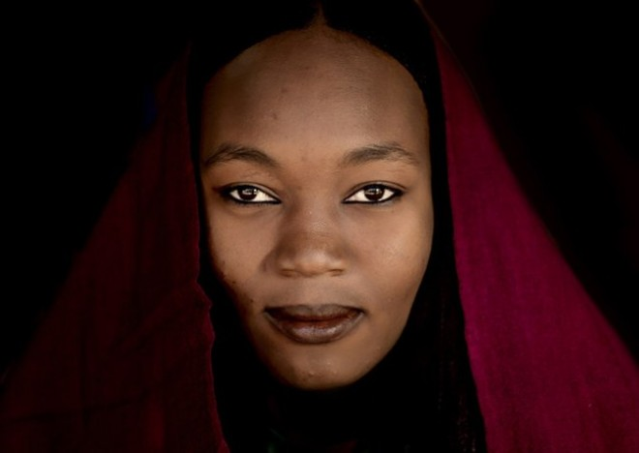
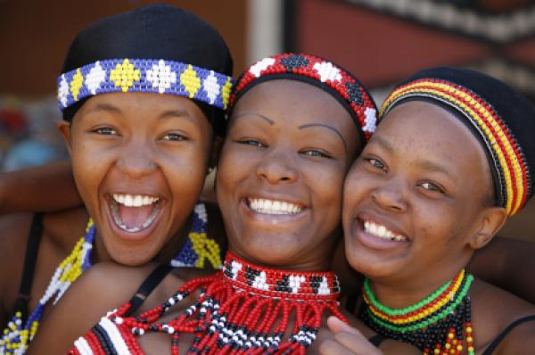
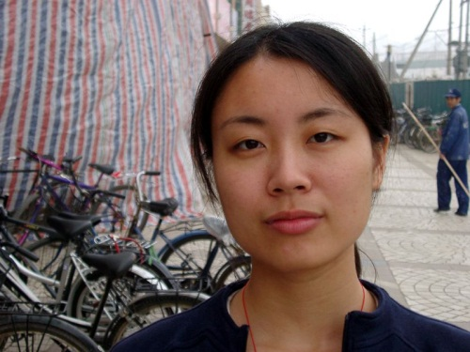
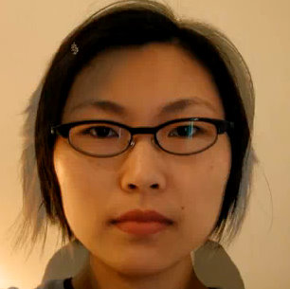
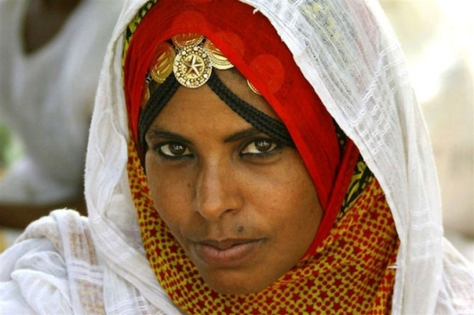
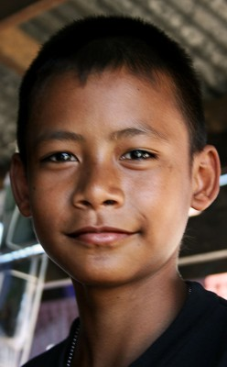
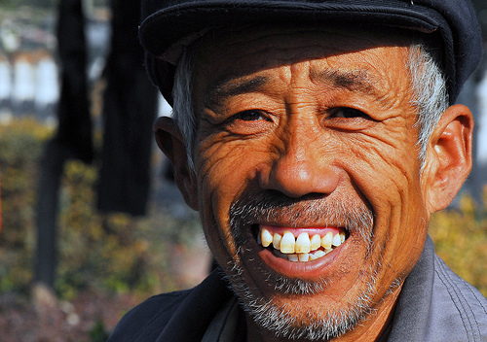
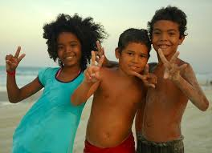
The Faces of English Today

Slide 7
English Today

Slide 8
How did this video make you feel?

Slide 10
English as a Native Language
Primary/ Secondary Language
Foreign
Language

Slide 11
English as a Native Language
Second Language
Foreign
Language

Slide 12
Regional Varieties
Konglish
Chinglish
Turklish
Finglish
Poglish
Norweglish
Dunglish
Czenglish
Porglish
Hinglish
Spanglish
Greeklish
Tinglish

Slide 13
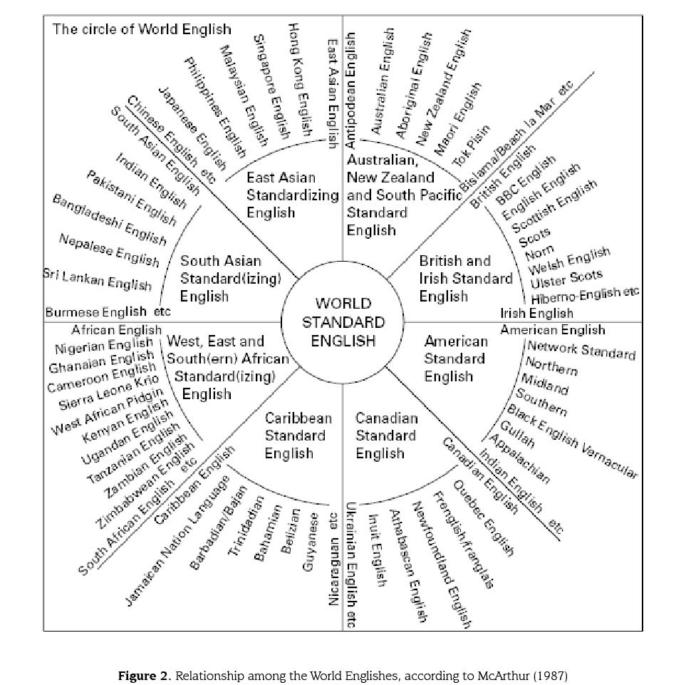

Slide 14
English is now an international language

Slide 15
Current Facts
Currently, non-native speakers outnumber native speakers
5 to 1
Who are you and your students most likely to interact in English with?

Slide 16
English Speakers Today

Slide 17
Current Facts
There are now speakers of English all around the world.
There are many fluent non-native speakers.
EFL learners use the English language mostly for purposes of communication.
English should not necessarily affect ones national identity.

Slide 18
Reflective task
Think about today’s lesson
What were some key things you learned?
How can you apply what you learned to your future in this field?

Slide 19
What does English sound like?

Slide 20
Activity
Write down the score you would give these speakers of English from 1-10.
1 = very very bad
10 = perfect!

Slide 24
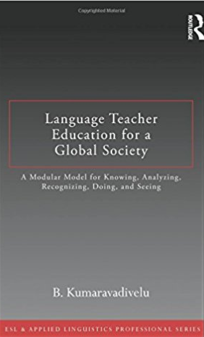

Slide 25
The Interests of the West

Slide 26
Scholastic Dimension
The West has furthered its own best interests by promoting western knowledge and by belittling local knowledge about language learning, teaching, and teacher education.
i.e. CLT, TEE, Learner-centered

Slide 27
Linguistic Dimension
Knowledge and use of local language(s) were made irrelevant for purposes of learning and teaching English worldwide.
i.e. TEE, English only zones, English names, Native speaking teachers

Slide 28
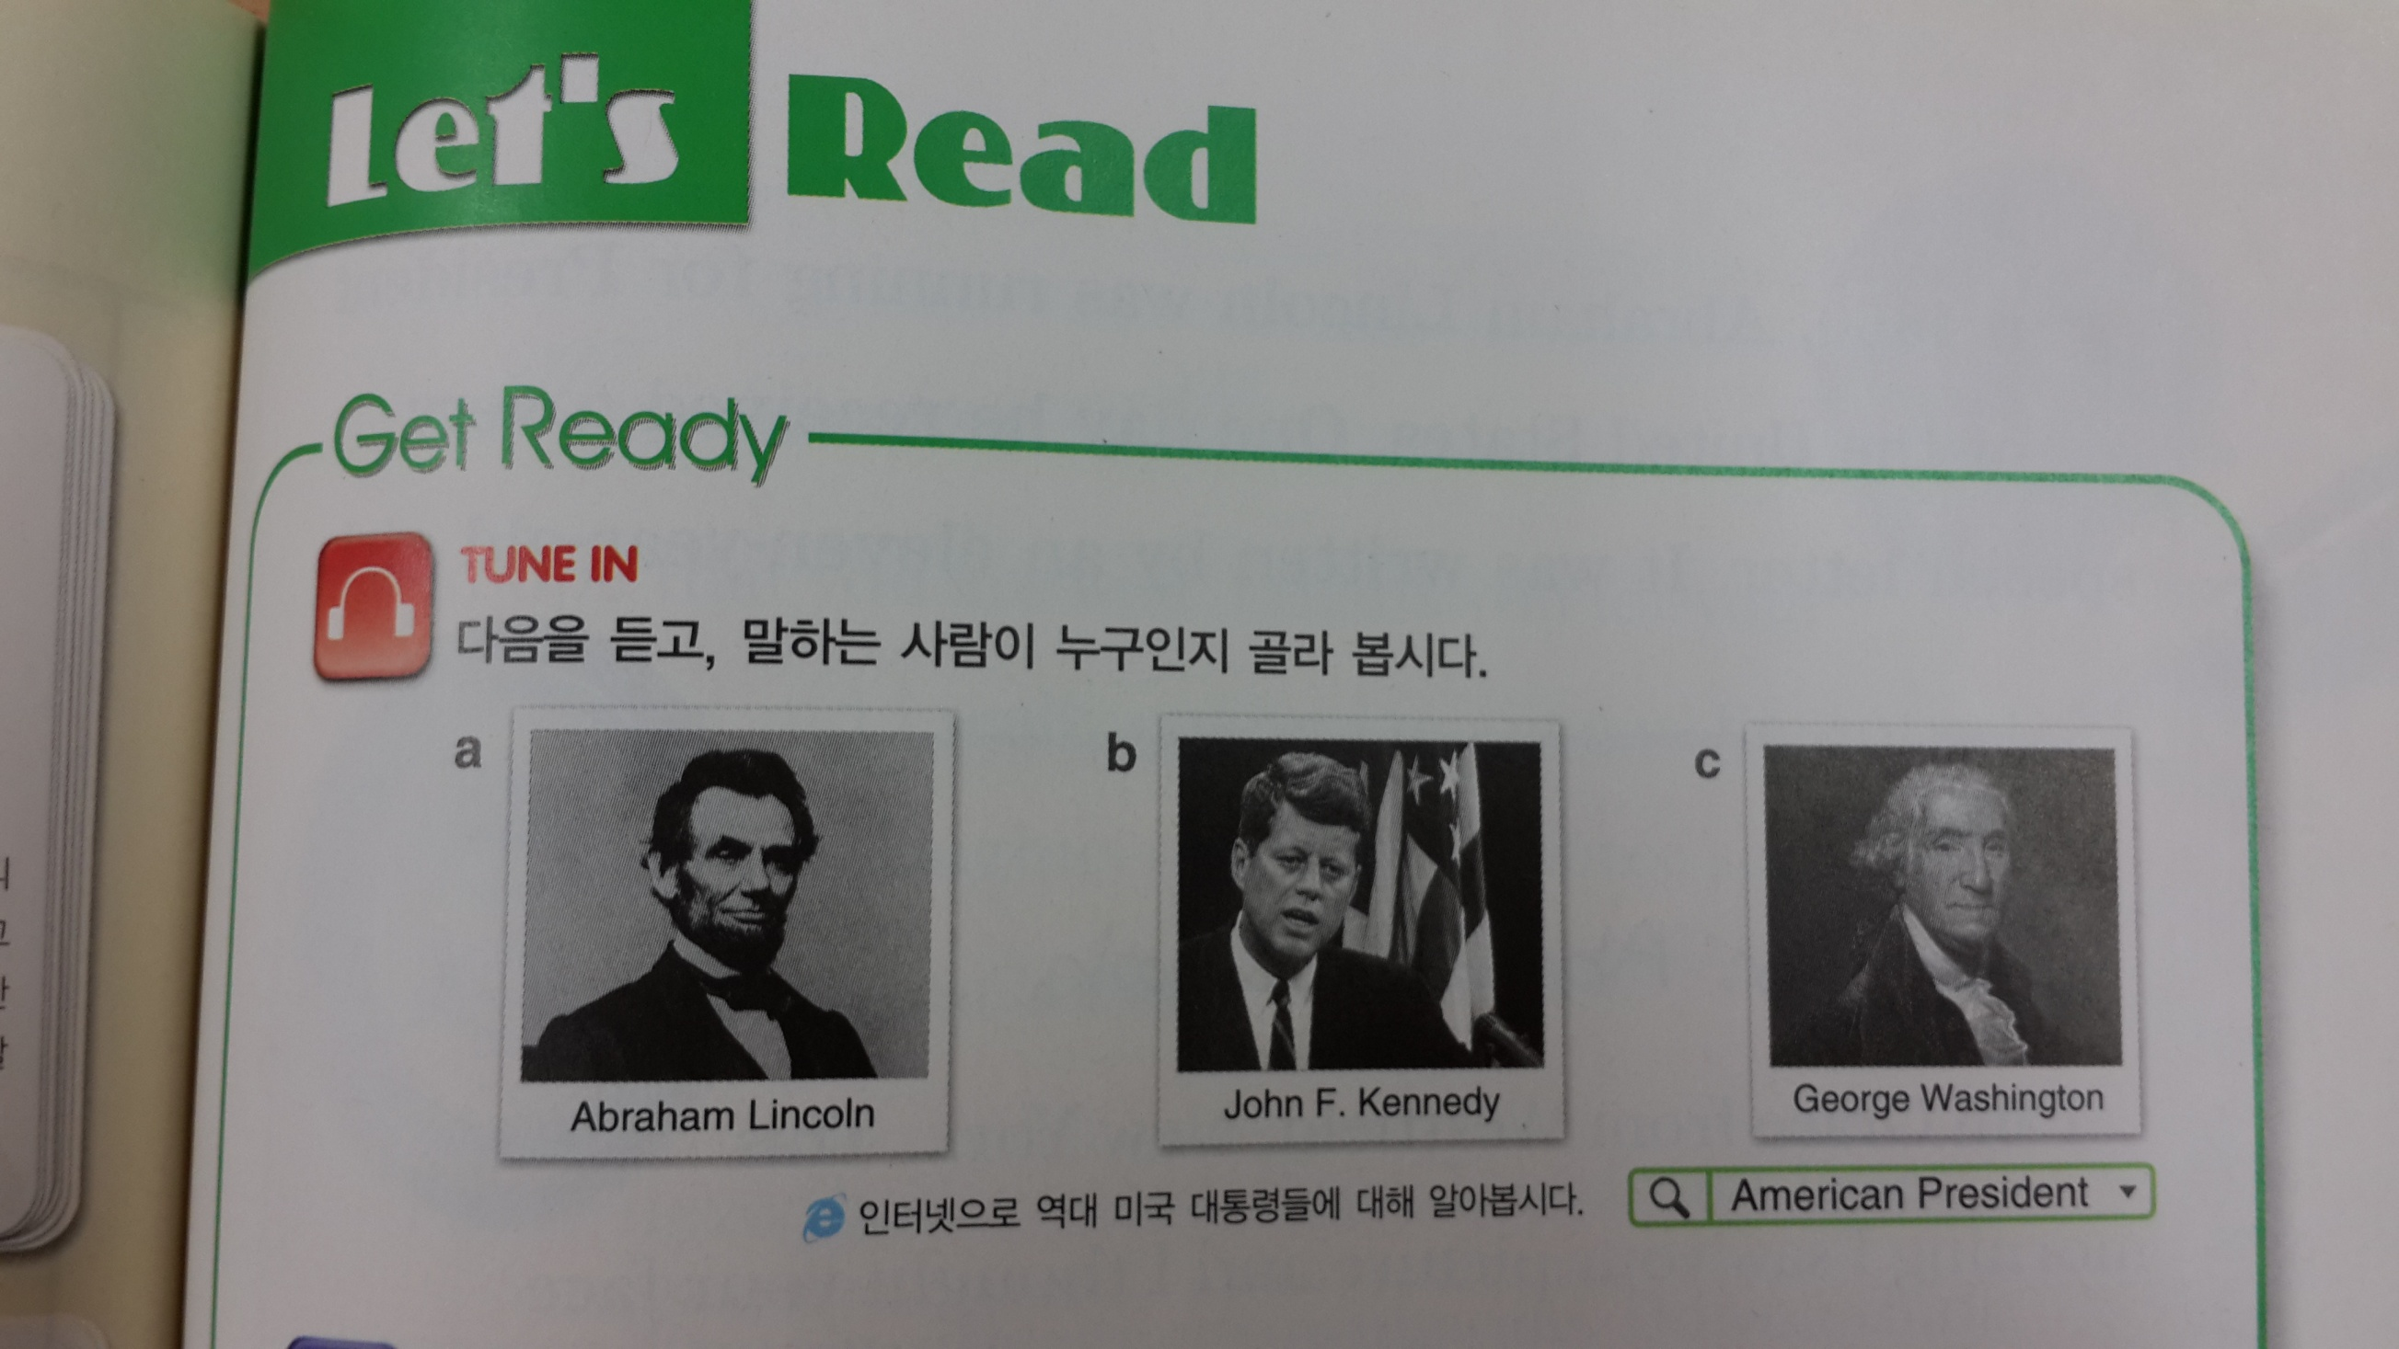
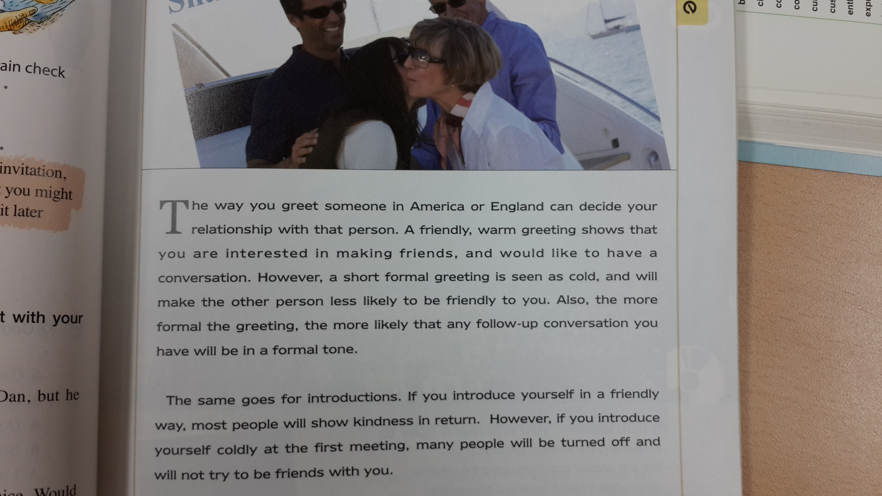
Cultural Dimension
The teaching of English language has been associated with the teaching of western culture in order to develop cultural assimilative tendencies among L2 learners.
Westernization of learners
i.e. major focus on western culture, little focus on world cultures, little focus on being able to promote your own culture in English

Slide 29
Overall Benefits
All of this is linked to an economic dimension aimed at job and wealth creation benefitting the economy of English speaking countries through a worldwide ELT industry.
i.e. Just because you can speak it, you can teach it!

Slide 30
The New Paradigm

Slide 31
What now?
The linguistic and cultural sensitivities triggered by cultural globalization have prompted the English language teaching community to try to make a meaningful shift in policies and programs, and methods and materials governing English language teaching and teacher education.

Slide 32
What’s really important?
With your group discuss your opinions about the order of importance of the following for English learners today.
Pronunciation
Grammar
Confidence
A large vocabulary
Comprehensible output
Being familiar with different dialects
Understanding western culture
Idioms and slang

Slide 33
What I think…
Comprehensible output
Confidence
Being familiar with different dialects
A large vocabulary
Pronunciation
Grammar
Understanding western culture
Idioms and slang

Slide 34
Jack. C. Richards

Slide 35
Key Points
In countries like Korea, Korean language and culture needs to come first. (한국에서는 한글과 한국문화가 우선이다)
English should not take over Korean culture and identity. (영어가 한국문화와 자기 정체성을 차지하지 않아야 한다)
You can be brilliant in your own language. English does not = intelligence! (자기의 언어 가지고도 훌륭할 수 있다)
English is an additional skill.

Slide 36
Key Points
There are many fluent English speakers, not all are native…
The most important thing is to be comprehensible
Be proud to be a Korean English speaker
Native speakers can have troubles in international settings.
Native speakers should try to understand your English just as much as you try to understand theirs.

Slide 37
In the classroom
It is important to maintain cultural values and identity when learning English.
Foster the acceptance of different varieties of English.
Expose learners to varieties of English that they will likely encounter.
Introduce learners to the cultures they will be most likely to interact with.
Non-native speakers can be great role models for English learners.

Slide 38
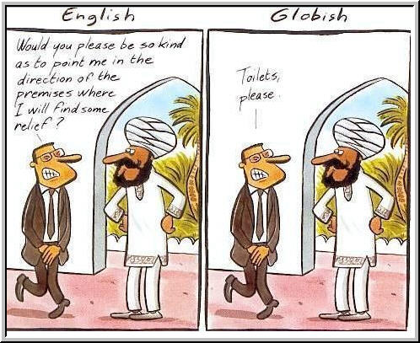
Fluency can be dangerous in International settings

Slide 39
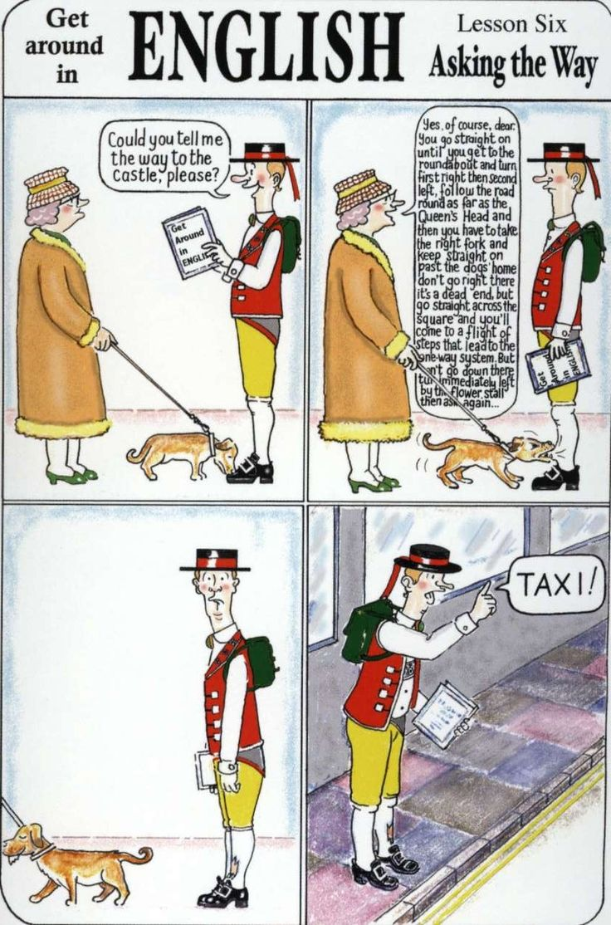

Slide 41
Mind Your Language

Slide 42
Discussion
With your group discuss the answers and reasons to the questions from the beginning of class.

Slide 43
What do you think?
English teachers and learners should know a lot about western culture and manners.
The more nativelike a person’s pronunciation is, the better their English is.
Being like a native speaker should be the primary goal of English learners in South Korea.
The use of Konglish by Korean English speakers should be avoided in South Korea.
Generally speaking, an English teacher with English as their L1 is better than an English teacher with English as their L2.
Language teachers in South Korea should focus on helping their learners communicate with native English speakers.
Knowing a lot of idioms and slang is important in becoming fluent in English.
Grammar is an important element of being a good English speaker.
It is recommended for English learners in South Korea to use an English name.

Slide 44
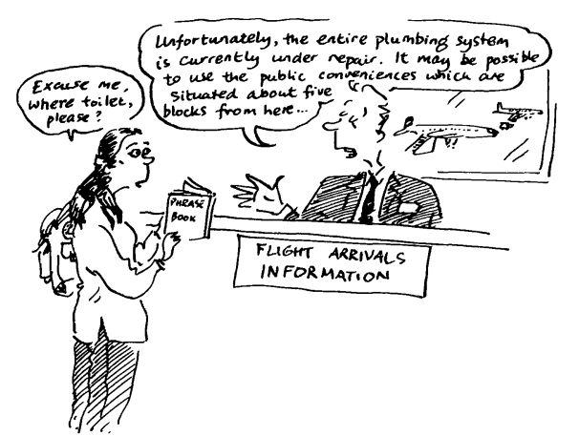

Slide 45
Goals of English
English is more than just a test score, It is a life skill.
The primary goal of learning English should be to understand others and be understood (native and non-native).
Accuracy in grammar, pronunciation are not as important if they do not affect comprehensibility.

Slide 46
Wrap-up
In this lesson was there any information that shocked you? If so, why?
After learning about English today has your thinking changed about English? How so?
Was there anything you disagreed with? If so, explain.
What can you do to be a more successful user of English in today’s world?

