Slide 1
The Keys to Online Communication

Slide 2
Where do you write?
When do you write in English on the internet?
What websites or apps do you use English with the most?

Slide 3
Percentage of Internet Content by Language

Slide 4
Internet Users by Language

Slide 5
Key Points in Internet Writing
Remember: What you write on the internet can affect the way people perceive you.
Clear writing reaches the widest possible audience by being simple and easy to understand.
Focus on the message and emotion in your writing.
Example:
hand in your assignment before class on Friday
HAND IN YOUR ASSIGNMENT BEFORE CLASS ON FRIDAY
Please, hand in your assignment before class on Friday ☺
TIP: Please and I’m sorry but…. Are ways to make messages much softer

Slide 6
Examples of softening
I’m sorry but you handed in your assignment late so I have to deduct one point ☹
YOUR ASSIGNMENT IS LATE. ONE POINT DEDUCTION!

Slide 7
Using “Please”
It’s always a good habit to use please and thank you ☺
Can you please…. ?
Please, …. ?
Very nice: Can you please change the date of the exam?
Soso: Please, change the date of the exam.
Rude: Change the date of the exam.
Very Rude: CHANGE THE DATE OF THE EXAM!!

Slide 8
Emoticons
:D __________
:) __________
:P __________
:( __________
;) __________
=,( __________
:@ __________
:| __________
:o __________

Slide 9
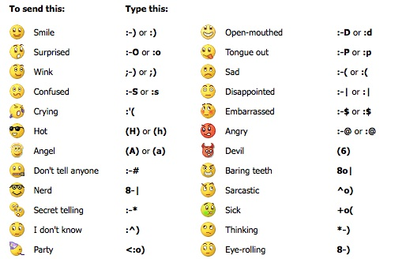

Slide 10
Clarity and Emotion practice
I can’t come to work because I am sick. (to your boss)
I want to change my exam time (to your professor)
I DON’T WANT TO SEE THAT MOVIE!!! :@ ( to your new friend)
Your assignment was TERRIBLE! DO IT AGAIN! ( a teacher to a student)

Slide 11
TIPS
When something is not possible:
will not be able to/ won’t be able to
Asking for permission to do something:
Would you mind if…?
Would it be possible to…?
Requesting something:
Could you please
Would you mind (gerund)….?

Slide 12
Example
I’m sorry Prof. G, I will not be able to attend class tomorrow. Would it be possible to hand in the assignment one day late?

Slide 13
Final Task
Yo Prof.G,
My bus is LATE! I AM GOING TO BE LATE FOR CLASS!!! Don’t mark me as late because I don’t want to lose points!
JiSu
Send an email to Prof. G at prof.gwhitehead@gmail.com

Slide 14
Write your own message
Think of a situation
Write a message to me explaining your situation.

Slide 15
www.chatstep.com

Slide 16
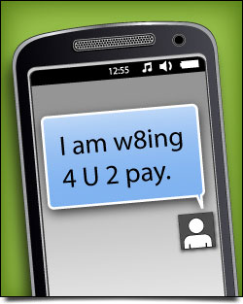
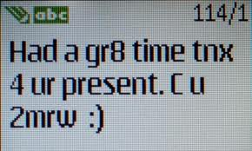
Text Messaging

Slide 18
Can you decode these texts?
4got to tell u that u looked gr8t last nite.
@ work sry ill call u l8r
R we gng 2 go Evlnd tmrow?
Pls let me kno b/c I have 2 make a resv tdy.

