Slide 1
Nice to Meet You!

Slide 2
Interviews

Slide 3
Think of some questions you want to ask….
What’s your favorite?
What kind of _____ do you like?
How many ____ do you have?
Do you_____?
Can you _____?
who, what, when, where, why, how
do, can, will etc.

Slide 4
Interview Time
45 second interview and answer
Switch role
45 seconds more
Change partners
After you have met everyone, STOP!

Slide 5
Find someone….

Slide 6
Turn to page 7.

Slide 7
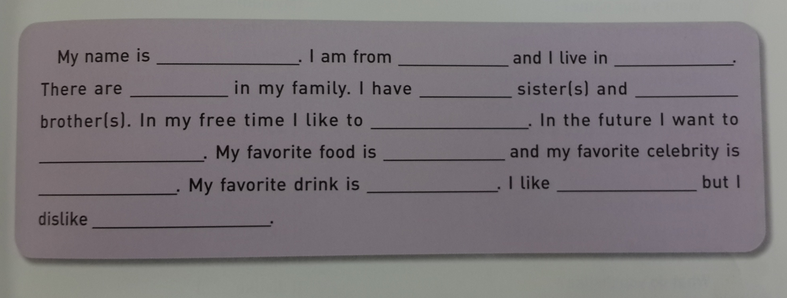
Turn to page 5.

Slide 8
Deeper Interview
A: Introduce yourself to your partner
B: ask as many questions as possible to get more details about A
Switch
You have about 5 minutes per person.

Slide 10
Interview Game

