Slide 1
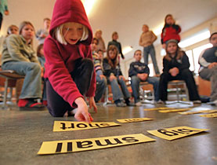
Young English Language Learners

Slide 2
What do you think?
Do adults learn English faster than young learners?.
Do children who study English early become more fluent than those who start later?
Are people who start learning language as an adult less fluent than those who start earlier?
Can YELLs learn grammar rules without being explicitly taught them?
Does allowing children to speak Korean in class help them learn better?
Does sending YELLs to an English 학원 (private academy) benefit their language acquisition?
Can playing games in English class be more effective for YELLs language growth than focused studying?
Can forced studying be detrimental to language learning?
How important is reading for young learners to development?

Slide 3
Think about it…
What are the differences between the way that adults learn and the way that children learn English?

Slide 4
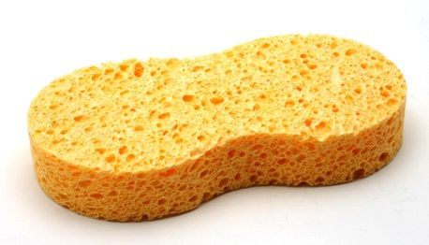
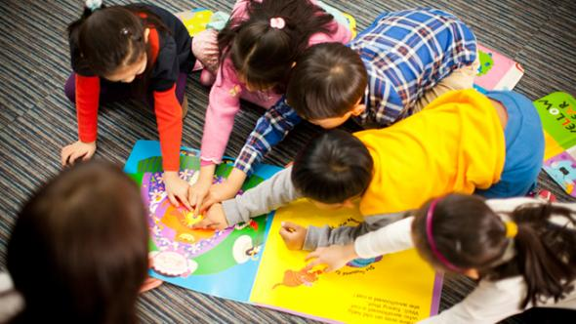
Children absorb what is around them without paying specific attention.
Adults are able to focus their attention more.

Slide 5
Who is better at learning a language?
Adults | YELLs
Can learn things faster due to focused studying and cognitive abilities. | Can learn things through absorption but sometimes take longer to develop. i.e. pronunciation
Have a well developed L1 therefore have stronger L1 influence on L2 learning | Can develop both languages at the same time and are still learning their L1
Have more obligations and less time to spend on language learning | Have more time to develop their language
Self-directed | Need someone to manage their learning environment
Have many inhibitions | Have some inhibitions

Slide 6
What do you think?
At what age do you think children should start learning English in Korea?
Is younger better? Why or Why not?

Slide 7
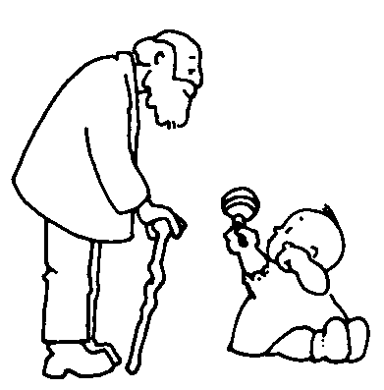
Is younger better?
Learners are never to young to be introduced and surrounded by English
Books
T.V.
Music
Games
English Toys
Learners can be too young to study it

Slide 8
Learning/ Studying
It depends how children are being taught, and how often.
Bilingual environment vs non- bilingual environment.

Slide 9
Different Environments
Bilingual environment
Non-bilingual environment

Slide 10
Bilingual environment
Parents speak different languages to the child
Parents can both speak 2 languages but one language is used in the house and the other is used outside
Parents do not speak an L2 but they live in a place which the child is exposed to the L2 and interacts in the L2
안녕하세요

Slide 11
Non-bilingual environment
Children do not get constant interactive exposure to the L2 (at least 5 hours a week)
Parents code-switch without any rules or reason
There is one dominant language that the child uses and is exposed to
?
?
?

Slide 12
Bilingual Environment
Specific rules/ guidelines must be followed to create a true bilingual setting
Who speaks which languages (one parent – one language)
When specific languages are spoken (minority language at home)
Which languages the child is expected to use
http://bilingualkidsrock.com/how-to-raise-a-bilingual/
If a true bilingual setting is not provided, both languages can suffer.

Slide 13
Non-bilingual Environment
Children should not be forced to study English at a young age but rather be surrounded by it and enjoy it. (Pull Don’t Push!)
Children should first be able to produce the language in Korean before focused studying of English.
They should start when they show interest in starting.
If children are not getting enough input then then their may be little benefit of starting early. Starting in middle school, with the right environment can produce the same results! (Ellis, 2011; Lightbown & Spada, 2013; Nunan, 2013)
Minimum of 3 hours a week, spaced out evenly (Lightbown & Spada, 2013).

Slide 14
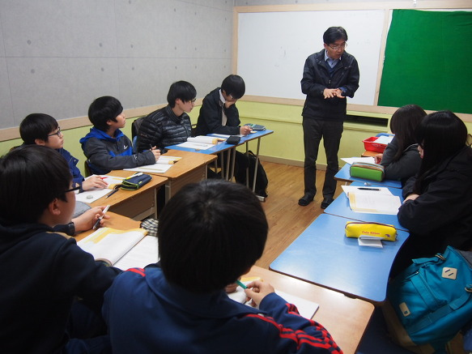
Are 학원’s beneficial to YELLS?

Slide 16
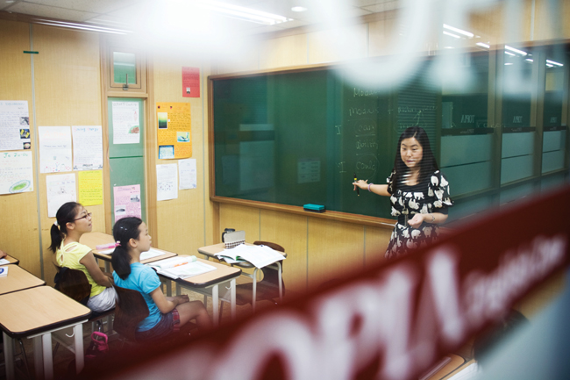
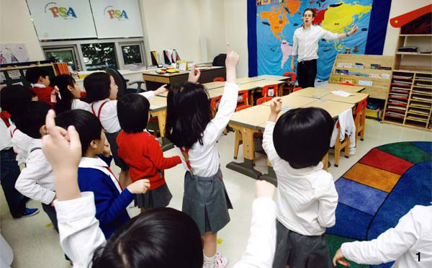
학원Checklist
How often?
Teacher qualifications
Education
Experience
Director’s background
Business vs Education
Environment
Age appropriate
Welcoming
Student centered
U-shape vs Grouping vs Rows
Education style
Interactive
Enjoyable
Activity focused
Student-centered
Materials
Interesting
Age appropriate
Interactive

Slide 17
Situational Application
Your friend is having a baby (YAY!~) They want to know your advice on the best way for them to foster a bilingual child. What would you tell them?
Your friend is considering moving to a native speaking country for a year or two with their 6 year old child to foster their English development. What advice would you give them?

Slide 18
Situational Application
Your friend is considering sending their child to an English 학원. What advice would you give them?
Your friend is bragging of their 9 year old child’s English abilities telling you that their child knows so many vocabulary words. That’s because they are sending their child to an intensive English school where they memorize 50 words a day. The child always complains that they hate English but the parents don’t care. They are satisfied with his test scores.

Slide 19
What do you think? REVIEW
Children learn language faster than adults
Children should learn English as early as possible.
Sending a child to 학원 will benefit their English development.
Forced studying can lead to excellent results in young learners English development.
Reading an English book to a child once a week will benefit their English development.
Sending a child to another country to develop their English is beneficial.
Parents who do not speak English well can not create a bilingual environment.

Slide 20
Key Points
What should the goals of a YELL teacher be?

Slide 21
Things to keep in mind when planning children’s English classes!
Surround children with English input that THEY are interested in. They will absorb it!
What is taught is not always learned and what is learned is not always taught.
It is crucial that YELLs have positive feelings towards learning English. They should enjoy what they are doing in class.
Children need to feel successful to gain confidence.
Too much focus on accuracy de-motivates learners. Try not to over correct. Only correct mistakes they leads to communicative breakdown or misunderstanding.
Classroom should facilitate and support pair and group work. (collaboration)
Peer scaffolding through L1 use can be a great tool in multi-level classrooms.

Slide 22
Suggested Reading
Lightbown, P. M., & Spada, N. (2013). How Languages are Learned 4th edition-Oxford Handbooks for Language Teachers. Oxford University Press.
Chapter 7 – pg. 204-205 – Section 5

Slide 24
The World of English

Slide 25
How could these pages be improved?

Slide 26
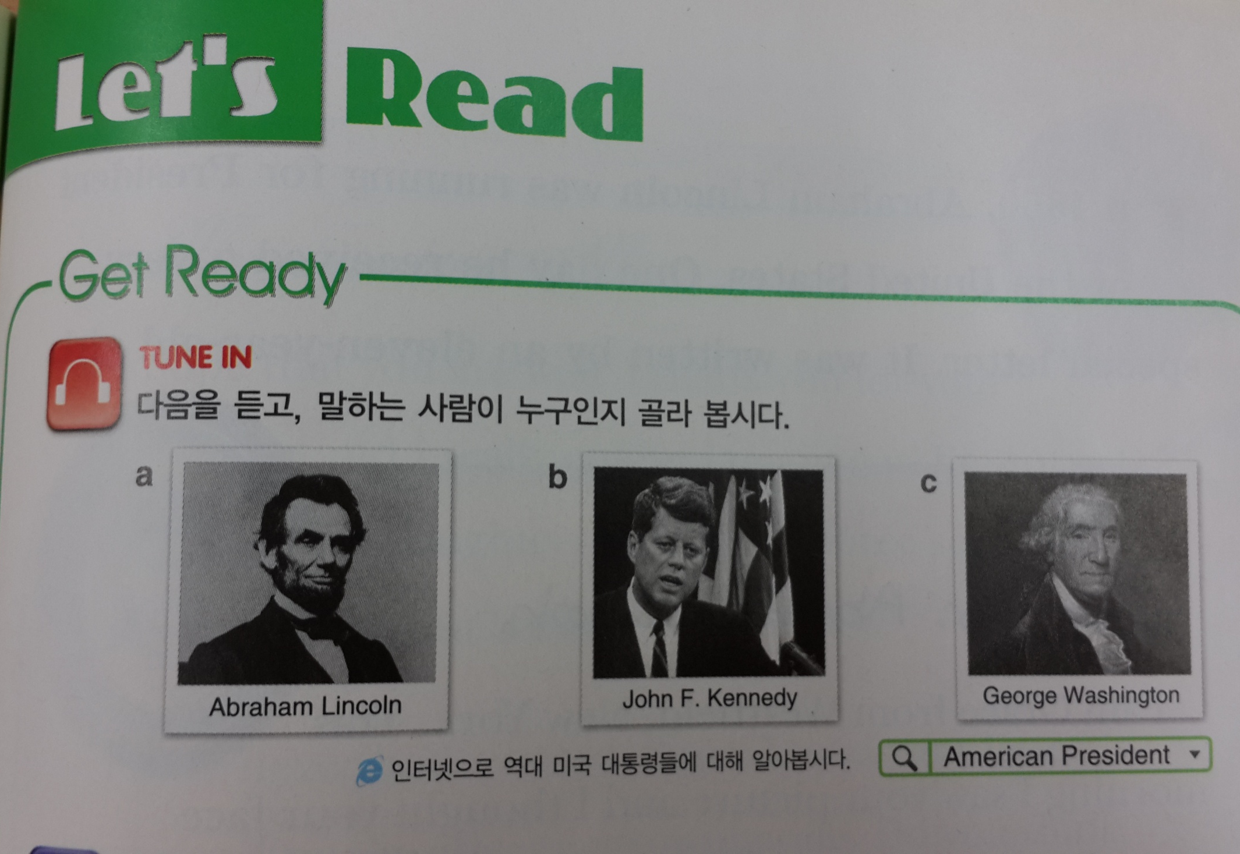

Slide 29
Native language and L1 Cultural identity (linguistico-cultural) is closely associated with the discussion of CPH, since it was found in the study that people who immigrate after 10 years of age often tend to be dominated by their own culture and language; however, the opposite result was found in the case of immigrants who are under-10 years old, they often switch their linguistico-cultural identity and transform their dominant language to the language and culture of the host country (Jia & Aaronson, 2003).

Slide 30
Among many others is Cook (2002), who argues that L2 users should be evaluated in their own rights and standards, rather than an unequal comparison with native speakers. According to him, “ultimate attainment is a monolingual standard rather than an L2 standard” (2002, p. 6)

Slide 31
The literature is mostly inclined to the notion that late learners also can be successful learners.

Slide 32
However, in a hypothetical state, we may argue that in terms of acquiring native-like pronunciation, an early start may give some advantages, nevertheless, in terms of other aspects of acquisition, any positive correlation of age was not found. If the belief holds true, the hegemony in the planning of English language policy in a second or foreign language context suggests that early introduction of a second language access needs to be re-evaluated entirely. Thus in consequence, English language teaching methodology, curriculum, material, teachers’ beliefs, and practice will face radical changes.

