Slide 1
PROJECT BASED LEARNING
Introduction

Slide 2
Getting Ready
KWL (Know, Want to Know, Learn)
  What do you know about Project Based Learning (PBL)?
  What do you want to know about PBL?
  Are there any specific questions you have about Project Based Learning (PBL)?

Slide 3
Some background on PBL
John Dewey initially promoted the idea of "learning by doing“
‘‘Doing projects’’ is a long-standing tradition in American education.
Hands on learning
Educational research has advanced this idea of teaching and learning into a methodology known as "project-based learning“.
PBL responds to the need for education to adapt to a changing world (21st century skills)

Slide 4

WARNING
Projects and PBL are not always the same.
PBL follows specific principles and has specific guidelines.

Slide 5

21st Century Skills
In your opinions, what skills do you think are important to succeed in our world today?

Slide 6
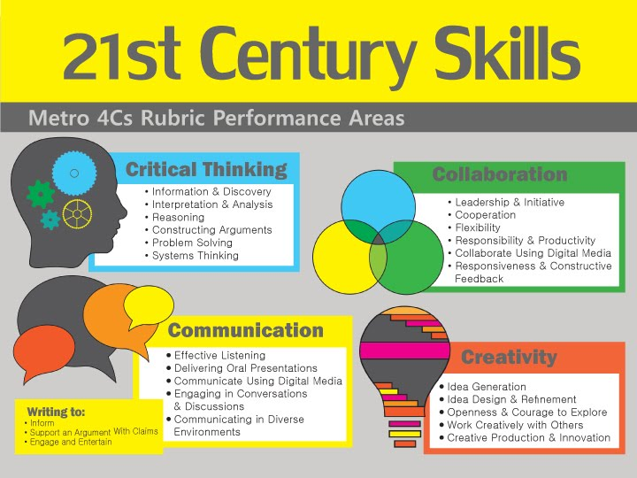

Slide 7
21st Century Skills
Critical thinking
Creativity
Collaboration
Communication
Information literacy
Media literacy
Technology literacy
Flexibility
Leadership
Initiative
Productivity
Social skills
https://www.aeseducation.com/career-readiness/what-are-21st-century-skills

Slide 8
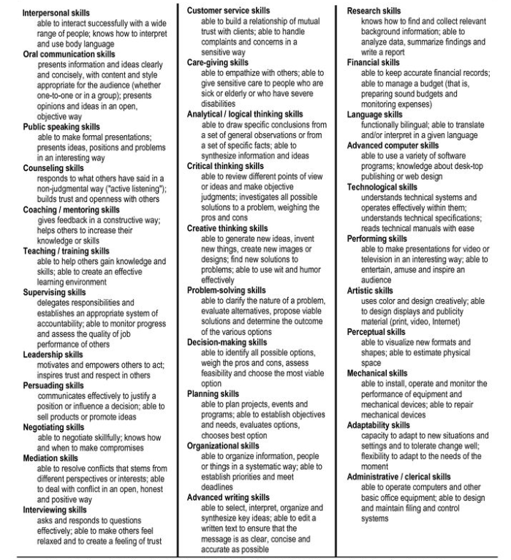
For a more comprehensive list
www.profgwhitehead.weebly.com

Slide 9
Project Based Learning

Slide 10
Original PBL Flow
1) Entry event ( Reading, Video, Story, Discussion, Pictures, etc.)
2) Teacher gives students a driving question (Kind of like a research question)
3) The students take time discussing the driving question and thinking about a project they can do
4) Each group chooses their own project
5) Students work on the project in groups
6) Students present their project
7) Students get feedback
8) Students present again

Slide 11
PBL Story
A 10th grade group of students are preparing to send care packages to a local nursing home and senior community center.
The students are answering the question, “How can we help our community?” Early in the project, youth discussed what they thought this question means and ways to answer it.
They decided to create care packages because of recent news reports. Since then, they have interviewed elderly family members as to identify useful items, and they have done some internet searches to find what common supplies elderly individuals often need.
They will deliver the care packages and give hand-written letters to those at the nursing home.

Slide 12
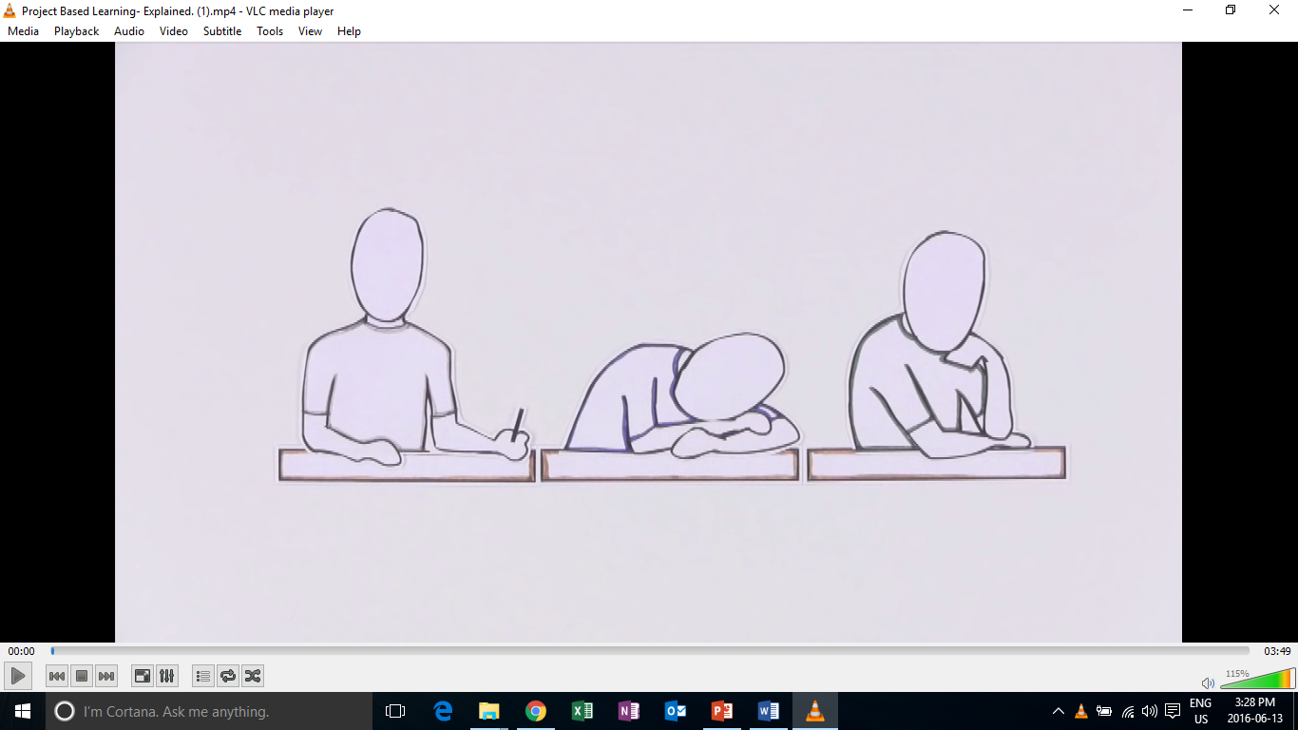
Introduction to PBL

Slide 13
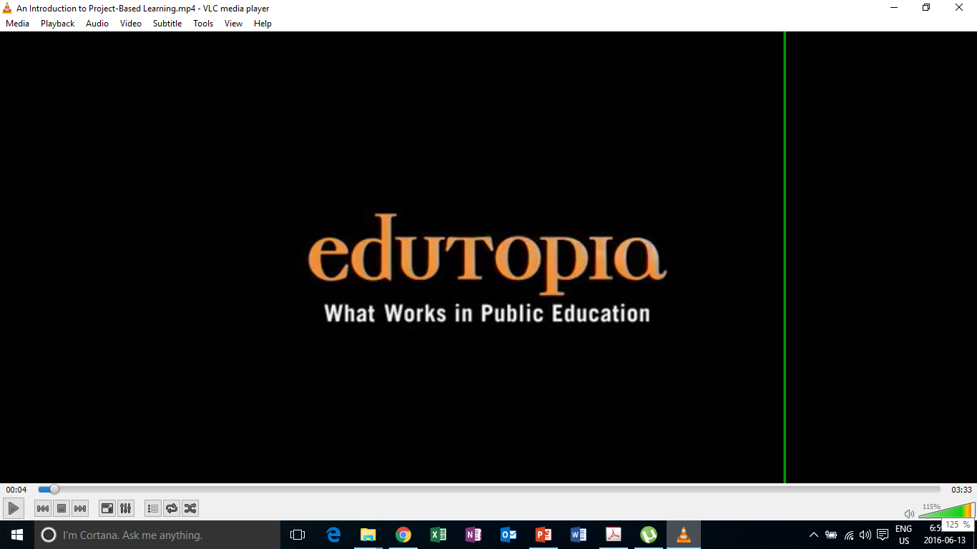
PBL in Action

Slide 14
Education in the 21st Century
The old-school model of passively learning facts and reciting them out of context is no longer sufficient to prepare students to survive in today's world.
Solving highly complex problems requires that students have both fundamental skills (reading, writing, math, science, etc. ) and 21st century skills.

Slide 15
What is project based learning?
Project-based learning if founded in the beliefs that students learn best by experiencing and dealing with real-world issues that are meaningful to them .
"One of the major advantages of project work is that it makes school more like real life. It's an in-depth investigation of a real-world topic worthy of children's attention and effort.“
-EDUCATION RESEARCHER SYLVIA CHARD

Slide 16
What does PBL involve?
students focused on real-world meaningful issues and problem solving
Skills that transfer outside of the classroom
increased student control over his or her learning
teachers serving as coaches and facilitators of inquiry and reflection
students (usually, but not always) working in pairs or groups
(Barron & Darling-Hammond, 2008; Thomas, 2000)

Slide 17
Research Findings
PBL vs. Traditional instruction
  PBL increases long-term retention of content, helps students perform as well as or better than traditional learners in high-stakes tests, improves problem-solving and collaboration skills, and improves students' attitudes towards learning (Strobel & van Barneveld, 2009; Walker & Leary, 2009).
  Schools where PBL is practiced find a decline in absenteeism, an increase in cooperative learning skills, and improvement in student achievement. When technology is used to promote critical thinking and communication, these benefits are enhanced.

Slide 18
Experiencing Project Based Learning
Sample Lesson

Slide 19
Topic (English Education)
Real-world problems
  In Korea, people spend more time and money on English education than any other country in the world.
  Still the overall proficiency and ability to use English in the real-world is relatively low.

Slide 20
Driving questions
What can be done to produce more proficient English learners within the current situation?

Slide 21
Project design questions
What can students do/ create/ design to address some of the issues in the current education system?

Slide 22
Project
You and your groupmates have decided to open your own private English school for middle and high-school students because you are not satisfied with the current state of English education in Korea.
You will meet with parents and potential learners to tell them about your school. Think about the following details:
    The aims of your school.
    They types of courses/ lessons your school will offer. (4-5)
    A weekly schedule.
    Why people should enroll in your school.
 | Monday | Tuesday | Wednesday | Thursday | Friday
5:00-5:50 pm | Dance
6:00-6:50 pm | Storytime

Slide 23
Reflection
Positive and negative points of PBL?
Challenges you face?
Additional questions?

Slide 24
Creating a Project

Slide 25
Original PBL Flow
1) Entry event ( Reading, Video, Story, Discussion, Pictures, etc.)
2) Teacher gives students a driving question (Kind of like a research question)
3) The students take time discussing the driving question and thinking about a project they can do
4) Each group chooses their own project
5) Students work on the project in groups
6) Students present their project
7) Students get feedback
8) Students present again

Slide 26
PBL Lesson Example
Students watch a video, read, or see pictures about global warming.
Teacher discusses the topic with students
Teacher puts the driving question on the board “ What daily actions of humans are contributing most to global warming?” (Students discuss)
Teacher then asks students to think about “ what can your group do to raise other students awareness of this trash issue?”
Some groups choose a video, some choose a poster, one groups chooses brochure
They create it
They present/share it
They get feedback and revise
Present again

Slide 27
Revised PBL for Korean English Classrooms
Entry event
  Discussion of the topic & problem that will be focused on
Teacher gives the students a project to do
Students work on the project in groups
Students present the project

Slide 28
Teacher’s job
Technology
What is a problem or issue related to the topic that is relevant and relatable to my students?
What kind of project can students do to address the problem?
How will they present it?
How will it be assessed?

Slide 29
Project task ideas (try to think of more)
Design
  A new product
  A new way of doing something
  A better something (menu, phone, etc.)
Make/ Create
  A plan
  A poster
  A storybook
  A brochure
  An advertisement
  A video
  A play/ drama
Build
  A model
  A structure
Write
  A letter
  A poem
  A short story
  A book
  A speech
  Rewrite something
Prepare
  To present your ideas
  To debate
  To teach a lesson

Slide 30
General Topics from Textbooks
What are some general topics of themes that you cover in your classes or that are in the textbooks you use?

Slide 31
Food
Travel
Health & Beauty
Other?
What is a problem or issue related to the topic that is relevant and relatable to my students?
What kind of project can students do to address the problem?
How will they present it?
How will it be assessed?
TIP:
Think about issues in your school, community, current events, student’s lives and interests.

Slide 32
How will it be presented?
As a presentation in front of the class
A performance
As a video
Group to group
Roundtable
Panel
Jigsaw
Gallery walk
Rotation fair (my favorite)
TIP:(graphic organizer for audience)

Slide 33
Assessment in PBL Lessons

Slide 34
Performative
Based on 21st century skills

Slide 35
When to assess…
The process
The product
The presentation
As a whole

Slide 36
Analytic Vs. Holistic Rubrics
Analytic rubrics list the criteria for an assignment and describe these criteria in varying levels of quality.
A holistic rubric describes the attributes of each grade or level. It gives an overall score rather than breaking things down and scoring each criteria.
  Most student work will likely fit into more than one category for different criteria. The scorer must choose the grade that best fits the student performance.

Slide 37
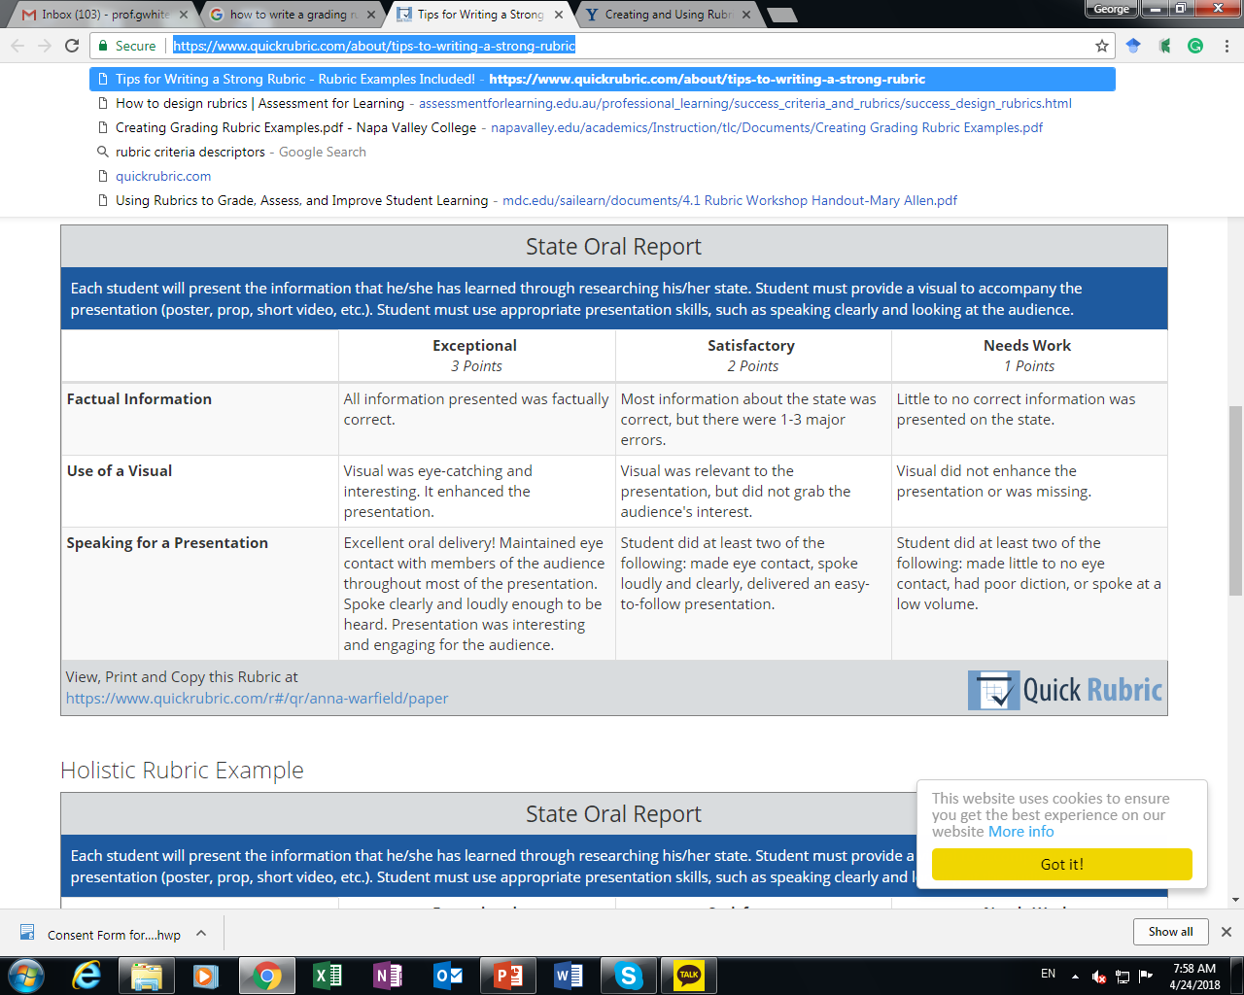
Analytic Rubric Sample

Slide 38
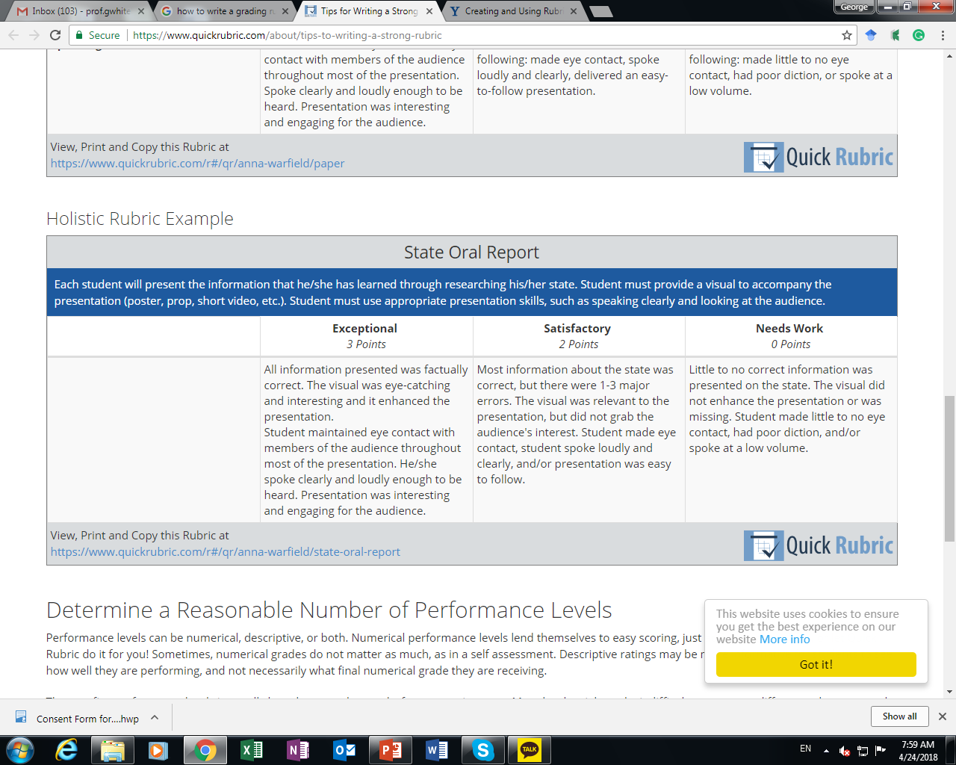
Holistic Rubric Sample

Slide 39
When to assess…
During the process?
  What can be assessed?
The product?
  What can be assessed?
The presentation
  What can be assessed?

Slide 40
What can be assessed?
In the process
  Collaboration
  Participation
  Use of L2
The product
  Language accuracy
  Organization
  Design
  Creativity
  Overall quality
The presentation
  Comprehensibility
  Accuracy
  Organization/Flow

Slide 41
Blank Rubric
Criteria | 4 | 3 | 2 | 1 | Student’s Score

Slide 42
Wording
Always
Often
Sometimes
Rarely
Never
Above expectations/ requirements
Meets expectations/ requirements
Does not meet expectations/ requirements
Excellent
Very good
Satisfactory
Less than satisfactory
Exceptional
Satisfactory
Needs work
High level
Satisfactory level
Low level
Less than/ more than x number of something

Slide 43
5 | 4 | 3 | 2 | 1
Always | Often | Sometimes | Rarely | Never
Above |  | Meets |  | Does not meet
Excellent | Very good | Satisfactory | Less than satisfactory | Poor
Exceptional |  | Satisfactory |  | Needs work
High level |  | Satisfactory level |  | Low level
Less that 3 mistakes |  | 3-5 mistakes |  | More than 5 mistakes
More than 5 times |  | 3-5 times |  | Less than 3 times

Slide 44
Sample Projects

Slide 45
Critical Thinking
UNIT: The Community
  1. Choose a name for your city
  2. Make a list of important places in the city and put them in alphabetical order
  3. Make a map of your city and mark where the important places are

Slide 46
Critical Thinking
UNIT: Jobs
  1. I will give each group a job card
  2. Individually make a job advertisement for that job
  3. You should include a job description , salary (based on real world information )and the types of people you want to recruit.
  4. Share your job advertisement individually in front of the class

Slide 47
Project
Designing projects for your classrooms

Slide 48
Project
With your group choose 1 chapter from a public school textbook of your choice. Create a project for each chapter following PBL guidelines. Think about:
  What is a problem or issue related to the topic that is relevant and relatable to my students?
  What kind of project can students do to address the problem?
  How will they present it?
  How will it be assessed?
You will share your PBL lessons in a PBL fair and receive comments and feedback from your peers and professor

Slide 49
Project Fair
Presentations and feedback

Slide 50
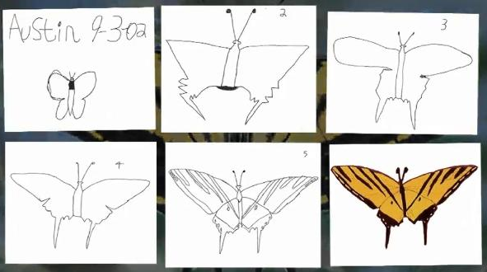
Austin’s Butterfly

Slide 51
Revisions
Reflecting on your project
Redrafting your original design
Refining your project
Building Excellence in Student Work (Austin’s Butterfly)

Slide 52
Final Reflection
Practicality of implementation

Slide 53
Reflection
How can teachers implement PBL in English language classrooms in South Korea?
  How practical do you think PBL is in the Korean context (very practical, somewhat practical, not practical)? Why?
  What are some of the possible difficulties with using PBL in your classroom?
  How could these difficulties be resolved?

Slide 54
Useful Websites
www.bie.org
http://www.leadingpbl.org/w/page/24328306/PBL%20Gallery
https://21centuryedtech.wordpress.com/2013/09/15/the-pbl-super-highway-over-45-links-to-great-project-based-learning/
http://www.elltoolbox.com/pbl.html
http://www.mrsoshouse.com/pbl/pblin.html

