Slide 1
PROJECT BASED LEARNING
Introduction

Slide 2
Some background on PBL
John Dewey initially promoted the idea of "learning by doing“
‘‘Doing projects’’ is a long-standing tradition in American education.
Hands on learning
Educational research has advanced this idea of teaching and learning into a methodology known as "project-based learning“.
PBL responds to the need for education to adapt to a changing world (21st century skills)

Slide 3
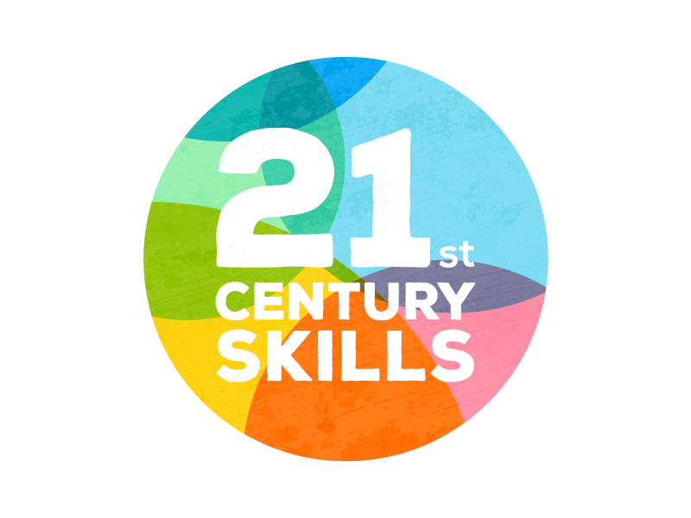
21st Century Skills
In your opinions, what skills do you think are important to succeed in our world today?

Slide 4
21st Century Skills
personal and social responsibility
planning, critical thinking, reasoning, and creativity
strong communication skills, both for interpersonal and presentation needs
cross-cultural understanding
visualizing and decision making
knowing how and when to use technology and choosing the most appropriate tool for the task

Slide 5
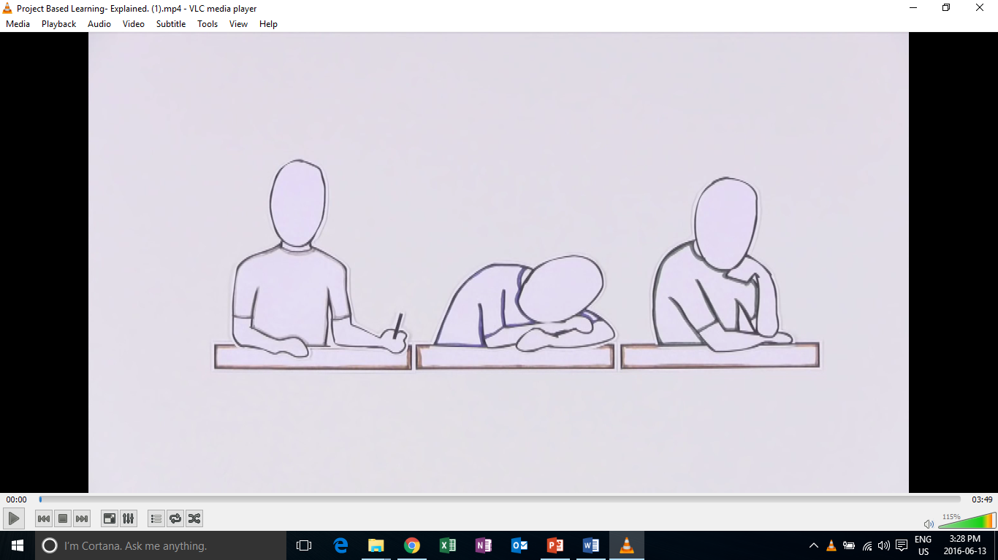
Introduction to PBL

Slide 6
PBL in Action

Slide 7
Education in the 21st Century
The old-school model of passively learning facts and reciting them out of context is no longer sufficient to prepare students to survive in today's world.
Solving highly complex problems requires that students have both fundamental skills (reading, writing, and math) and 21st century skills (teamwork, problem solving, research gathering, time management, information synthesizing, utilizing high tech tools).

Slide 8
What is project based learning?
Project-based learning if founded in the beliefs that students learn best by experiencing and dealing with real-world issues that are meaningful to them .
"One of the major advantages of project work is that it makes school more like real life. It's an in-depth investigation of a real-world topic worthy of children's attention and effort.“
-EDUCATION RESEARCHER SYLVIA CHARD

Slide 9
What does PBL involve?
students focused on real-world meaningful issues and problem solving
Skills that transfer outside of the classroom
increased student control over his or her learning
teachers serving as coaches and facilitators of inquiry and reflection
students (usually, but not always) working in pairs or groups
(Barron & Darling-Hammond, 2008; Thomas, 2000)

Slide 10
Learning Outcomes
PBL vs. Traditional instruction
PBL increases long-term retention of content, helps students perform as well as or better than traditional learners in high-stakes tests, improves problem-solving and collaboration skills, and improves students' attitudes towards learning (Strobel & van Barneveld, 2009; Walker & Leary, 2009).
Schools where PBL is practiced find a decline in absenteeism, an increase in cooperative learning skills, and improvement in student achievement. When technology is used to promote critical thinking and communication, these benefits are enhanced.

Slide 11
Discussion
What are some obstacles to PBL in your teaching context?

Slide 12
Creating a Project

Slide 13
Original PBL Flow
1) Entry event ( Reading, Video, Story, Discussion, Pictures, etc.)
2) Teacher gives students a driving question (Kind of like a research question)
3) The students take time discussing the driving question and thinking about a project they can do
4) Each group chooses their own project
5) Students work on the project in groups
6) Students present their project
7) Students get feedback
8) Students present again

Slide 14
PBL Lesson Example
Students watch a video, read, or see pictures about global warming.
Teacher discusses the topic with students
Teacher puts the driving question on the board “ What daily actions of humans are contributing most to global warming?” (Students discuss)
Teacher then asks students to think about “ what can your group do to raise other students awareness of this trash issue?”
Some groups choose a video, some choose a poster, one groups chooses brochure
They create it
They present/share it
They get feedback and revise
Present again

Slide 15
Revised PBL
Entry event
Discussion of the topic & problem that will be focused on
Teacher gives the students a project to do
Students work on the project in groups
Students present the project

Slide 16
Teacher’s job
Technology
What is a problem or issue related to the topic that is relevant and relatable to my students?
What kind of project can students do to address the problem?
How will they present it?
How will it be assessed?

Slide 17
Project task ideas (try to think of more)
Design
A new product
A new way of doing something
A better something (menu, phone, etc.)
Make/ Create
A plan
A poster
A storybook
A brochure
An advertisement
A video
A play/ drama
Build
A model
A structure
Write
A letter
A poem
A short story
A book
A speech
Rewrite something
Prepare
To present your ideas
To debate
To teach a lesson

Slide 18
General Topics from Textbooks
What are some general topics of themes that you cover in your classes or that are in the textbooks you use?

Slide 19
Food
Travel
Health & Beauty
Other?
What is a problem or issue related to the topic that is relevant and relatable to my students?
What kind of project can students do to address the problem?
How will they present it?
How will it be assessed?
TIP:
Think about issues in your school, community, current events, student’s lives and interests.

Slide 20
How will it be presented?
As a presentation in front of the class
A performance
As a video
Group to group
Roundtable
Panel
Jigsaw
Gallery walk
Rotation fair (my favorite)
TIP:(graphic organizer for audience)

Slide 21
Assessment in PBL Lessons

Slide 22
Performative
Based on 21st century skills

Slide 23
When to assess…
The process
The product
The presentation
As a whole

Slide 24
Analytic Vs. Holistic Rubrics
Analytic rubrics list the criteria for an assignment and describe these criteria in varying levels of quality.
A holistic rubric describes the attributes of each grade or level. It gives an overall score rather than breaking things down and scoring each criteria.
Most student work will likely fit into more than one category for different criteria. The scorer must choose the grade that best fits the student performance.

Slide 25
Analytic Rubric Sample

Slide 26
Holistic Rubric Sample

Slide 27
When to assess…
During the process?
What can be assessed?
The product?
What can be assessed?
The presentation
What can be assessed?

Slide 28
What can be assessed?
In the process
Collaboration
Participation
Use of L2
The product
Language accuracy
Organization
Design
Creativity
Overall quality
The presentation
Comprehensibility
Accuracy
Organization/Flow

Slide 29
Blank Rubric
Criteria | 4 | 3 | 2 | 1 | Student’s Score

Slide 30
Project
Designing projects for your classrooms

Slide 31
TASK
With your group choose a chapter from a public school textbook of your choice. Design a project based lesson for a chapter following PBL guidelines. Think about:
Entry events (Video, Readings, Main chapter theme, Dialogue, Discussions etc.)
Real-world problem and connection to students
Project details (Specifics of the project)
How learners will share their projects
How it will be assessed

Slide 32
Useful Websites
www.bie.org
http://www.leadingpbl.org/w/page/24328306/PBL%20Gallery
https://21centuryedtech.wordpress.com/2013/09/15/the-pbl-super-highway-over-45-links-to-great-project-based-learning/
http://www.elltoolbox.com/pbl.html
http://www.mrsoshouse.com/pbl/pblin.html

