Slide 1
PROJECT BASED LEARNING
Introduction

Slide 2
Getting Ready
KWL (Know, Want to Know, Learn)
  What do you know about Project Based Learning (PBL)?
  What do you want to know about PBL?
Are there any specific questions you have about Project Based Learning (PBL)?

Slide 3
Some background on PBL
John Dewey initially promoted the idea of "learning by doing“
‘‘Doing projects’’ is a long-standing tradition in American education.
Hands on learning
Educational research has advanced this idea of teaching and learning into a methodology known as "project-based learning“.
PBL responds to the need for education to adapt to a changing world (21st century skills)

Slide 4

WARNING
Projects and PBL are not always the same.
PBL has specific guidelines.

Slide 5

21st Century Skills
In your opinions, what skills do you think are important to succeed in our world today?

Slide 6
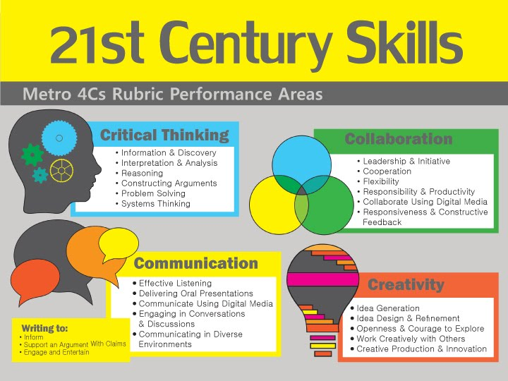

Slide 7
21st Century Skills
personal and social responsibility
planning, critical thinking, reasoning, and creativity
strong communication skills, both for interpersonal and presentation needs
cross-cultural understanding
visualizing and decision making
knowing how and when to use technology

Slide 8
PBL Story
A 10th grade group of students are preparing to send care packages to a local nursing home and senior community center.
The students are answering the question, “How can we help our community?” Early in the project, youth discussed what they thought this question means and ways to answer it.
They decided to create care packages because of recent news reports. Since then, they have interviewed elderly family members as to identify useful items, and they have done some internet searches to find what common supplies elderly individuals often need.
They will deliver the care packages and give hand-written letters to those at the nursing home.

Slide 9
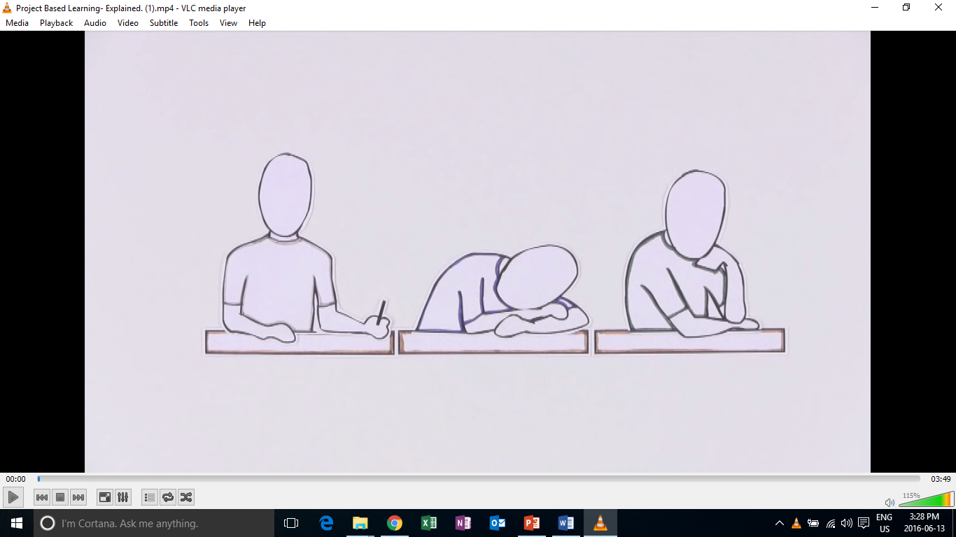
Introduction to PBL

Slide 10
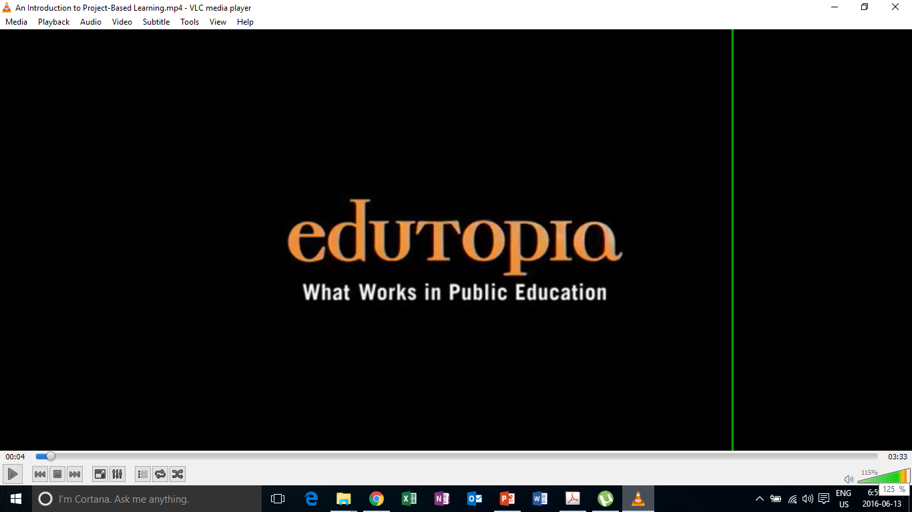
PBL in Action

Slide 11
Education in the 21st Century
The old-school model of passively learning facts and reciting them out of context is no longer sufficient to prepare students to survive in today's world.
Solving highly complex problems requires that students have both fundamental skills (reading, writing, and math) and 21st century skills (teamwork, problem solving, research gathering, time management, information synthesizing, utilizing high tech tools).

Slide 12
What is project based learning?
Project-based learning if founded in the beliefs that students learn best by experiencing and dealing with real-world issues that are meaningful to them .
"One of the major advantages of project work is that it makes school more like real life. It's an in-depth investigation of a real-world topic worthy of children's attention and effort.“
-EDUCATION RESEARCHER SYLVIA CHARD

Slide 13
What does PBL involve?
students focused on real-world meaningful issues and problem solving
Skills that transfer outside of the classroom
increased student control over his or her learning
teachers serving as coaches and facilitators of inquiry and reflection
students (usually, but not always) working in pairs or groups
(Barron & Darling-Hammond, 2008; Thomas, 2000)

Slide 14

Problem Based vs. Project Based
Both are inquiry based teaching methods
Inquiry-based teaching methods engage students in creating, questioning, and revising knowledge, while developing their skills in critical thinking, collaboration, communication, reasoning, synthesis, and resilience (Barron & Darling-Hammond, 2008).
Problem-based learning, focuses on solving a problem but doesn't necessarily include a student project.
Project-based learning involves a task and some form of student presentation, and/or creating an actual product or artifact.

Slide 15
Learning Outcomes
PBL vs. Traditional instruction
  PBL increases long-term retention of content, helps students perform as well as or better than traditional learners in high-stakes tests, improves problem-solving and collaboration skills, and improves students' attitudes towards learning (Strobel & van Barneveld, 2009; Walker & Leary, 2009).
  Schools where PBL is practiced find a decline in absenteeism, an increase in cooperative learning skills, and improvement in student achievement. When technology is used to promote critical thinking and communication, these benefits are enhanced.

Slide 16
Project Based Learning
PBL experience

Slide 17
Topic (English Education)
Real-world problems
  In Korea, people spend more time and money on English education than any other country in the world.
  Still the overall proficiency and ability to use English in the real-world is relatively low.

Slide 18
Driving questions
What can be done to produce more proficient English learners within the current situation?

Slide 19
Project design questions
What can students do/ create/ design to address some of the issues in the current education system?

Slide 20
Project
You and your groupmates have decided to open your own private English school for middle and high-school students because you are not satisfied with the current state of English education in Korea.
You will meet with parents and potential learners to tell them about your school. Think about the following details:
    The aims of your school.
    They types of courses your school will offer. (4-5)
    The types of lessons your school conducts.
    A weekly schedule.
    Why people should enroll in your school.
 | Monday | Tuesday | Wednesday | Thursday | Friday
5:00-5:50 pm | Dance
6:00-6:50 pm | Storytime

Slide 21
MFI | LDL | MFO/ FD
Reading | Grammar
 | Words | Speaking/Writing
Listening | Etc.

Slide 22
Reflection
Positive and negative points of PBL?
Challenges you face?
Additional questions?

Slide 23
Keys to Successful Projects

Slide 24

Key 1: Meaningful projects
Many students find schoolwork meaningless because they don’t perceive a need to know what they’re being taught. Students must perceive the work as personally meaningful. (Relevant, Relatable, Interesting)

Slide 25
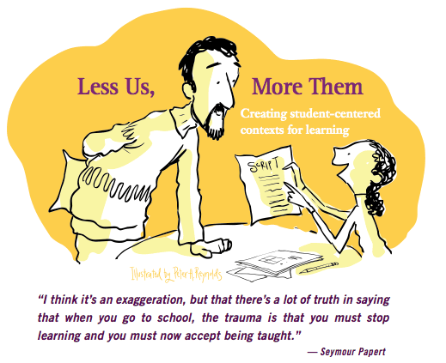
Key 2: Student voice and choice
In terms of making a project feel meaningful to students, the more voice and choice, the better. As teachers and students become more familiar with PBL, teachers can increasingly release “control” and become more of a facilitator.
From guide to Facilitator

Slide 26

Key 3: Time (Enough but not too much)
It is important to give students enough time to generate and share their ideas with one another. However, without any time constraints learners may have a hard time getting things done. Monitor time closely and adjust the time as needed by learners.

Slide 27

Key 4: Sharing
When students know that the work they are creating in a project will be shared they usually put more effort into things as their pride is at stake. Projects can be shared in may different ways, varying the ways in which projects are shared can add diversity to the process.

Slide 28
Creating a Project

Slide 29
Original PBL Flow
1) Entry event ( Reading, Video, Story, Discussion, Pictures, etc.)
2) Teacher gives students a driving question (Kind of like a research question)
3) The students take time discussing the driving question and thinking about a project they can do
4) Each group chooses their own project
5) Students work on the project in groups
6) Students present their project
7) Students get feedback
8) Students present again

Slide 30
PBL Lesson Example
Students watch a video, read, or see pictures about global warming.
Teacher discusses the topic with students
Teacher puts the driving question on the board “ What daily actions of humans are contributing most to global warming?” (Students discuss)
Teacher then asks students to think about “ what can your group do to raise other students awareness of this trash issue?”
Some groups choose a video, some choose a poster, one groups chooses brochure
They create it
They present/share it
They get feedback and revise
Present again

Slide 31
Revised PBL
Entry event
  Discussion of the topic & problem that will be focused on
Teacher gives the students a project to do
Students work on the project in groups
Students present the project

Slide 32
Teacher’s job
Technology
What is a problem or issue related to the topic that is relevant and relatable to my students?
What kind of project can students do to address the problem?
How will they present it?
How will it be assessed?

Slide 33
Project task ideas (try to think of more)
Design
  A new product
  A new way of doing something
  A better something (menu, phone, etc.)
Make/ Create
  A plan
  A poster
  A storybook
  A brochure
  An advertisement
  A video
  A play/ drama
Build
  A model
  A structure
Write
  A letter
  A poem
  A short story
  A book
  A speech
  Rewrite something
Prepare
  To present your ideas
  To debate
  To teach a lesson

Slide 34
General Topics from Textbooks
What are some general topics of themes that you cover in your classes or that are in the textbooks you use?

Slide 35
Food
Travel
Health & Beauty
Other?
What is a problem or issue related to the topic that is relevant and relatable to my students?
What kind of project can students do to address the problem?
How will they present it?
How will it be assessed?
TIP:
Think about issues in your school, community, current events, student’s lives and interests.

Slide 36
How will it be presented?
As a presentation in front of the class
A performance
As a video
Group to group
Roundtable
Panel
Jigsaw
Gallery walk
Rotation fair (my favorite)
TIP:(graphic organizer for audience)

Slide 37
Assessment in PBL Lessons

Slide 38
Performative
Based on 21st century skills

Slide 39
When to assess…
The process
The product
The presentation
As a whole

Slide 40
Analytic Vs. Holistic Rubrics
Analytic rubrics list the criteria for an assignment and describe these criteria in varying levels of quality.
A holistic rubric describes the attributes of each grade or level. It gives an overall score rather than breaking things down and scoring each criteria.
  Most student work will likely fit into more than one category for different criteria. The scorer must choose the grade that best fits the student performance.

Slide 41
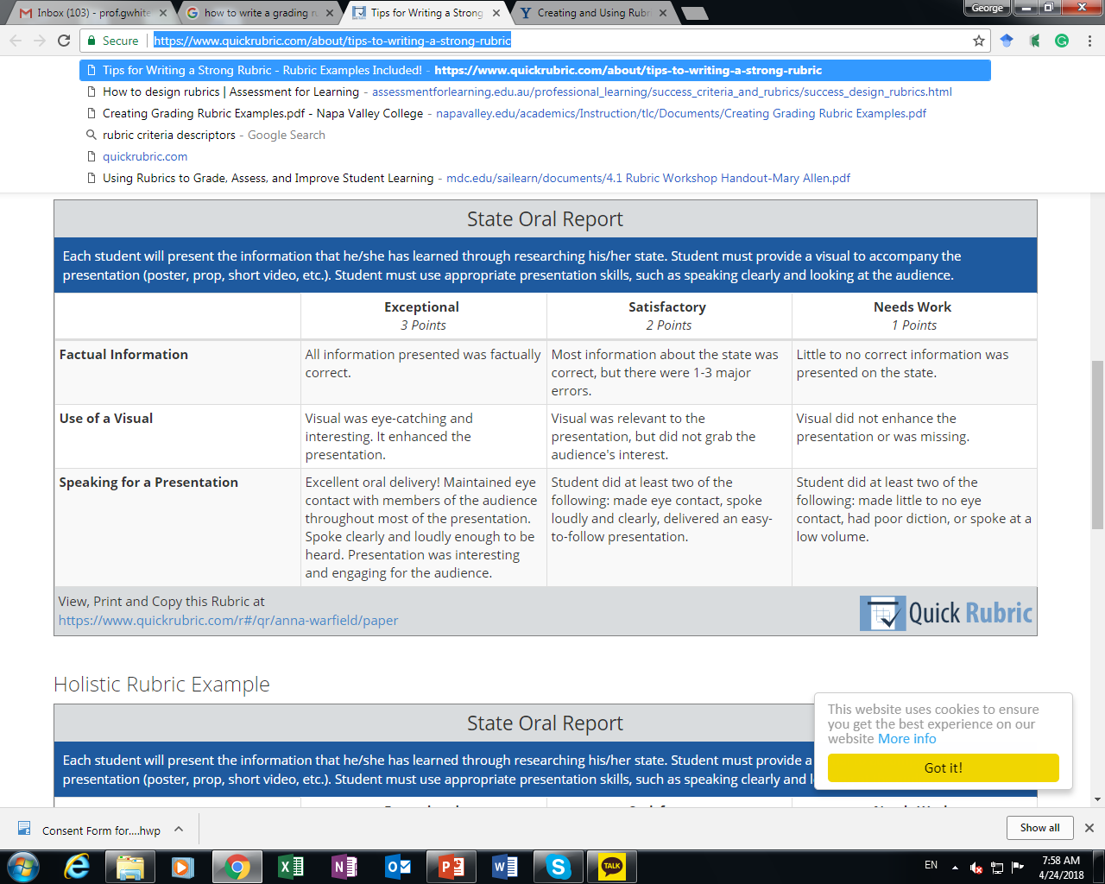
Analytic Rubric Sample

Slide 42
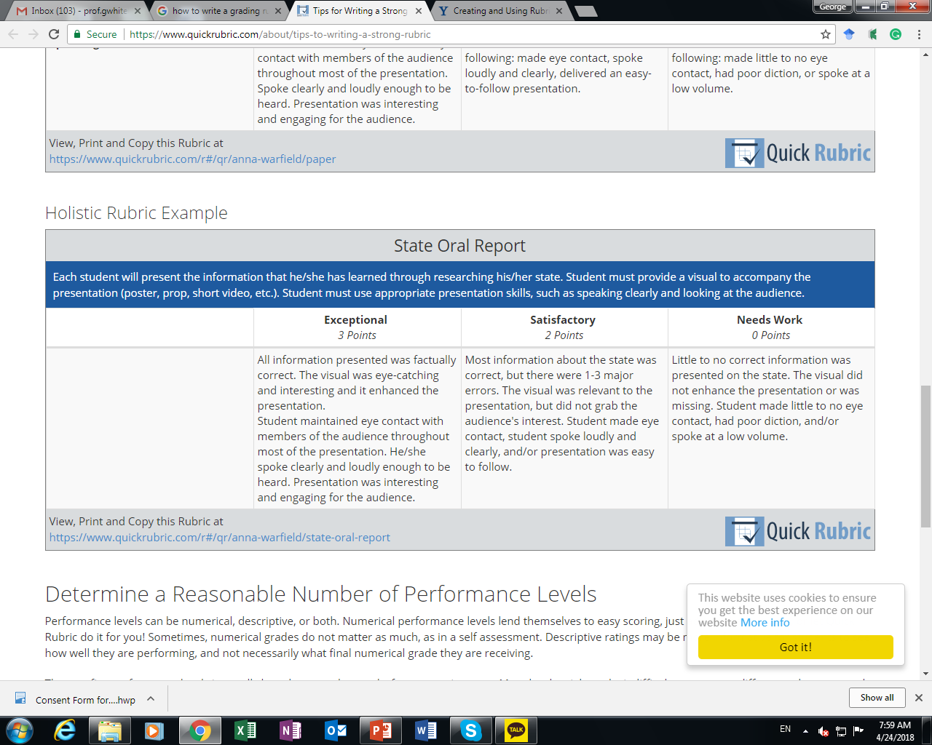
Holistic Rubric Sample

Slide 43
When to assess…
During the process?
  What can be assessed?
The product?
  What can be assessed?
The presentation
  What can be assessed?

Slide 44
What can be assessed?
In the process
  Collaboration
  Participation
  Use of L2
The product
  Language accuracy
  Organization
  Design
  Creativity
  Overall quality
The presentation
  Comprehensibility
  Accuracy
  Organization/Flow

Slide 45
Blank Rubric
Criteria | 4 | 3 | 2 | 1 | Student’s Score

Slide 46
Wording
Always
Often
Sometimes
Rarely
Never
Above expectations/ requirements
Meets expectations/ requirements
Does not meet expectations/ requirements
Excellent
Very good
Satisfactory
Less than satisfactory
Exceptional
Satisfactory
Needs work
High level
Satisfactory level
Low level
Less than/ more than x number of something

Slide 47
5 | 4 | 3 | 2 | 1
Always | Often | Sometimes | Rarely | Never
Above |  | Meets |  | Does not meet
Excellent | Very good | Satisfactory | Less than satisfactory | Poor
Exceptional |  | Satisfactory |  | Needs work
High level |  | Satisfactory level |  | Low level
Less that 3 mistakes |  | 3-5 mistakes |  | More than 5 mistakes
More than 5 times |  | 3-5 times |  | Less than 3 times

Slide 48
Sample Projects

Slide 49
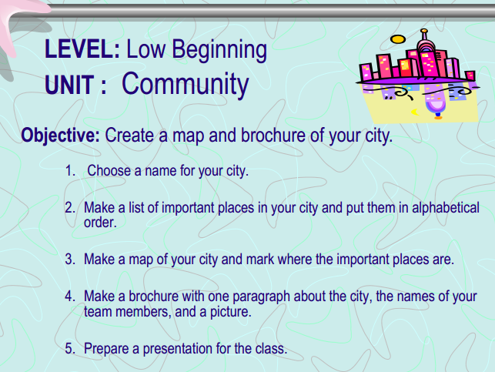
Critical Thinking
UNIT: The Community
  1. Choose a name for your city
  2. Make a list of important places in the city and put them in alphabetical order
  3. Make a map of your city and mark where the important places are

Slide 50
Critical Thinking
UNIT: Jobs
  1. I will give each group a job card
  2. Individually make a job advertisement for that job
  3. You should include a job description , salary (based on real world information )and the types of people you want to recruit.
  4. Share your job advertisement individually in front of the class

Slide 51
Task
With your group, choose 2 of the following projects and revise them to fit the guidelines of PBL. Focus on the following:
  Entry events
  Real-world connection
  Driving questions
  Project details
  How learners will share their projects
  Fashion
  Travel
  Festivals
  Technology
  Relationships
  Family
  Hobbies

Slide 52
Project
Designing projects for your classrooms

Slide 53
Project
With your group choose 1 chapter from a public school textbook of your choice. Create a project for each chapter following PBL guidelines. Think about:
  What is a problem or issue related to the topic that is relevant and relatable to my students?
  What kind of project can students do to address the problem?
  How will they present it?
  How will it be assessed?
You will share your PBL lessons in a PBL fair and receive comments and feedback from your peers and professor

Slide 54
Project Fair
Presentations and feedback

Slide 55
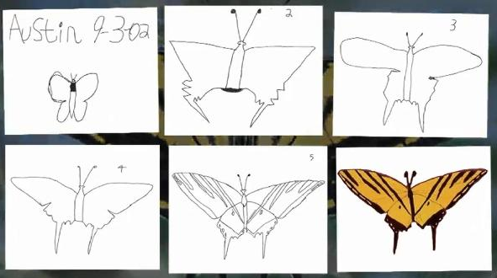
Austin’s Butterfly

Slide 56
Revisions
Reflecting on your project
Redrafting your original design
Refining your project
Building Excellence in Student Work (Austin’s Butterfly)

Slide 57
Final Reflection
Practicality of implementation

Slide 58
Reflection
How can teachers implement PBL in English language classrooms in South Korea?
  How practical do you think PBL is in the Korean context (very practical, somewhat practical, not practical)? Why?
  What are some of the possible difficulties with using PBL in your classroom?
  How could these difficulties be resolved?

Slide 59
Useful Websites
www.bie.org
http://www.leadingpbl.org/w/page/24328306/PBL%20Gallery
https://21centuryedtech.wordpress.com/2013/09/15/the-pbl-super-highway-over-45-links-to-great-project-based-learning/
http://www.elltoolbox.com/pbl.html
http://www.mrsoshouse.com/pbl/pblin.html

Slide 60
Appendices

Slide 61
Project Types
Solving a Real-World Problem (Investigating a problem and presenting solutions)
Meeting a Design Challenge (Presenting a plan)
Exploring an Abstract Question (Presenting deep thoughts)
Conducting an Investigation (Investigating and reporting)
Taking a Position on an Issue (Debating, discussing, speech)

Slide 62
Solving a real-world problem
Students investigate a problem at their school, in their community, in the wider world, or one modeled after problems faced by people on the job or professionals in a particular discipline.
How can the lunch menu at our school be improved?
  Design a better lunch meal plan at our school for the month of July.
What can we as educators do to promote 21st century skills in our classrooms?
  Propose 4 ways to help promote 21st century skills in out classrooms.

Slide 63
Meeting a design challenge
This is a broad category that could range from developing a proposal or plan, to actually creating or constructing something.
How can we raise funds to help people in need?
  Design a plan to help raise funds
How can we create a website that encourages others to read the books we like?
  Design a plan for a website than can help encourage others to read the books we like.

Slide 64
Exploring an Abstract question
In this kind of project, students are not focused on a concrete problem or product, but rather on abstract ideas and concepts.
What is a healthy diet?
  Students plan and conduct an awareness-raising campaign about nutrition in their community.
Why do people move?
  Students read stories and compare national and local data, then produce videos that answer the driving question with examples from their community.

Slide 65
Conducting an investigation
This kind of project involves students in answering a question that requires research, data collection, and analysis.
How good is the drinking water in our town?
  Students conduct experiments, do field work, and interview experts to prepare a presentation to the community.
Did birds evolve from dinosaurs?
  Students act as teams of scientists weighing the evidence in a panel discussion and written report.

Slide 66
Taking position on an issue
Students in this type of project study a controversial or debatable issue, gather evidence, and make an argument.
Should Korea accept more immigrants into the country?
  Students read various articles and watch various new reports about the issue to learn about immigration in the country. Students think about the pros and cons of increased immigration and present their views in the form of a moving debate.
Are GMO foods harmful or beneficial?
  Students evaluate the evidence on both sides and present their positions in a panel format.

Slide 67
Driving Questions

Slide 68
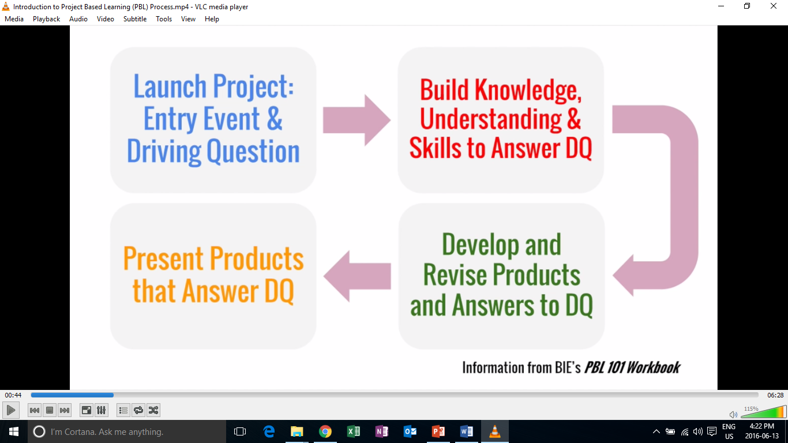
Creating a project
1) Entry event ( Reading, Video, Story, Discussion, Pictures, etc.)
2) Driving question
3) Discussing ways to address driving questions
4) Choosing project
5) Working on projects n groups
6) Feedback and revision
7) Present/ share

Slide 69
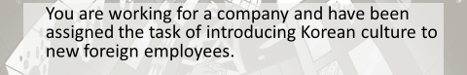
Connecting
Creating a project around a topic or entry event that is relevant, relatable and interesting for students.
  Entry events can include: Readings, Videos, Audio, Discussion, Dialogue etc.
In order to generate interest and make a connection to learners, the teacher can create a story, situation, or event. (TIP: it doesn’t have to be real! But it needs to fish their attention ^^)

Slide 70
Example
Students watch a video, read, or see pictures about littering and trash.
Teacher discusses with students trash issues in Korea
Teacher poses the following question “ what can our class do to raise other students awareness of this trash issue?”
Discuss different projects with students. (i.e. They make a brochure, video, etc.)
They create it
Get feedback
They present/share it
Revise
Present again

Slide 71
Driving questions
A driving question is a question that sparks students’ curiosity and motivates them to engage in activities to find the answer.
It should make students say something like “hmm.. I don’t know the answer to that. Let’s find out!”
Driving questions outline the issue/problem that will be focused on.

Slide 72
Driving questions
To be effective, a driving question should be:
(1) engaging for students
  Relevant, relatable, interesting
  Easy for students to understand
(2) open-ended
  It has several possible “right answers.”
  The answer will be original; it is not “Google-able” by students.
  The answer is complex and requires in-depth research and investigation.
(3) aligned with learning goals.
  Students will need to research and learn to answer the question and develop and use certain skills in the process.

Slide 73
Good and Bad Driving Questions
What are some problems with English education in Korea?
How can English education be made better in Korea?
What is global warming?
In what ways are humans contributing to global warming?
What are some good points about technology in school?
In what ways can smartphones help students learn English?
How do the habits of healthy people differ from the habits of unhealthy people?
What habits do healthy people have?
Checklist:
Engaging for students
Open-ended
Aligned with learning goals

Slide 74
Driving Questions
Question | Targeted problem
In what ways… | Is the problem happening? Is the problem getting worse? the problem be made better? do A & B differ?
How…
Why…
What is contributing to… | the problem?
What is being done to resolve/ address…

Slide 75
Project Design Questions
Question | Who | Action | For what purpose? | Targeted problem
What | I students citizens teachers our class our school | do make create design produce build | to fix to contribute to to raise awareness of to help to help improve | targeted problem?
How can

Slide 76
Project task ideas (try to think of more)
Design
  A new product
  A new way of doing something
  A better something (menu, phone, etc.)
Make/ Create
  A plan
  A poster
  A storybook
  A brochure
  An advertisement
  A video
  A play/ drama
Build
  A model
  A structure
Write
  A letter
  A poem
  A short story
  A book
  A speech
  Rewrite something
Prepare
  To present your ideas
  To debate
  To teach a lesson

Slide 77
General Topics from Textbooks
What are some general topics of themes that you cover in your classes or that are in the textbooks you use?
The environment

Slide 78
Connection and Driving Questions
For the following topics what connections to the real world can you make that would be relevant, relatable and interesting for your learners? (TIP: remember you can make a story or situation)
The Environment
Food
Travel
Health & Beauty
What driving questions would you use to?
What project design question/ questions would you use?
TIP:
Think about issues in your school, community, current events, student’s lives and interests.
Checklist:
Engaging for students
Open-ended
Aligned with learning goals

Slide 79
Project task ideas (try to think of more)
Design
  A new product
  A new way of doing something
  A better something (menu, phone, etc.)
Make/ Create
  A plan
  A poster
  A storybook
  A brochure
  An advertisement
  A video
  A play/ drama
Build
  A model
  A structure
Write
  A letter
  A poem
  A short story
  A book
  A speech
  Rewrite something
Prepare
  To present your ideas
  To debate
  To teach a lesson

Slide 80
How will it be presented?
As a presentation in front of the class
A performance
As a video
Group to group
Roundtable
Panel
Jigsaw
Rotation fair (my favorite)
TIP:(graphic organizer for audience)

