Slide 1
China Scholarship Council 3-Month English Teacher Overseas Study Program
Dr. George E. K. Whitehead

Slide 2
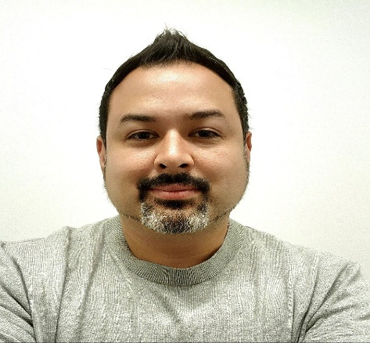
Introduction
George Elliott Koichi Whitehead, PhD
Department of Language & Literacy Education

Slide 3
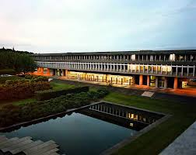
Associates of Arts
BA Linguistics
Certificate for Teaching ESL Linguistics
MA TEFL/ TESL
PhD Education

Slide 4
Career Timeline
King George International College/ Canada TESOL Center
ESL instructor
TESOL Instructor
International adult English language learners
Korean elementary, middle, high school English language learners
International pre- & in-service teachers
2006-2009
2009-2010
Kyonggi University
Director of TESOL Department
TESOL Instructor
Curriculum Developer
Pre- & in-service teachers
2010-2015
Gyeonggi-do Institute for Foreign Language Education
Head Instructor
Curriculum Developer
In-service public school English teachers
Public elementary, middle, & high-school English language learners
Assistant Professor
English Language & Literature Department
Undergraduate English Lang. & Lit. majors
M.A. English Education majors
2015-2018
University of Suwon
Assistant Professor
Department of ELT
Department of ELT Materials Development
M.A. ELT majors
M.A. ELT MD majors
In-service teachers
International Graduate School of English
2018-2019
Associate Professor
Graduate School of TESOL
Department of ELT & ELT Materials & Technology
ELT Department Chair
M.A. ELT majors
M.A. ELT Materials & Tech. majors
M.A. KFL English language learners
2019-Present
Hankuk University of Foreign Studies
Notes:
ESL 2006-2007
Maple College Head Instructor/ Curriculum Developer 07/2007 – 10/2008
Canada TESOL Center Vancouver, Canada 10/2008 – 05/2009
Instructor Instructed and managed the following courses for pre- and in-service teachers of English:
TESOL for Adults, TESOL for Children, TESOL for Junior, Preparation for TESOL, and
School Management.
Kyonggi University – TESOL for Adults, TESOL for Children in Partnership with Canada TESOL Center
IGSE and HUFS – Mention Advising Thesis and Portfolio students

Slide 5
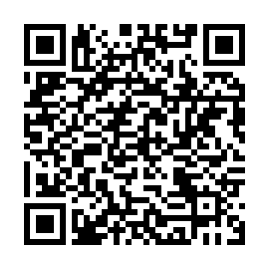
Research Overview
Predominantly qualitative researcher
Areas of expertise:
Language Teacher Education
Language Teacher Educators
the Local Contextualization of Language Teaching and Learning Practices
Recent publications in System, Language Teaching Research, MLJ, and TESOL Quarterly.

Slide 6
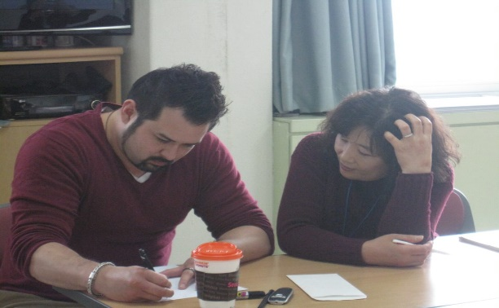
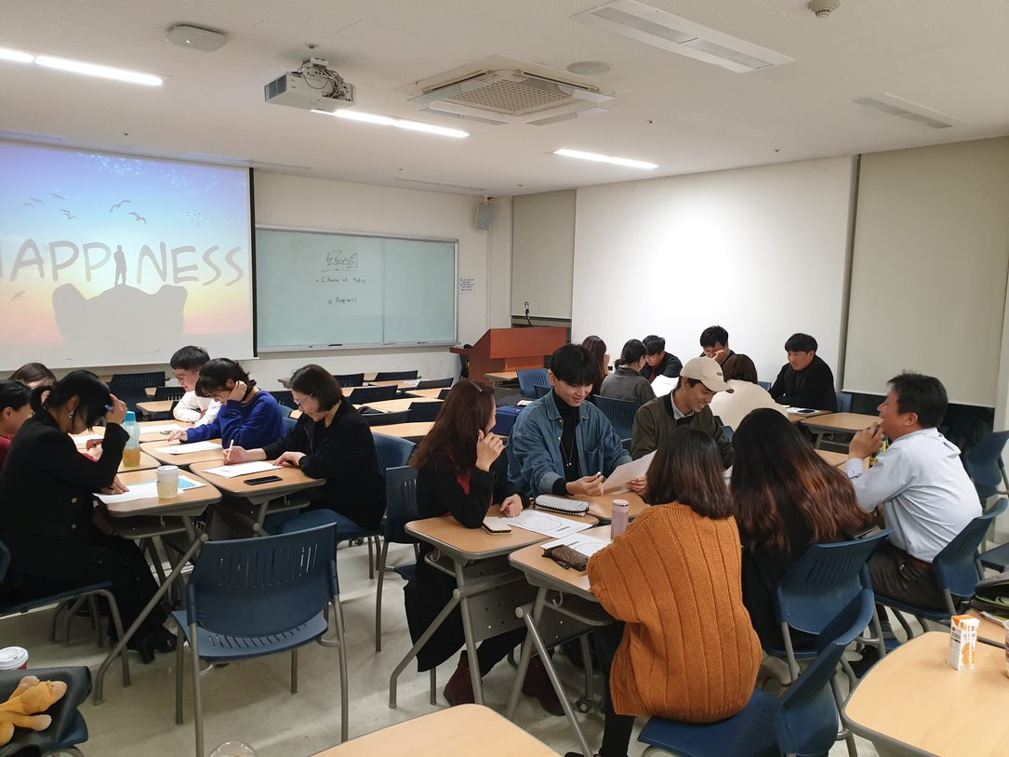
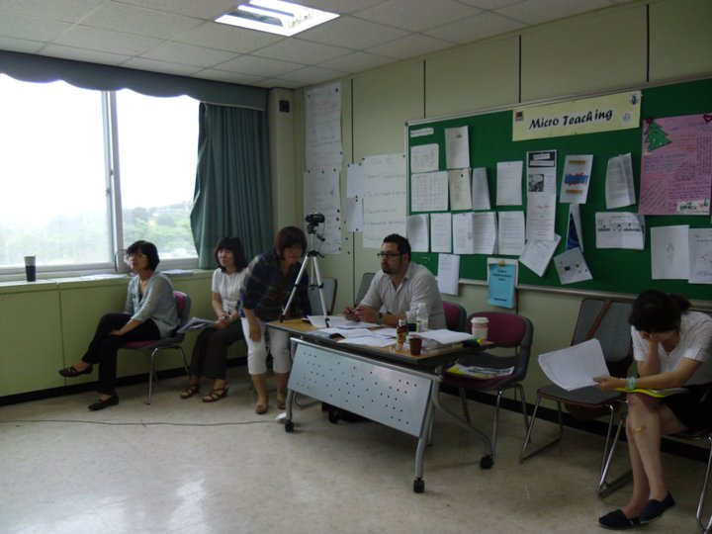
In the Classroom
Eclectic & dynamic application-based lessons
Situationally adaptive
Inclusive and supportive environment
Teacher-student/ student-student rapport
Praxis-oriented
Iterative
Reflective
Notes:
Inclusive and supportive environment - create a supportive and respectful learning environment where students feel valued, and supported in the learning process. I also seek to foster a sense of community among students by encouraging collaboration, communication and peer feedback. By putting students at the centre of my teaching, I aim to help them develop critical thinking, problem-solving and lifelong learning skills.

Slide 7
Questions?

Slide 8
About this program

Slide 9
Problems in pre- and in-service teacher education programs
Considering teacher education courses like this one what are some of the biggest problems that have been reported in the literature?
If you are not familiar with the literature, think about your own experiences

Slide 10
Common problems
Focus on knowledge ( what teachers should know, not what teachers need to be able to do)
Gap between theory and practice (theory is not presented in a practical way)
Content being mismatched with context (drawn from western contexts)
Teacher educators
Little to no experience in teacher learners’ context
Often not up to date on what is going on currently
Content often drawn from what is being used or what is popular in western contexts (UK, US, CELTA, DELTA, TESOL certificates etc.)

Slide 11
Program Overview
In this course you will embark on a journey through core principles and concepts as well as current issues in English language education.
You will be guided through a serious of reflective discussions and application tasks that will you develop your understanding and ability to use what you learn in your teaching context.
A major part of this program is reflecting on your current paradigms of English education to foster higher metacognitive awareness of your own learning and teaching.
You will slowly build up your new knowledge and skills during the program before planning and teaching your own lesson that can be applied in your teaching context toward the end of the program.

Slide 12
The course
This course is designed to help you:
develop a deeper understanding of core principles and concepts in English education and language teaching practices
develop a critical eye for how language is learned, taught, and acquired
develop higher metacognitive awareness as teachers and learners of English
reflect on appropriate approaches and aims for English education in your teaching context

Slide 13
Overview
Designed as 2 parts
Part 1 – Foundations of good English teaching
Part 2 – Content and Language Integrated Learning
*Supplemented with school visits and possible guest presentations

Slide 14
Part 1 – Foundations

Slide 15
Part 2 – CLIL

Slide 16
Reflective Assignments
Post-lesson reflections will be assigned weekly or bi-weekly and will consist of a short, written reflection of the content covered in class.

Slide 17
Application Tasks
During the course you will take part in various application tasks that will contribute to your deeper understanding and ability to implement what you are learning.
There will be live practice during class as well as written application tasks.

Slide 18
Final Application Task
Assignment #1: Lesson plans for a one-semester course
Participants will be expected to re-design one of the courses that they teach, including developing new unit/lesson plans, homework assignments, teaching materials and instructional resources.
Assignment #2: Video recording of a 40-minute “master class”
Participants will prepare and deliver one of the re-designed lessons demonstrating mastery of relevant skills. This lesson will be videotaped and peer-reviewed.

Slide 19
Contact
Website: profgwhitehead.weebly.com
Email: g.whitehead@ubc.ca

