Slide 1
Language and Culture
Examining the relationship between language and culture

Slide 2
THINKING TASK
1) What is culture?
2) How would you define culture?

Slide 3
CULTURE from the Latin word ‘colere’: to build ,to care for’, to plant or to cultivate.
Culture is a fuzzy set of attitudes, beliefs, behavioural norms, and basic assumptions and values that are shared by a group of people, and that influence each member's behaviour and his/her interpretations of the "meaning" of other people's behaviour.
(Helen Spencer-Oatey, 2000)
Culture is the fabric of meaning in terms of which human beings interpret their experience and guide their action.
(Clifford Geertz)

Slide 4
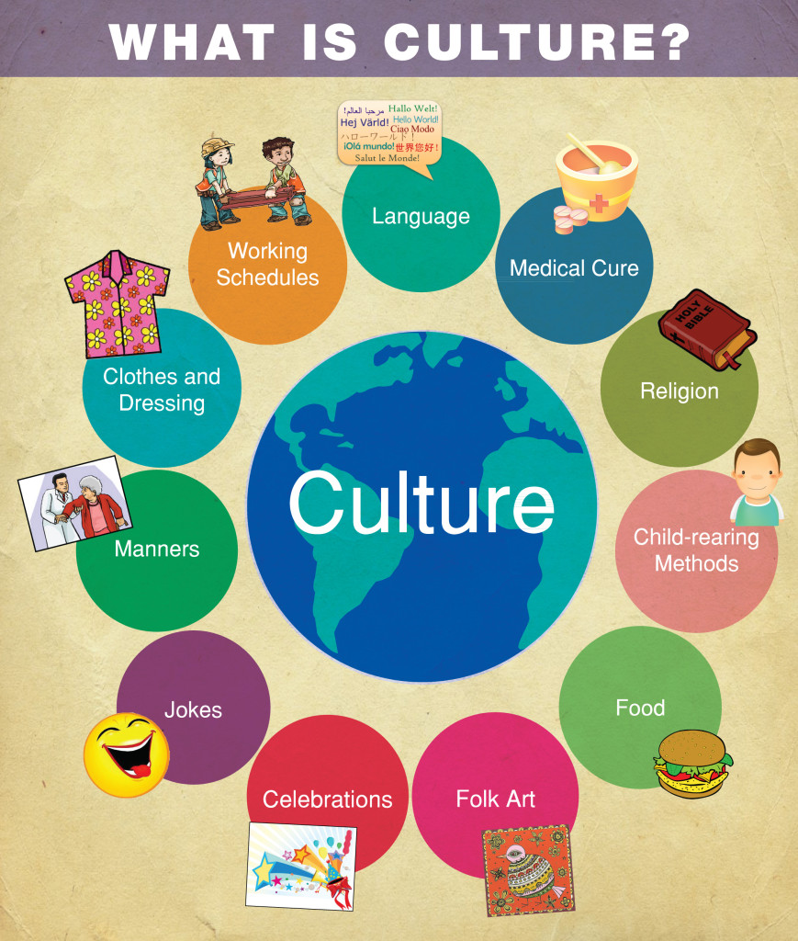

Slide 5
TYPES OF CULTURE
● CORPORATE CULTURE (the culture of a company or workplace)
● PROFESSIONAL CULTURE (the culture of a profession i.e. teachers, entertainers)
● GENDER CULTURE (the different cultures of men and women)
● AGE CULTURE (the culture of young, middle-aged, and old people)
● RELIGIOUS CULTURE (i.e. Christianity, Catholicsm, Islam, Buddhism)
● REGIONAL CULTURE (Seoul, Busan)
● CLASS CULTURE (working class, middle class, and upper class)

Slide 6
‘The Culture Onion’
C O U N T R Y
C O M P A N Y
T E A M
I N D I V I D U A L

Slide 7
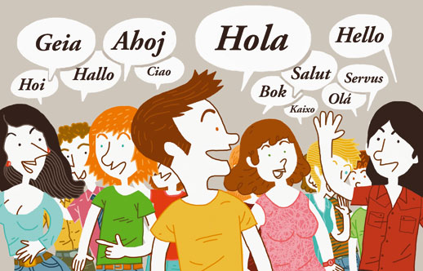
INTRACULTURAL vs INTERCULTURAL
Intracultural
1) The term intracultural is used to norms and beliefs from within one cultural group.
i.e. Cultural values and beliefs held among Korean citizens is intracultural.
Intercultural
1)The term intercultural is generally used to describe dimensions of culture that are not culture specific.
i.e. cultural dimensions applicable for all cultures.
2)Intercultural is also used to describe the culture that exists between those from different backgrounds.
i.e. English speakers

Slide 8
Thinking Task
What are some common intracultural beliefs in Korea? (zooming in)
What are some intercultural beliefs that are commonly shared around the world? (zooming out)

Slide 9
Language and Culture
1. Do you believe that language and culture are connected? Why or why not?
2. How is language and culture connected?

Slide 10
LANGUAGE & CULTURE
Think about your mother tongue:
1) How are Korean culture and language connected?
How does culture affect language?
How does language affect culture?

Slide 11
LANGUAGE & CULTURE
Now think about English:
1) What culture is English connected to?
How does culture affect English language?
How does the English language affect culture?

Slide 12
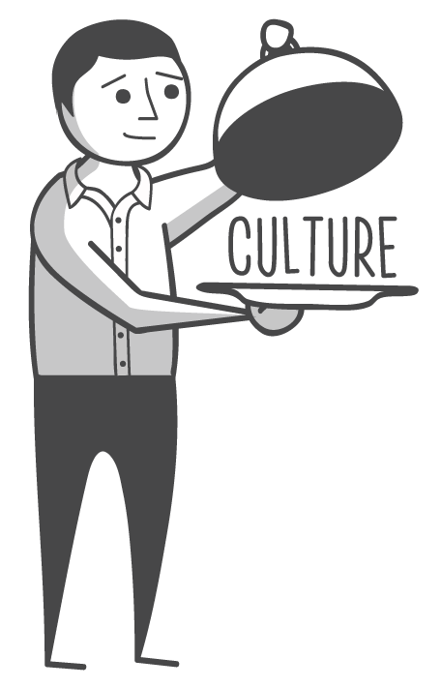
Language lessons
1. How is culture represented in English textbooks in Korea?
In stories? Dialogue? Culture points? Etc.
What aspects of culture? i.e. food, customs, clothing
Which countries culture?
2. How do you teach culture in your lessons? Or how do students learn about culture?

Slide 13
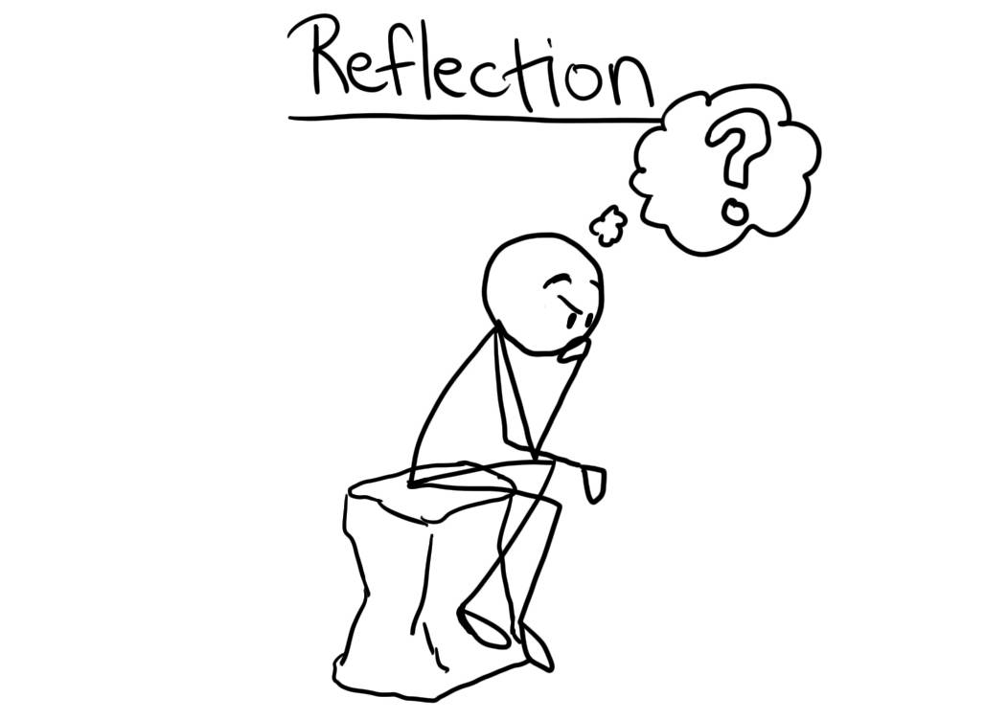
Wrap-up
What were some of the key points for you in this lesson?
What questions do you have?
What do you still want to know?

Slide 14
REFERENCES
Spencer-Oatey, H. (2000). Culturally Speaking : Managing Rapport through Talk across Cultures. London, Continuum.

