Slide 1

Welcome to Practices of Effective Language Teaching

Slide 2
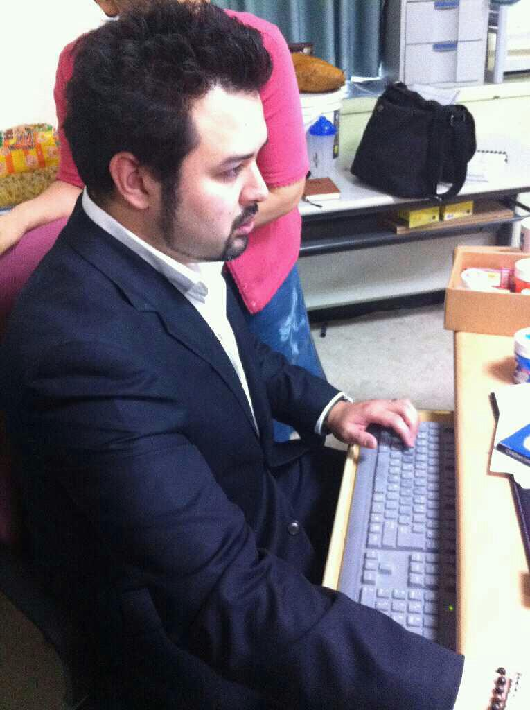
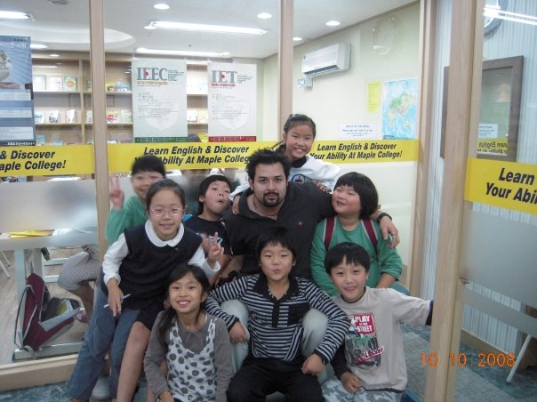
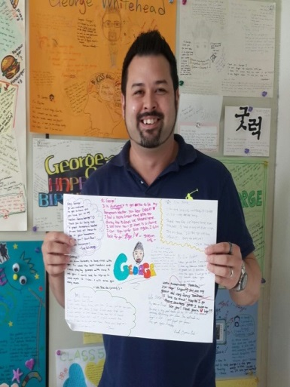
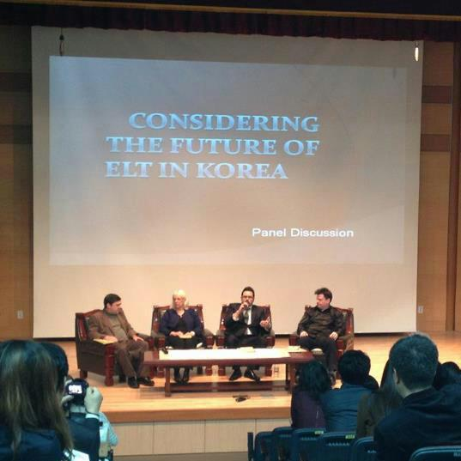
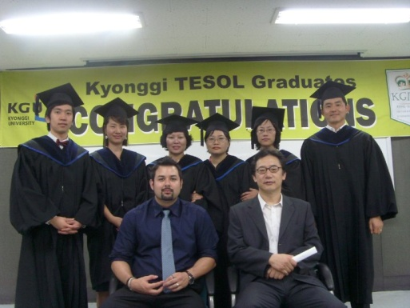
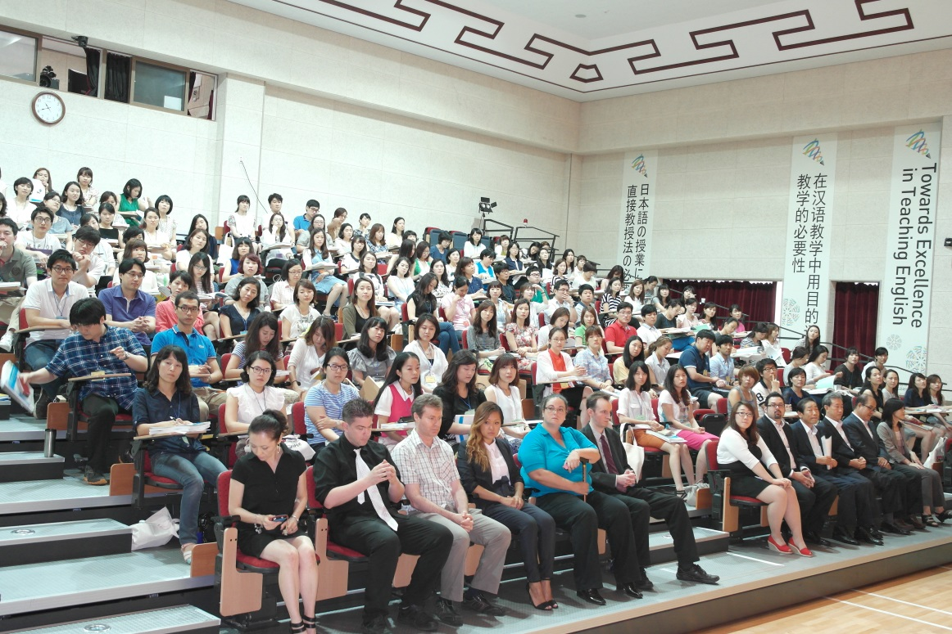
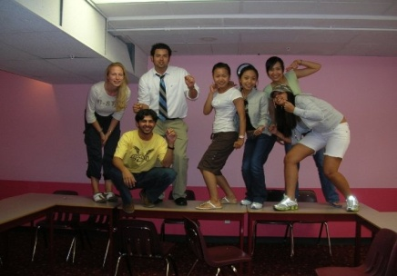
About me
George Elliott Koichi Whitehead
경일
Microteaching
Effective Teaching Techniques Instructor
Practices of Effective Language Teaching

Slide 3






Associates of Arts
BA Linguistics
Certificate for Teaching ESL Linguistics
MA TEFL/ TESOL

Slide 4
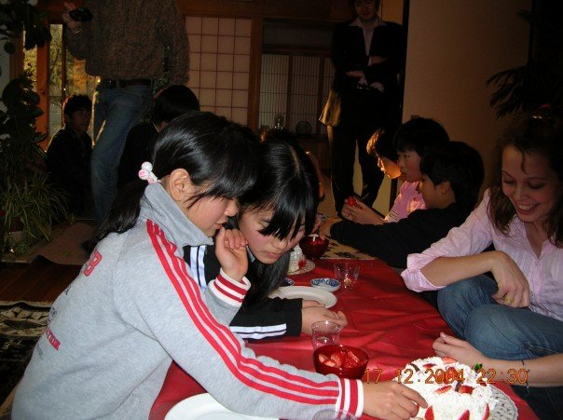
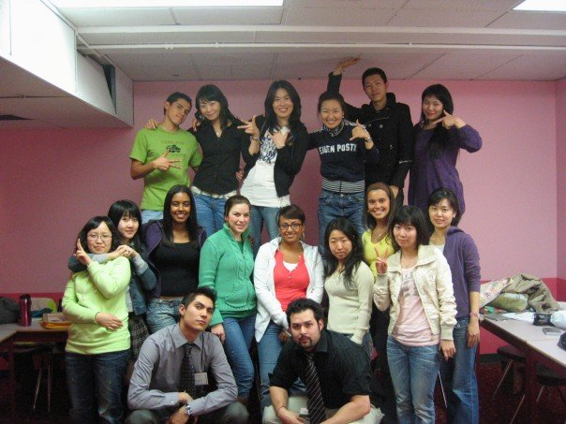


My 14 Year Career
The beginning…

Slide 5
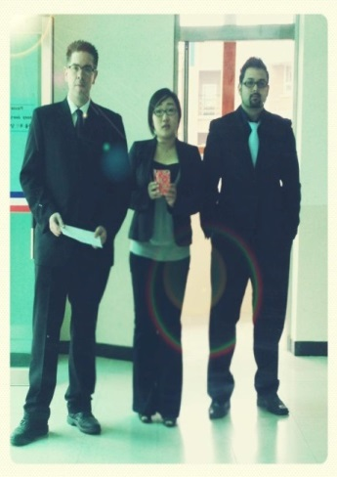
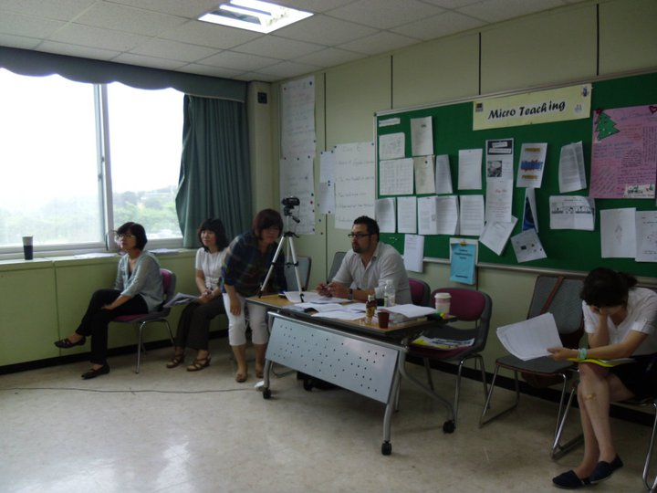
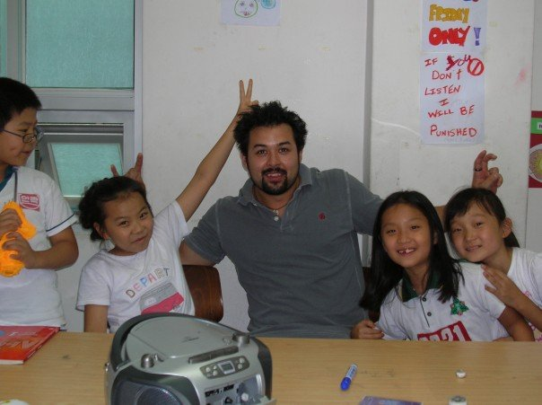


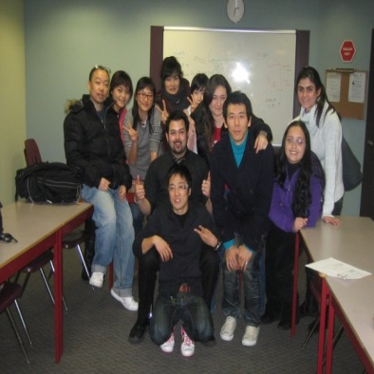
My 14 Year Career continued..

Slide 6

About the Course

Slide 7
Course Objectives
To challenge your current paradigms of language teaching
To raise awareness of key points in effective language teaching.
To foster effective classroom language.
To initiate self-reflection on one’s own teaching principles.

Slide 8
Syllabus Outline
Lesson | Practices of Effective Language Teaching
1 | Examining Current Views of English Language Teaching
2 | English as an International Language
3 | Intercultural Communication: The New Culture of English
4 | Key Points in Effective Language Teaching
5 | English Teacher Talk
6 | Instruction Checking
7 | Using L1 in the Classroom
8 | Motivating Students to Learn English
9 | Positive Classroom Management
10 | Video Observation
11 | Investigating the Current State of English Education in Korea
12 | Application Tasks

Slide 9
Evaluation
Application Tasks (90) You will be given a choice between a series of written application tasks through which you must demonstrate your knowledge and understanding of course contents. 15 points per task A total of 7 tasks; Choose 6 tasks. Be sure to read the instructions carefully! 1. EIL (2) 2. ICC (1) 3. English Teacher Talk (1) 4. Instruction Checking (1) 5. Use of L1 in the Classroom (1) 6. Motivating Students to Learn (1) 7. Positive Management (1) Due: Lesson 12 | Participation (30) You are expected to come to class with a positive attitude and an open mind. You are expected to participate in all classroom activities and discussions.

Slide 10
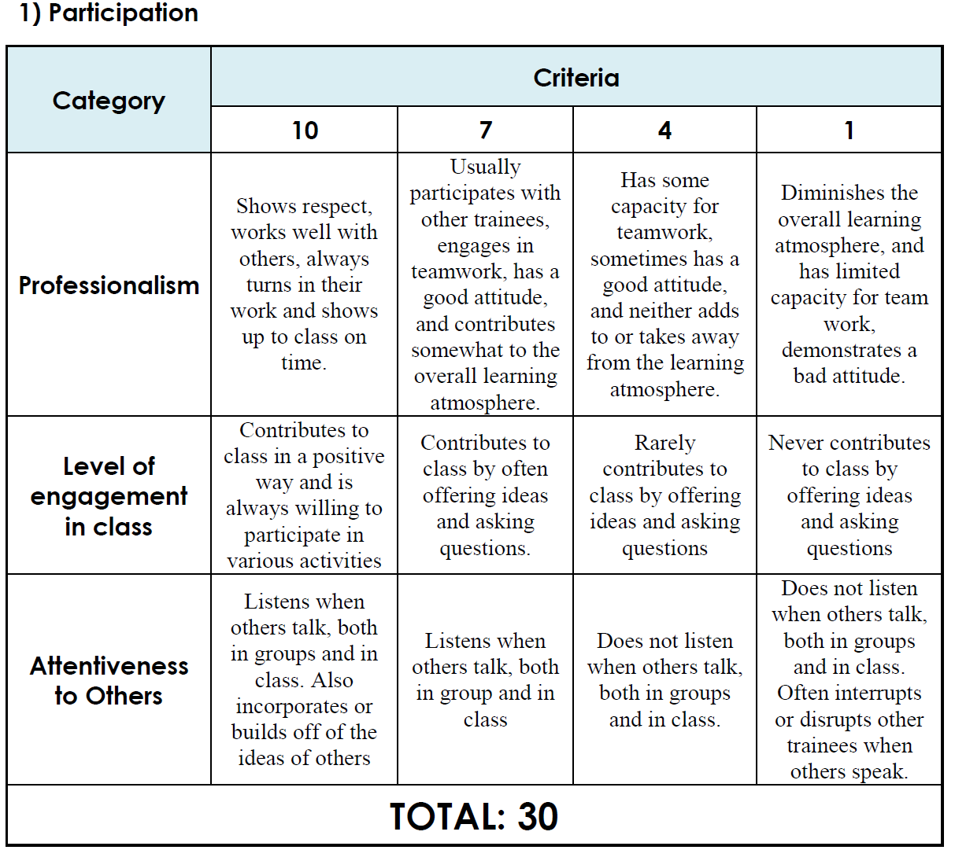

Slide 11
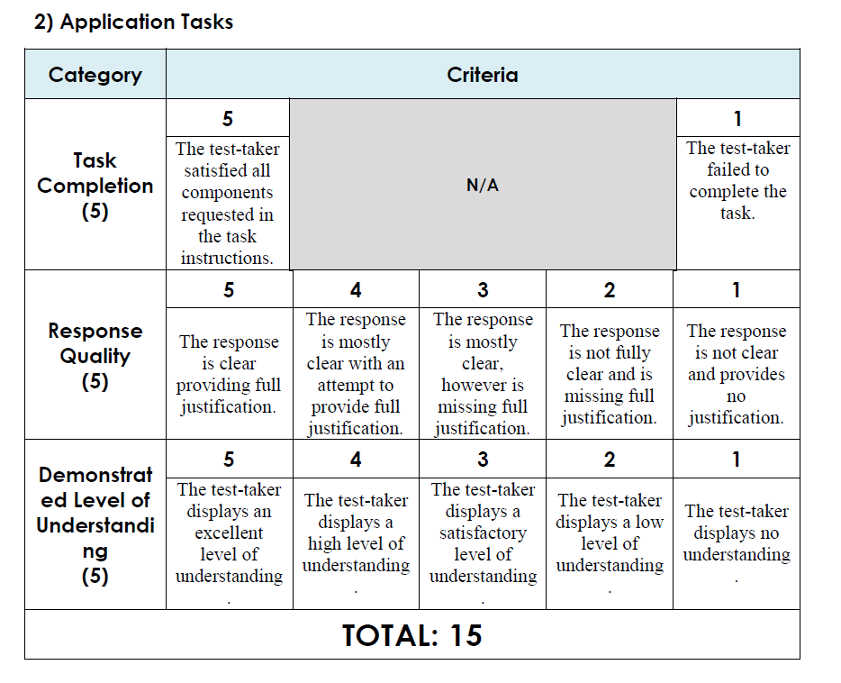

Slide 12
Submitting Application Tasks
Email your completed application tasks to gifle.pelt@gmail.com BEFORE the start of lesson 12.
Your file name and email subject line MUST include:
  Your name
  Student number
  Class number

Slide 13
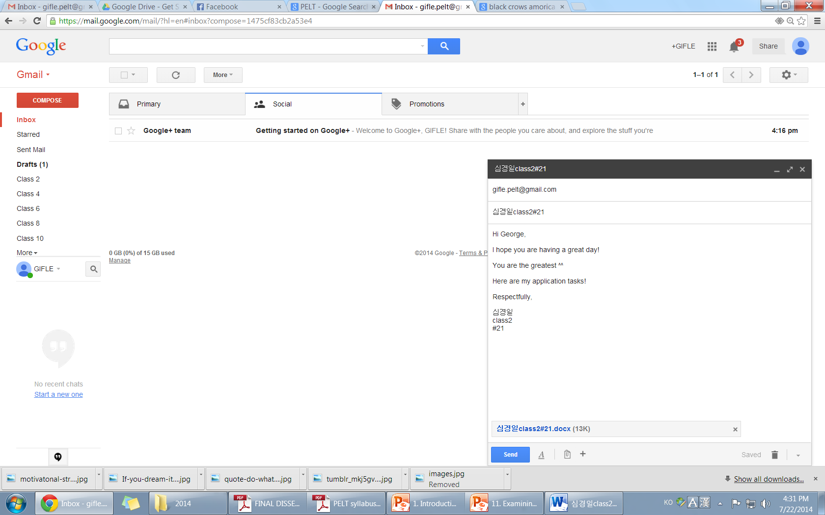
Sample Submission
To
Subject
A nice message
Attached file

Slide 14

Identify Yourself!

Slide 15

Examining Current Views
Your current views and attitude determines what happens in your classroom.
This reflection is a starting point to help you consider ways in which you may become a more effective teacher.

Slide 16


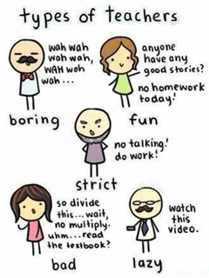

Slide 17
QUIZ TIME

Slide 18
[Part A] Your current outlook

Slide 19
[Part B] Your current attitude

Slide 20
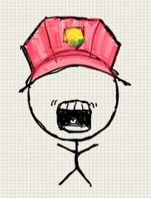
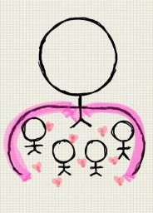
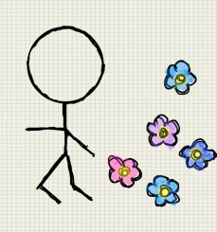
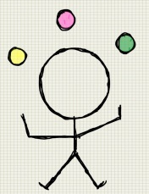

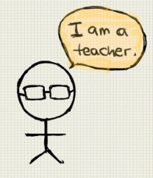

Results
Part A:
  Blue = Future
  Pink = Now
  Green = Past
Part B:
  Purple = Motivated
  Yellow = Complacent
  Orange = Defeated
Part C
  Drill Sergeant
  Mentor
  Free Bird
  Performer
  Lost
  Realistic
  Professor

Slide 21

Time Orientation
Studies have shown that Now/Future orientated individuals are more successful. (Zimbardo and Boyd, 2008; de Posada, 2009)
Past oriented teachers have difficulty dealing with change.
Now oriented also have trouble dealing with change.
Future oriented have trouble dealing with now.
If you are past oriented, think about what you need to do to be more now/future oriented.

Slide 22



Attitude and Motivation
Motivated
Complacent
Defeated
Low level of motivation and satisfaction leads to poor quality work produced (Dörnyei, Evans, 1998, quoted in Foskett & Lumby, 2003)
If you have low motivation to teach, try to find out how you can become more motivated.
Ask yourself:
  Why do you teach?
  What do you like about your job?
  What gives you job satisfaction?

Slide 23
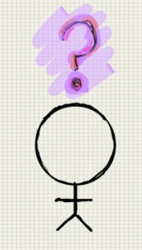


Characteristics
Drill Sergeant | Mentor | Free Bird | Performer | Lost | Realistic | Professor
Set goals to fulfil Demanding Push students to learn and do better | Encourage and inspire students Listen to students Show empathy | Easy going and relaxed Feels no pressure Low passion for students | Having fun in class Lively class Entertain more than teach | Always trying new ideas/activities Low cohesion Distracted easily | Aware and accept the current state Realistic goals Keep to only the necessity | Being receptive, well informed Professional divide Lack proactive skills
Reflect
Why?
What?
How?

